Slide 1
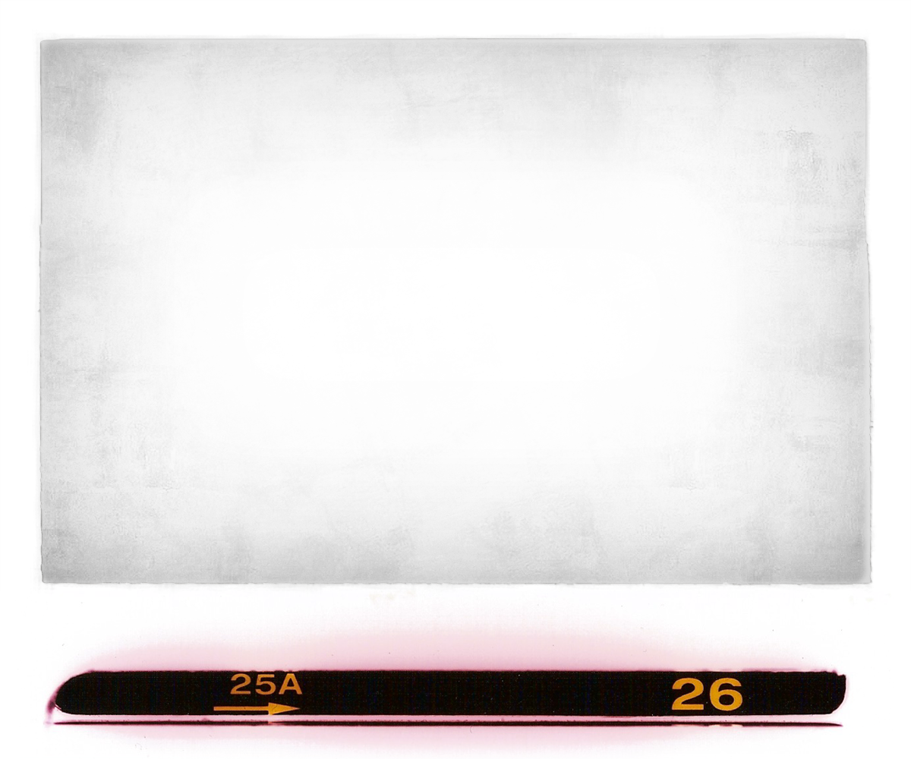
Building Holistic Community Experiences
(without a town center)
FALL 2020 VIRTUAL ROUNDTABLE
October 2, 2020
By Herb Freeman, President
Full Circle Ventures, Inc.
Notes:
Copyright (c) 2006 Herbert L. Freeman All Rights Reserved

Slide 2
The Proposition: A Town Center Is Not Necessary
Contrary to popular wisdom and the tenets of the New Urbanism, I believe most new greenfield traditional neighborhood developments ("TNDs") do not need a town center to be successful when competing against boring, conventional and ubiquitous suburban sprawl development.
Trying to get and keep small retail, restaurants, pubs and neighborhood services in a for-profit TND town center is just too difficult, expensive and risky. Office buildings and service businesses (think the one-off dentist, insurance agent, massage therapist, financial advisor, cpa, etc.) are just about as boring as conventional sprawl development.
Rather than any of that, let us offer our residents, who hunger for community, a wide variety of interesting, compelling, beautiful and nearby "walking points" which will impel them to get up, get out and walk about the neighborhood and the develop social connections with their neighbors that they crave.
Let’s discuss!

Slide 3
Village Centers Offer Quick and Local Shopping
Typically, between 10,000 and 30,000 square feet in size, the village center offers an array of goods and services geared to the daily needs of its surrounding neighborhoods. Often including a small specialty food market or pharmacy, a village center contains a limited number of tenants that offer a balance of food, personal, and professional services. Typical village center tenants include bagel stores, bakeries, banks, cof­fee shops, delis, dry cleaners, tailors, ﬁnancial services, ﬂorists, food markets, ice cream parlors, laundry centers, packing and shipping centers, package liquors, personal services, pharmacies, and real estate offices. Additionally, antique, bicycle, fashion and home stores often deploy in the centers.
The village center’s primary economic advantage is its close location to residences, allowing the time-pressed shopper to make a quick purchase on the way to or from home . . . so nearby surface parking is essential. Like corner stores, convenience center businesses do not always provide competitive prices, but focus on providing shoppers with quality goods and services that can be quickly purchased.
Source: “Village Centers Offer Quick and Local Shopping” by Robert Gibbs in Public Square, a CNU Journal, April 6, 2020.

Slide 4
Village Centers Offer Quick and Local Shopping
The International Council of Shopping Centers (ICSC) deﬁnes a convenience (village) center as follows:
A Convenience Center provides for the sale of personal services and convenience goods similar to those of a neighborhood center. It contains a minimum of three stores, with a total gross leasable area of 30,000 square feet or less. Instead of being anchored by a supermarket, a convenience center usually is anchored by some type of personal/convenience services such as a minimarket.
To be economically viable, a village center needs about 2,000 house­holds—the equivalent of two traditional neighborhood development (TND) neighborhoods. These centers should be located at the common entrance or intersection between two neighborhoods, preferably on the homebound side of the roadway. Locating a convenience center inside a neighborhood poses an economic challenge because of the smaller population and lower traffic levels unless the site is in a dense urban area.
Gibbs concludes, “Village centers are desirable neighborhood amenities and recommended for both new developments and as a resource for restoring historic neighborhoods.
Source: “Village Centers.” Offer Quick and Local Shopping” by Robert Gibbs in Public Square, a CNU Journal, April 6, 2020.

Slide 5
An Amenity, a Legacy or a Profit Center?
Gibbs: I always ask my developers why they're building the New Urban retail center. I give them three choices. They're building it as a pure profit center, in which case, it tends to be more conventional. Or they’re building it as a legacy and they're not really concerned whether it breaks even or makes a profit, they just want to build a beautiful place. Or they’re building it as an amenity—to sell houses quickly. If they're building it as a legacy or an amenity, it can be a lot more flexible because it doesn’t require market rate rents for the retail. A lot of developers are building really beautiful twenty to forty thousand square-foot centers as an amenity. They're two- and three-story buildings right on the street with parking in the rear and they're really quite beautiful. The developer subsidizes the rents, because they're using them as an amenity to sell houses or build a legacy. Developers that want to build a profit center to get a market rate of return generally have to be more conventional except in the case of the larger town center format. Then there's a lot of flexibility. You can actually build the small blocks and put the parking in the back or underground or in structures.
Source: “Great idea: Mixed-use urban centers”” by Robert Steuteville in Public Square, a CNU Journal, April 27, 2017.

Slide 6
A Mixed-Use Town Center Is Not Needed to Compete with
Conventional Suburban Sprawl
The Reasons:
The “over retailing of America” i.e. the over supply of retail space
E-Commerce and Less Demand for in person purchasing
Add to all of this unexpected risks like Covid-19
Too expensive and therefore too risky
Requires expertise not all TND developers have or can afford
Brain death caused by:
Necessity to design, finance and build the town center
Finding the tenants
Investing the tenant improvement allowances
Preserving the tenant mix
Possibly (probably?) subsidizing tenants
Collecting rents
Forming and running the merchants’ association
Dealing with failing and failed tenants
Wash, Rinse, Repeat - Start all over finding and replacing failed tenants -

Slide 7
Two Major Problems for the TND Town Center
Over Retailing and E-Commerce
The Over Retailing of America: “The United States became the most “over-retailed” nation on the planet. By the early 2000s, the US had multiple times the retail of other nations with similar wealth. Growth in US retail has slowed since then, but even so, “Retail square feet per capita in the United States is more than six times that of Europe or Japan,” said Richard Haynes, CEO of Urban Outfitters, in 2017.”
“Meanwhile, e-commerce has steadily grown. It amounts to about 14 percent of total retail sales in the US in 2019 [up from 1% in 2000]. All of this has negatively affected conventional brands that overbuilt retail in the 20th Century.”
Source: “A brief history of retail and mixed-use” by Robert Steuteville in Public Square, a CNU Journal, August 26, 2019

Slide 8
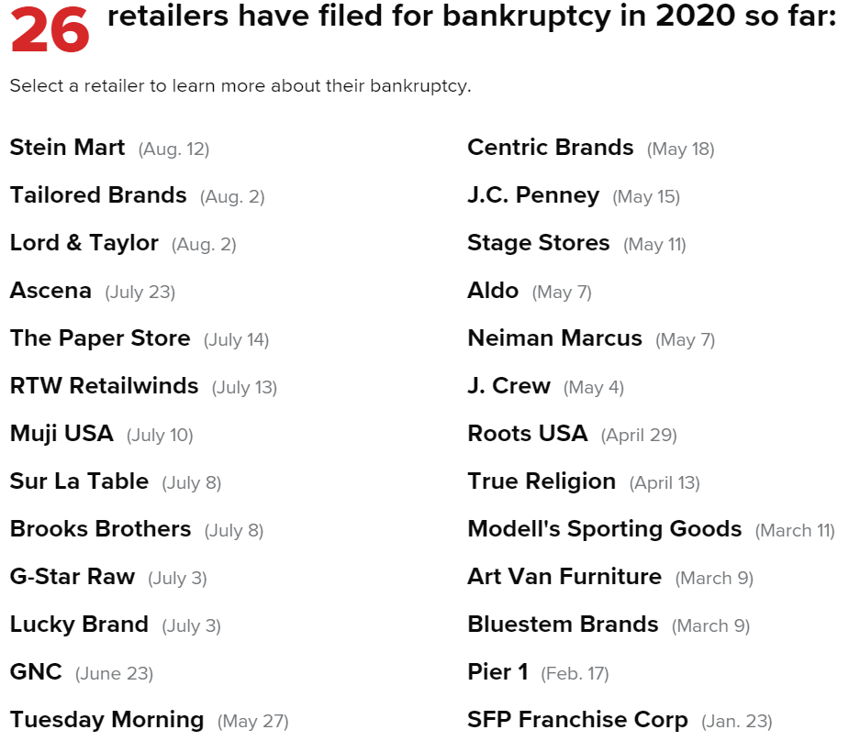

Slide 9
Permanent Store Closures Could Hit 25K in 2020, Coresight Says
Coresight Research estimates that 20,000 to 25,000 stores could permanently close in the U.S. this year, with 55% to 60% of those closures in malls, according to an emailed report.
That would more than double last year's closures, and it represents a significant increase over Coresight's previous closure estimate for 2020. So far Coresight has counted 4,005 planned closures for the year
The research firm also expects retail bankruptcies to rise, including Chapter 7 liquidations potentially.
Source: retaildive.com - https://www.retaildive.com/news/permanent-store-closures-could-hit-25k-in-2020-coresight-says/579443/ by Ben Unglesbee, June 9, 2020

Slide 10
What about Covid-19, 20, 21, 22?
Main Street America (a subsidiary of the National Trust for Historic Places) surveyed their network of 1,600 commercial districts nationwide, comprising 300,000 small businesses in between March 25th and April 6, 2020. More than 5,850 small business owners responded from 48 states, of which 91 percent of respondents reported owning businesses with fewer than 20 employees. “Thus, findings from this survey highlight the profound impact of the current crisis on the smallest, locally-owned businesses that are the backbone of American communities” says MSA.
Respondents include a wide range of businesses:
23 percent were non-food-related retail stores;
18 percent were restaurants, bars, or cafes.
About 12 percent were professional services (e.g. banking, legal, design, real estate).
Nearly 8 percent are personal care (barbershops, beauty and nail salons, etc.).
Categories include hotels and inns, health care practitioners, nonprofits, small grocery stores and other (26 percent).
About half of the businesses are owned by women, and six percent are minority owned.
The majority of these businesses—63 percent—do not sell online.
Seventy-eight percent have suspended their storefront operations.
https://higherlogicdownload.s3.amazonaws.com/NMSC/390e0055-2395-4d3b-af60-81b53974430d/UploadedImages/Resource_Center/COVID_19/NMSC57_MSA_COVID19IMAPCTSURVEY_F.pdf

Slide 11
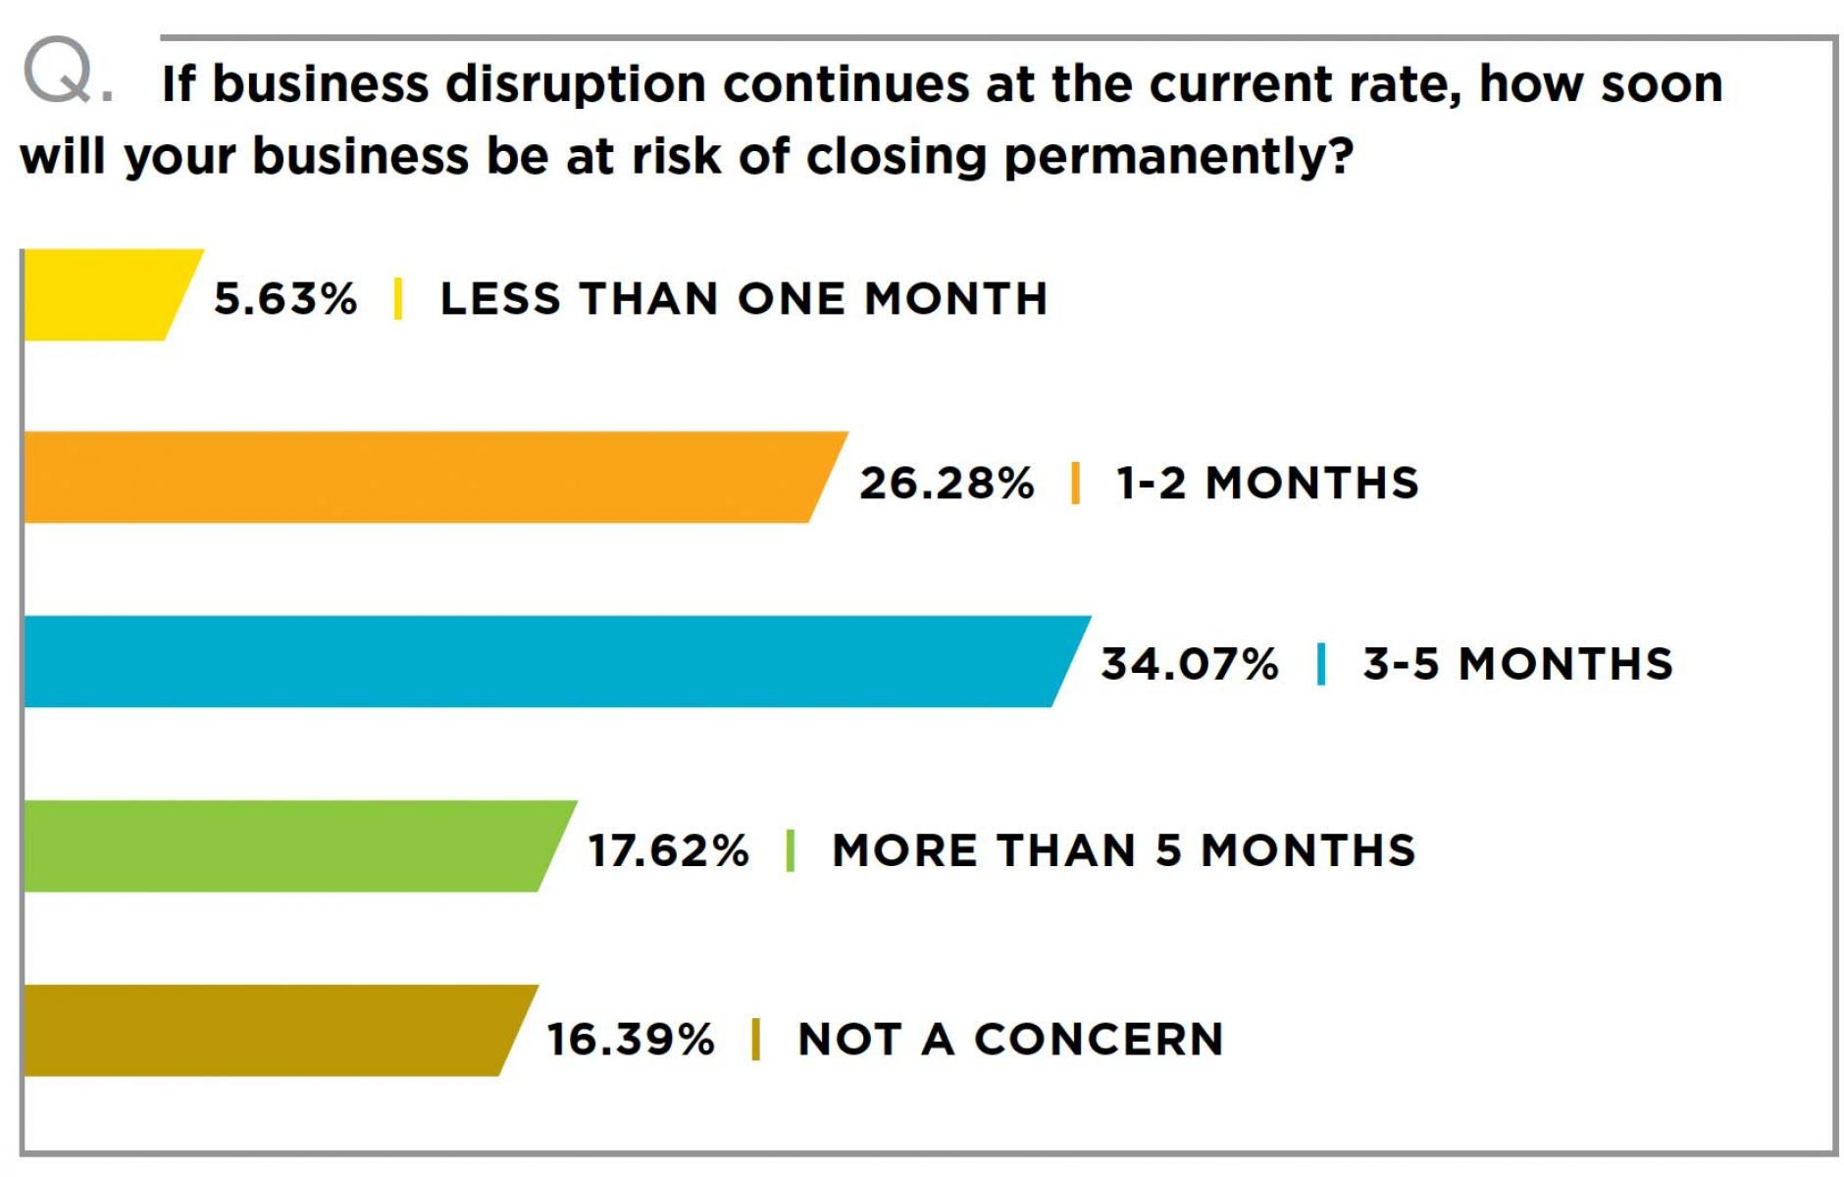
75% are at risk of closing in five months or less.
Source: “A brief history of retail and mixed-use” by Robert Steuteville in Public Square, a CNU Journal, August 26, 2019

Slide 12
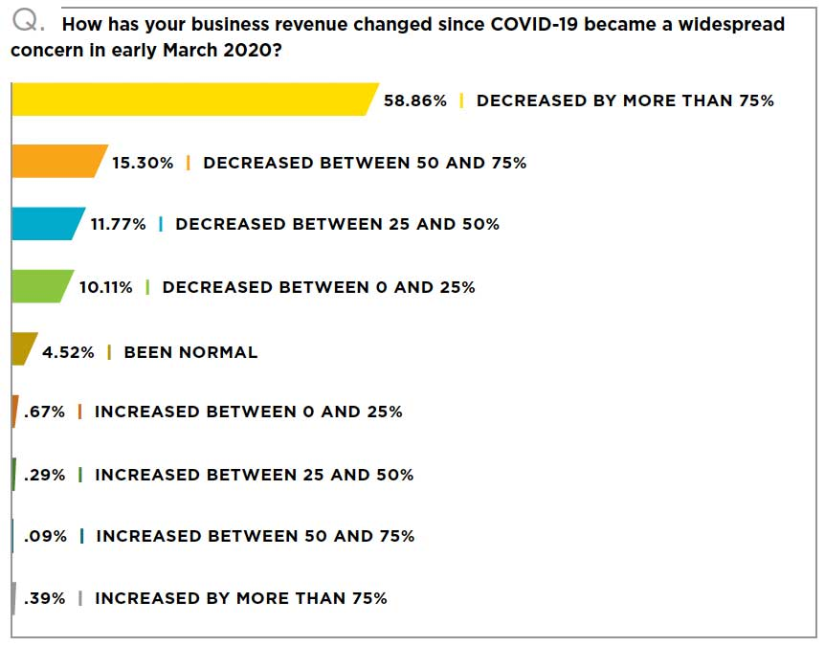
Source: “A brief history of retail and mixed-use” by Robert Steuteville in Public Square, a CNU Journal, August 26, 2019

Slide 13
Problems with Mixed-Use Centers in the Suburbs
No Anchor: Some mixed-use centers were designed without anchors, which is a mistake in all but the smallest scale projects: Anchors draw shoppers and support the smaller stores. “Every mixed-use project should have at least one anchor store,” notes Sharon Woods of LandUseUSA | Urban Strategies. “This may be a department store, grocery, hardware, pharmacy, or furniture store. In some markets, a cluster of destination-type restaurants can also serve as an anchor. These anchors are essential for attracting patrons that can then be converted into impulse and repeat shoppers.”
No Through Main Street: Town centers sometimes feel artificial or contrived because the main street isn’t a through street, Gibbs adds—they start and stop in the middle of nowhere. A real town is located on a main highway that connects part of the region together. If you build a town center on an arterial thoroughfare, you get more authenticity. Woods explains: “main street tenants have the best chance of succeeding when they are aligned along and facing the main traffic arterial. Tenants located along perpendicular or side streets tend to have less than half of the exposure to passing traffic, and therefore will be significantly disadvantaged.”
Source: “Designing and building mixed-use centers in the suburbs” by Robert Steuteville in Public Square, a CNU Journal, December 11, 2019

Slide 14
Problems with Mixed-Use Centers in the Suburbs - Continued
Poor Visibility and/or Parking: Village retailers can . . . be located on the ﬁrst ﬂoor of a mixed-use building as long as they can be easily seen from the primary roadway. The storefront signage and displays that shop owners use to draw the attention of passing motorists is their principal means of advertising, so careful building place­ment is crucial. These businesses also rely on customers who make quick visits for planned and impulse purchases, so nearby surface parking is essential.
Mixed use centers of all sizes rely on drive-by traffic, Wood notes. “The smaller the project, the more essential it is to have excellent visibility to impulse shoppers,” she says. “Larger centers are more likely to have anchors and a mix of destination-type stores to help compensate. Small town centers without anchors are the riskiest—and if they don’t have visibility to traffic then they shouldn’t even be considered.”
Source: “Designing and building mixed-use centers in the suburbs” by Robert Steuteville in Public Square, a CNU Journal, December 11, 2019

Slide 15
Civic Lots and Community Green Spaces
“Walking Points” or Community Amenities
Community Walking Points should be a mix:
Passive / Individual / Introspective
Active / Social / Extroverted
Varied for the generations
TND “Walking Points” could include be thematic. For example:
The Four Elements: Earth, Air, Fire, Water;
The Four Seasons,
Cycles of Nature,
Cycles of light and dark, day and night, the cycles of the moon,
The Universe,
The themes that reflect the Developer’s and/or community interests.

Slide 16
Walking Points . . . Passive / Individual / Introspective
Contemplative tree circle - a circle of two or more concentric circles of trees with benches or stone seats
Sacred site - A sort of "hollowed ground" with a classically designed very small building for contemplation, maybe even "mausoleumesque"
Green; orchard
Pergolas and arbors;
Wild flower meadow; native grass prairie; wet lands, pollinator plants
Bird houses/feeders ; butterfly habitat
Pond with fountain, benches, sitting stones; a quiet place for introspection
Follies; temples; pavilions – in the English style Garden building; conservatory, orangerie
Winter and Summer Sites - gathering areas that take into account exposure, wind and light/shadow and the seasons - for example the Winter Site area faces south so the sun warms the wall to one's back in winter and is sunken so the north wind blows over it. The Summer Site is sunken quite deeply so that one is in the shade and faces north away from the hot southern wind.
Seating areas, benches, niches

Slide 17
Walking Points . . . Passive / Individual / Introspective
Solar Circle with sundial. Sundials in a variety of styles, types and places (even on the walls of buildings).
Observatory - A building with a roll off or rotating roof for a telescope mount and a plaza with telescope mounts, perhaps with a perpetual calendar, lunar phase graphic, etc.
Celestial site - a circle with a star map stamped in the concrete, an obelisk in the center pointing at the zenith, benches oriented over arrows pointing to points on the horizon where the sun rises and sets on the solstices and equinoxes.
Clocks and Sun Dials - Pole mounted and/or wall mounted clocks and sun dials. Can be on the ground too.
Wind vanes on buildings and as art in public spaces
Flag poles - for US and State flags but more for festival, thematic, seasonal flags
Rain gauge - some sort of gigantic Rube Goldberg contraption, complicated, large-scale public rain gauge
Labyrinth and/or Maze - in a contemplative area, according to the classical patterns

Slide 18
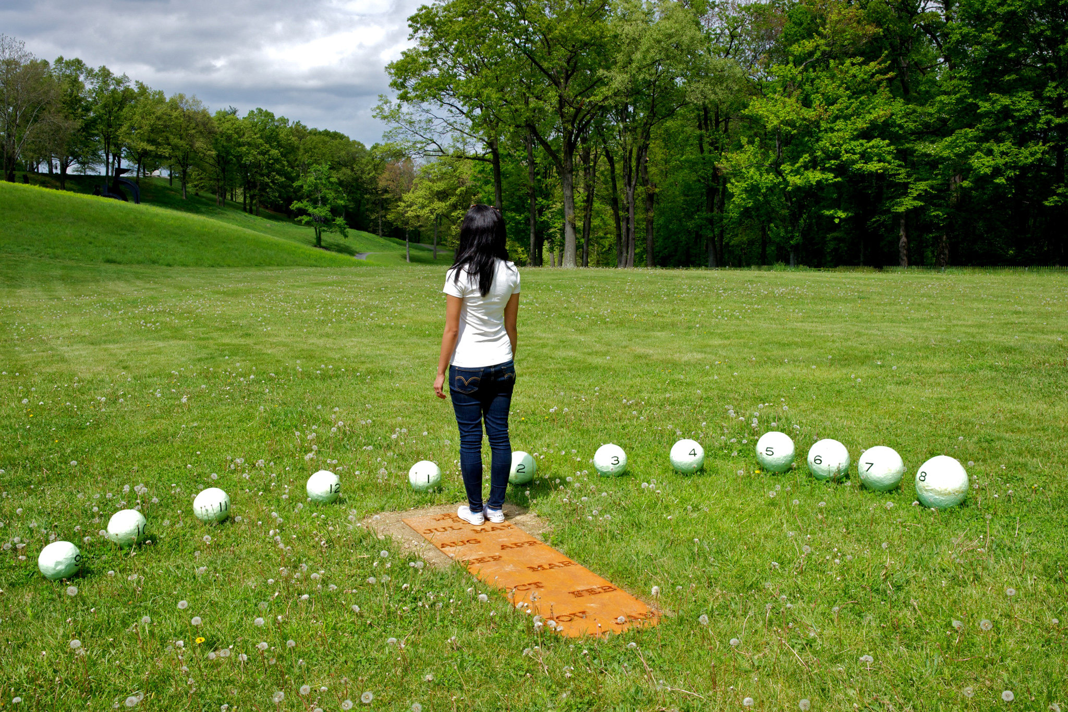
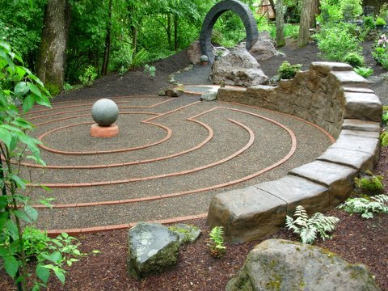
Civic Lot -Inspirations
Labyrinth

Slide 19
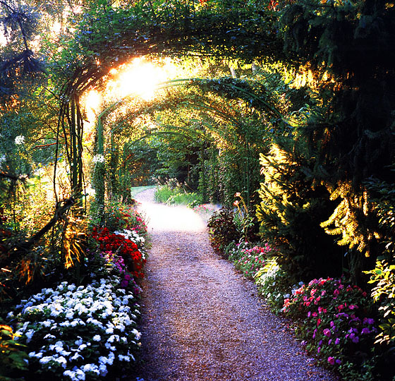
Civic Lot -Inspirations
Arbor

Slide 20
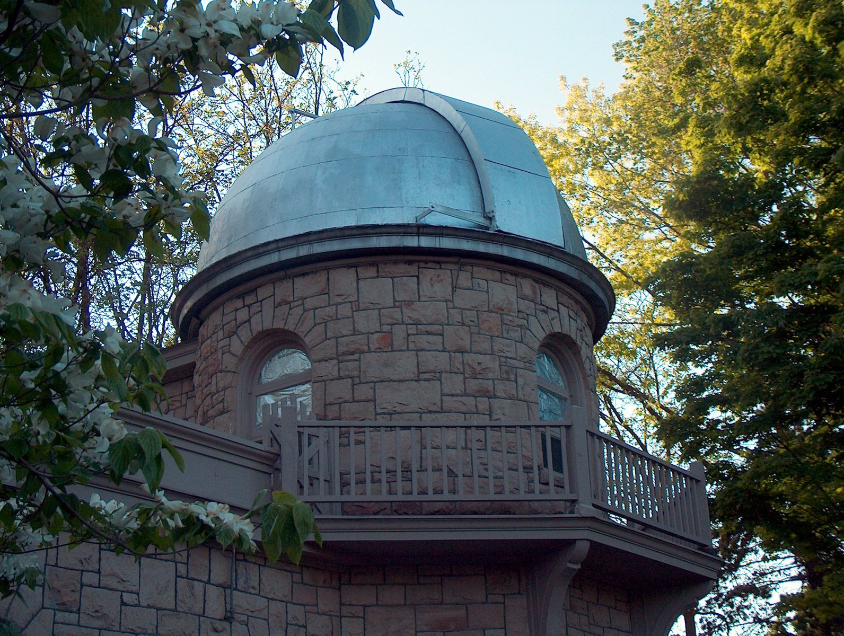
Civic Lot -Inspirations
Observatory

Slide 21
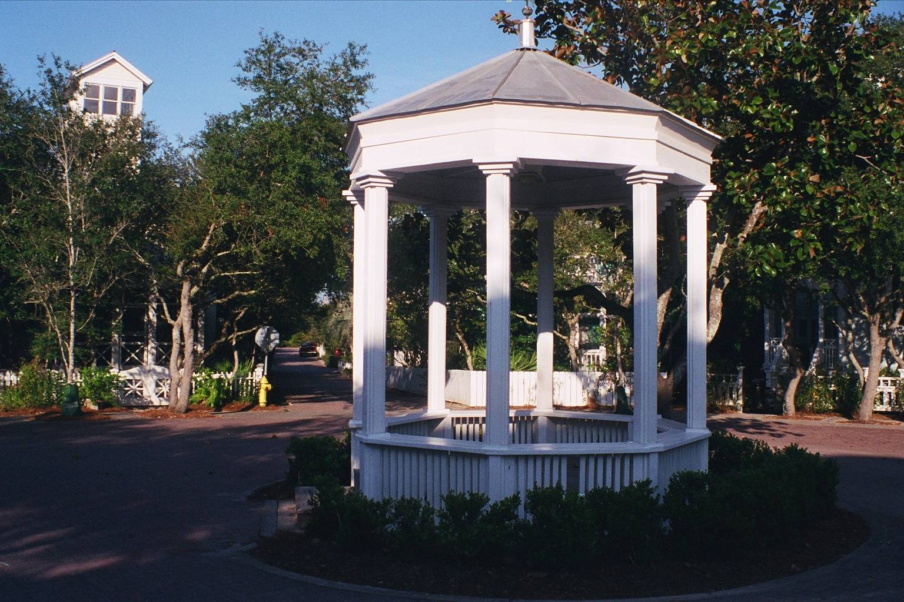
Civic Lot -Inspirations
Gazebo at Seaside, FL

Slide 22
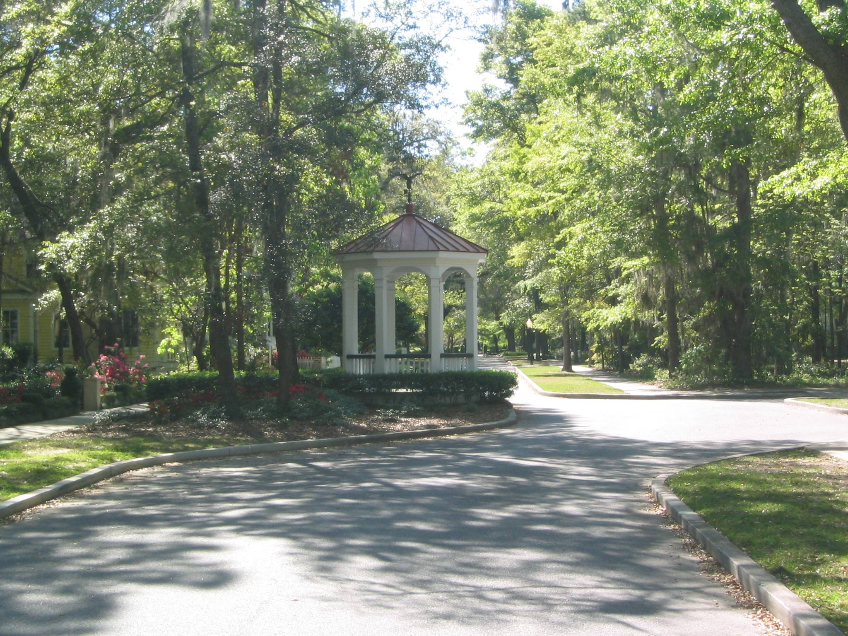
Civic Lot -Inspirations
Gazebo, New Point, Beaufort, SC

Slide 23
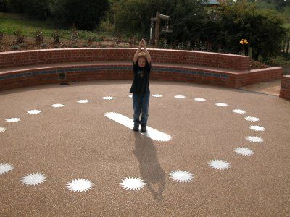
Civic Lot -Inspirations
Human or “Analemmatic” Sundial

Slide 24
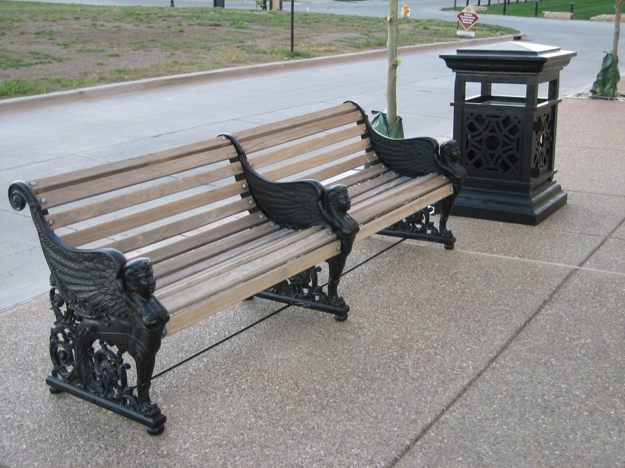
Street Seating
Benches at New Town at St. Charles, St. Charles, MO

Slide 25
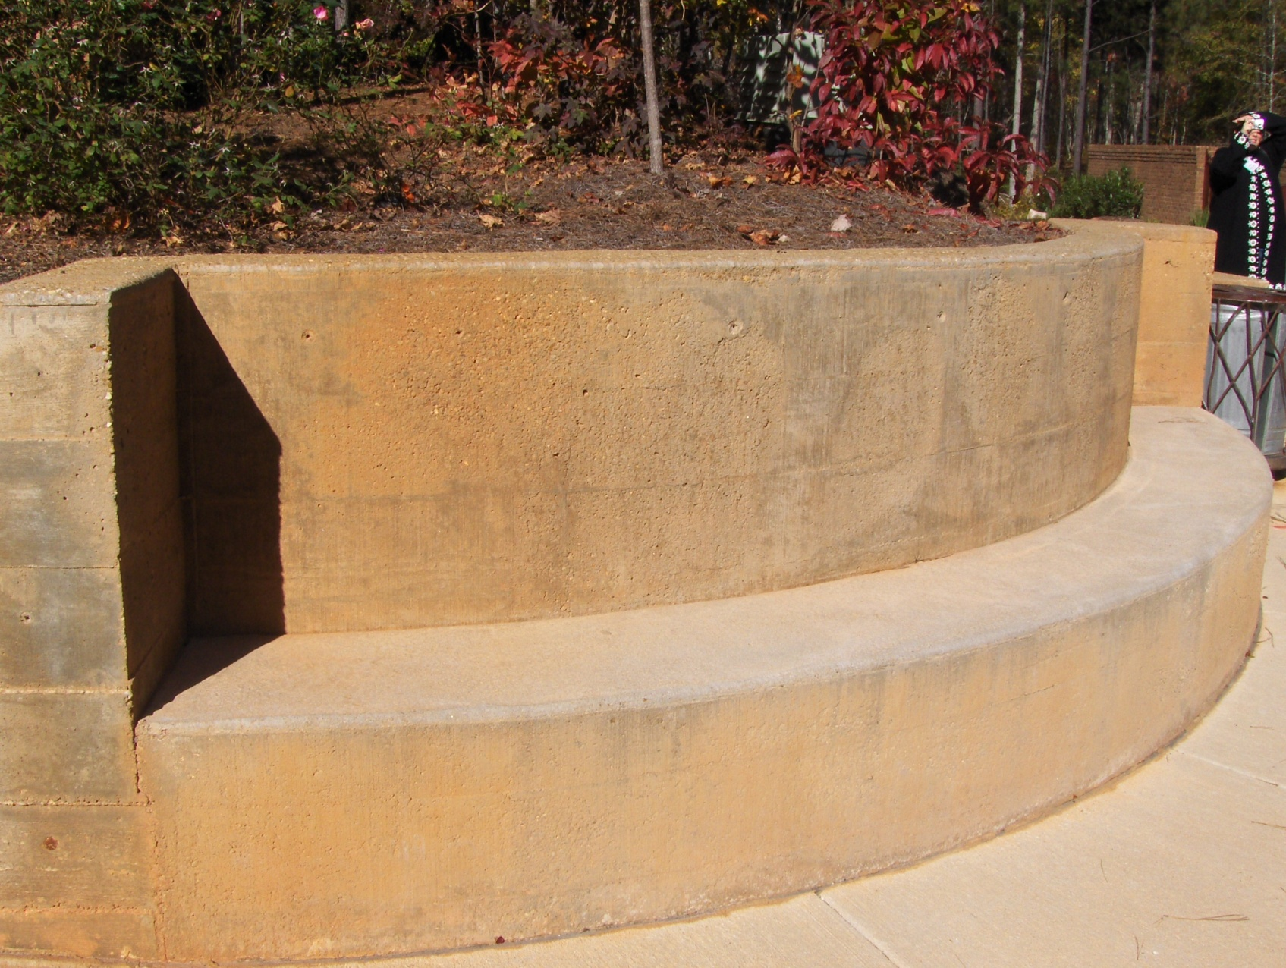
Street Seating
Bench in Retaining Wall, Serenbe, GA

Slide 26
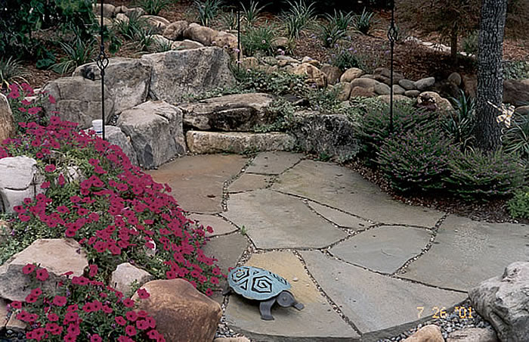
Civic Lot -Inspirations
Rock seating on a trail

Slide 27
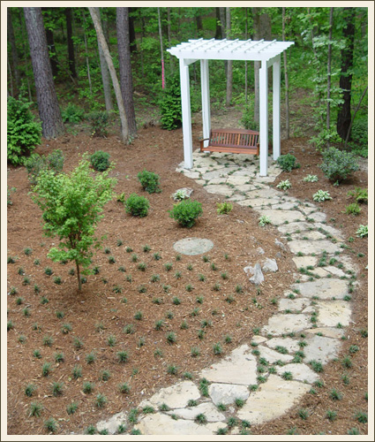
Civic Lot -Inspirations
Outdoor Swing, Serenbe near
Atlanta, GA

Slide 28
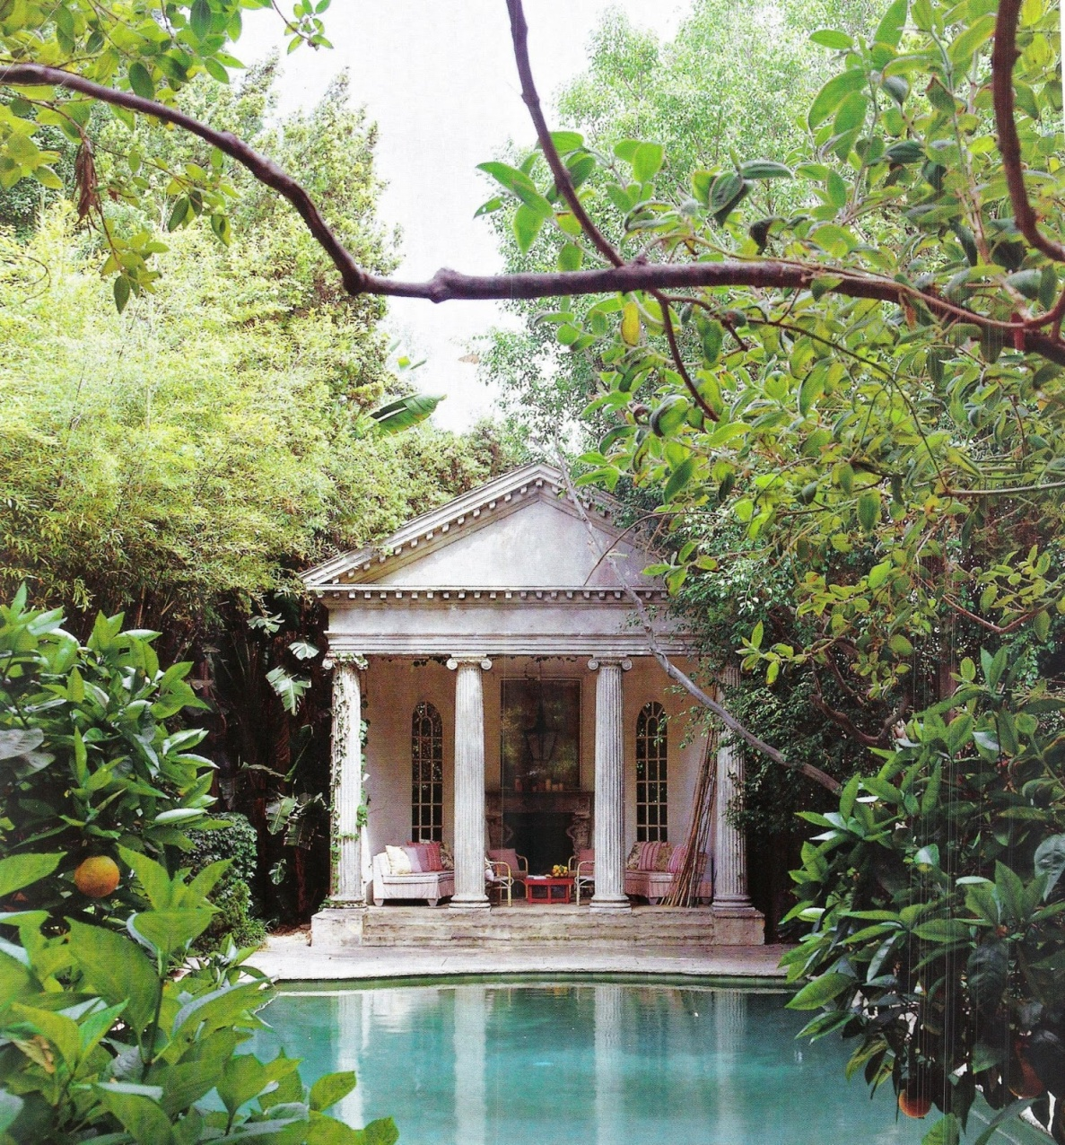
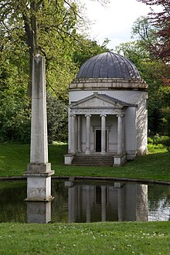
Civic Lot -Inspirations
Follies

Slide 29
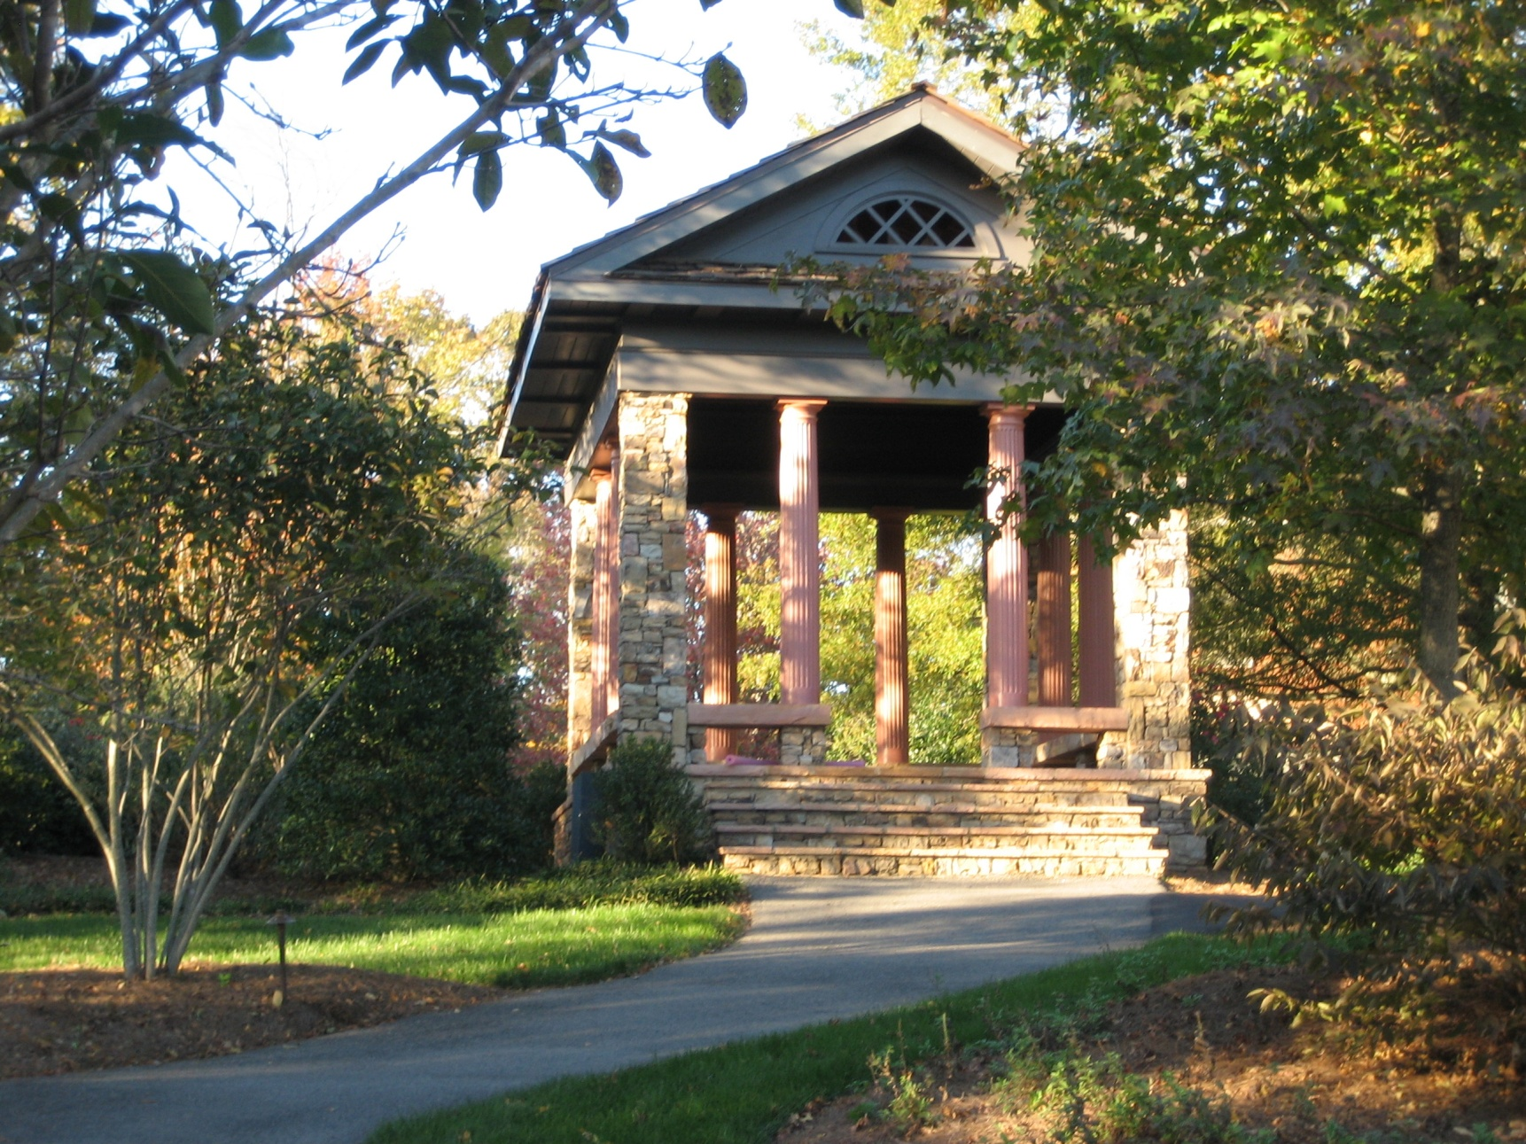
Civic Lot -Inspirations
Temple – Vickery in Cumming, GA

Slide 30
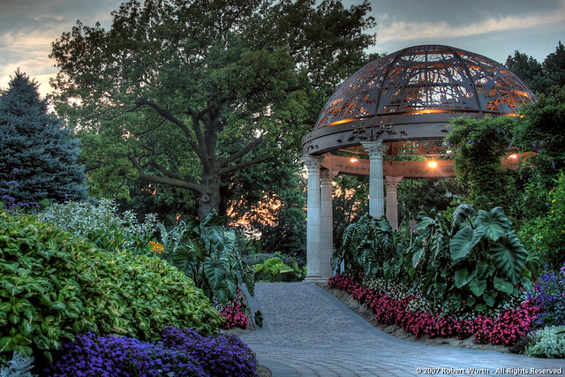
Civic Lot -Inspirations
At the Sunken Gardens, Lincoln, NE

Slide 31
Walking Points . . . Active / Social / Extroverted
Scary bridge across creek - a suspension foot bridge one person wide across the creek, scary enough that a six year old will be hesitant about crossing it the first time, but not so scared that he/she will not cross it; when the kid gets to the other side he is excited, giddy and wants to cross it again.
Stepping stones across creek - another way for a kid to cross the creek and have to think about it; wall rock steps up each side of the creek bank so the bank does not get eroded.
Community garden - a fenced place for people to have several rows in large, shared garden that is centrally located, with a water hydrant, shed for tools, hoses, a place for shade with benches for resting.
Chapel/Event Space – like at The Waters and New Town at St. Charles
Pond - with small pier, aquatic plants, fish, a small fountain or water fall to circulate the water; a pond for inquiry and activities.
Play grounds; tot lots, sports courts, dog parks
Pool or splash park
Putting green – Norton Commons has one
Ice skating rink (on pond or athletic field) - near the fireplace or fire pit
Sledding hill - steep and near the outdoor fireplace or fire pit
Concrete or stone chair circle like the one in the town center in Kentlands

Slide 32
Walking Points . . . Active / Social / Extroverted
Public green, square or plaza - for celebrations, concerts, movies, fairs.
Farmers' Market - a place for local vendors to set up stalls for the sale of produce, crafts, arts.
Trails/paths for walking and bikes
Amphitheater and/or band stand - Norton Commons, Woodstock Downtown
Children’s theater – there is a great on at New Town at St. Charles, MO
Digging hill, digging pit – Carlton Landing at Lake Eufala, OK has a digging hill
Tree houses
Croquette lawn; Bocce Ball, etc.
Picnic area with pavilion, grills and tables
Fire pit and outdoor fire place – fire brings people together and for many is bonding and mesmerizing.
Community Post Office – Everyone meets everyone else there.
Community Center
Class room(s), meeting rooms
Exercise/fitness room
Wine cellar/Pub, Café, Community Store – subsidized as an amenity
“Rambles” in the alleys - Neighborhood space for nearly any amenity or use.

Slide 33
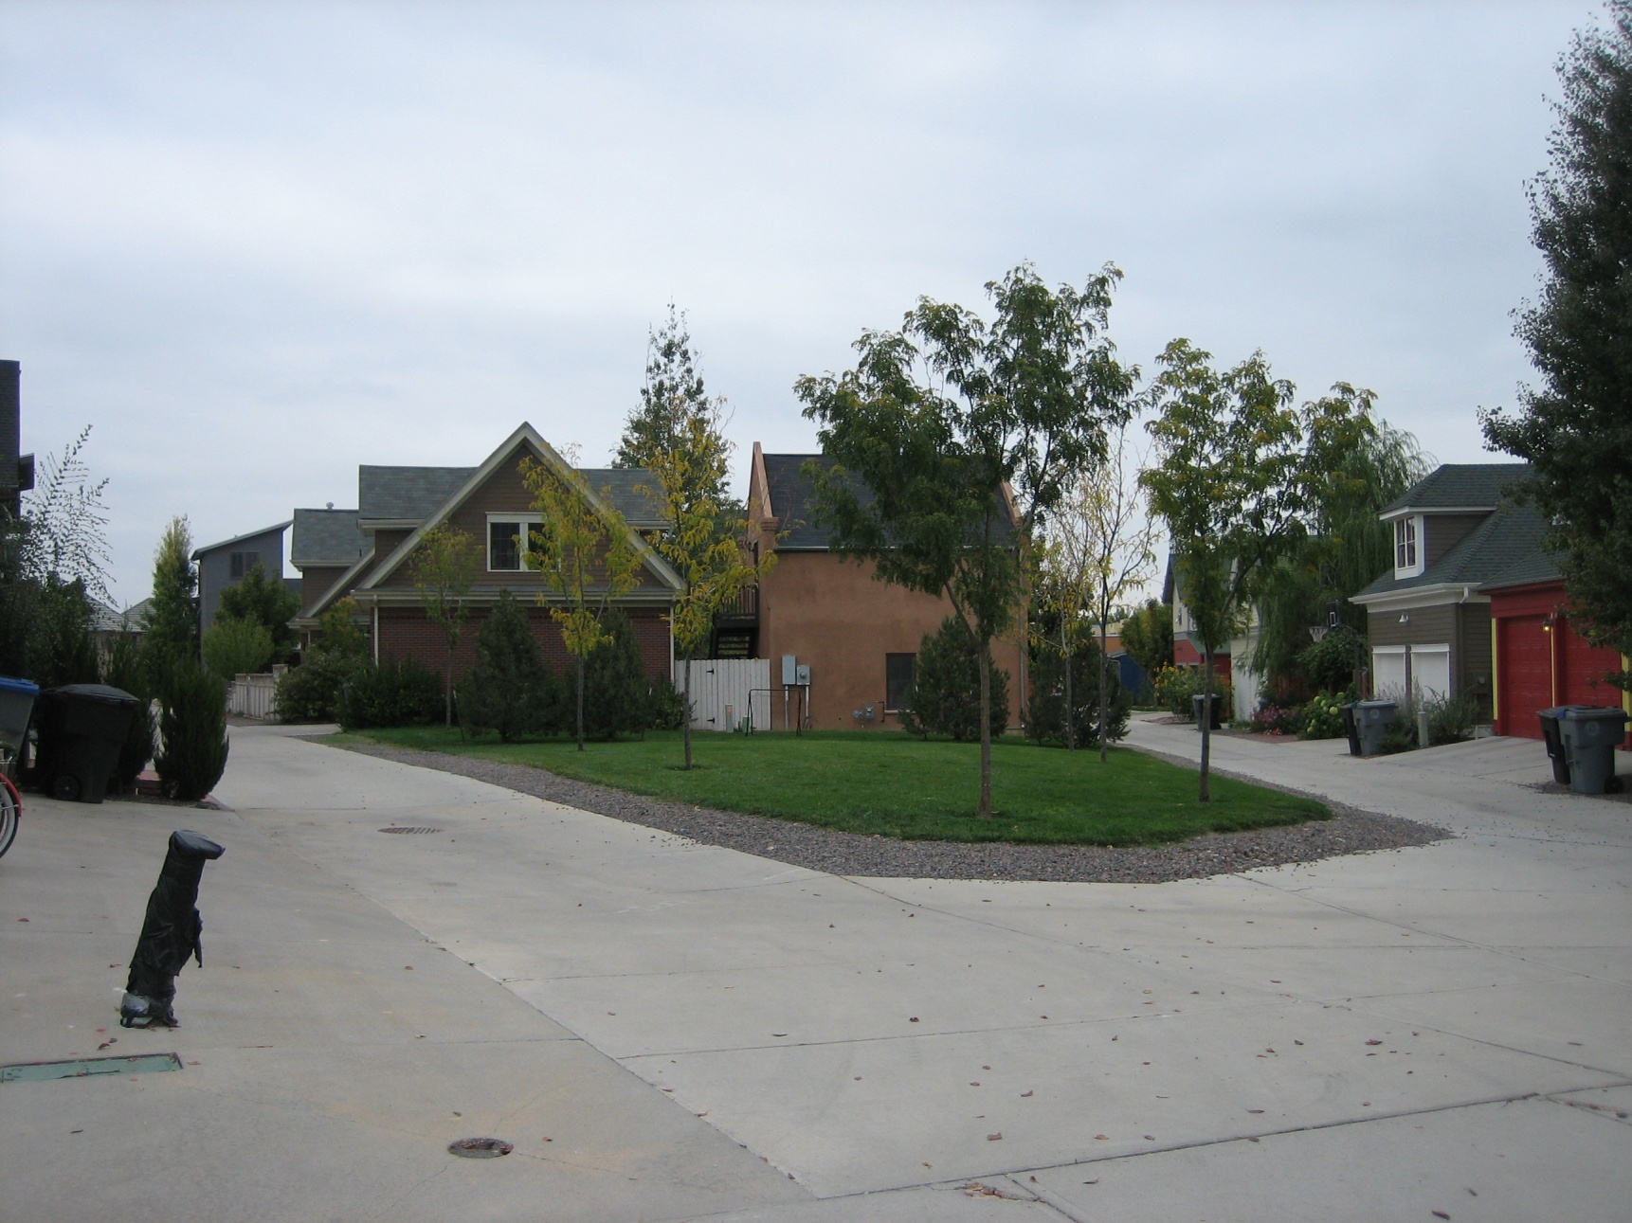
Ramble – the Public Space in the Alleys
Prospect in Longmont, CO

Slide 34
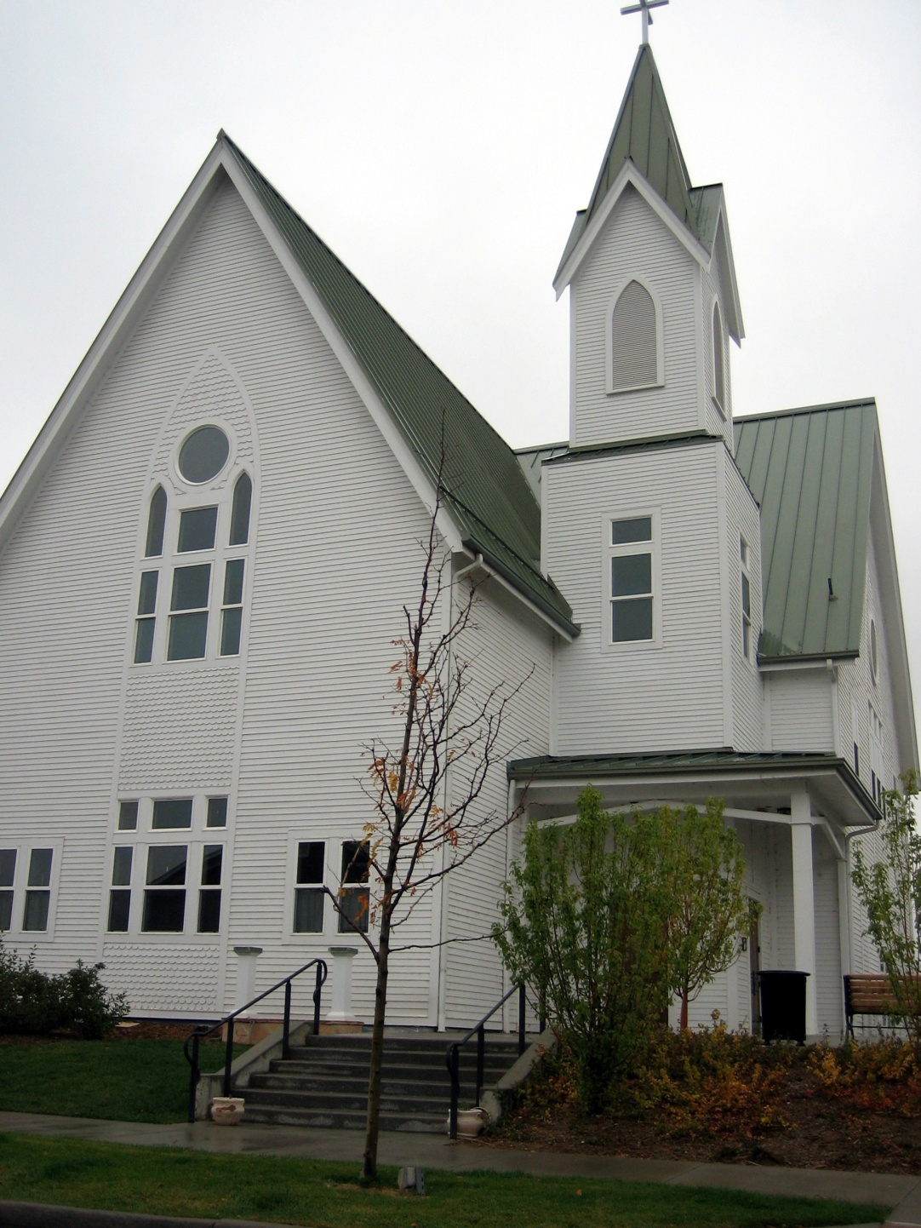
Civic Lot -Inspirations
Bradburn, Westminster, CO

Slide 35
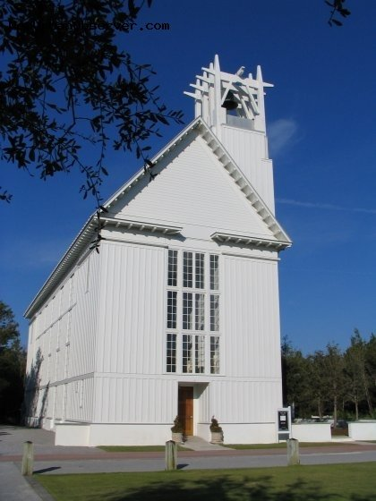
Civic Lot -Inspirations
Seaside, FL

Slide 36
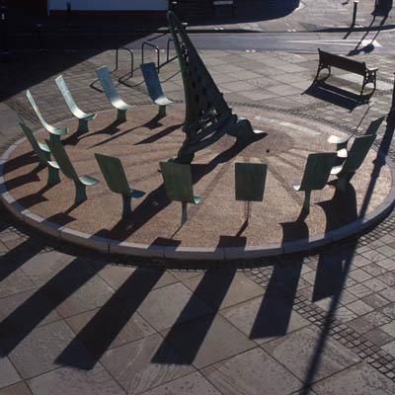
Civic Lot -Inspirations
Sun Dial in a Seating Circle

Slide 37
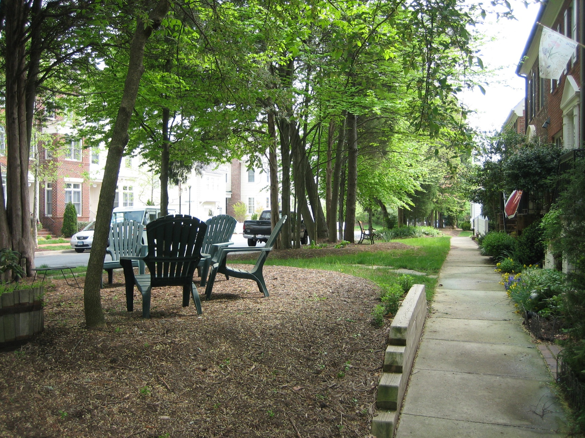
Green between Street and Homes
Kentlands in Gaithersburg, MD

Slide 38
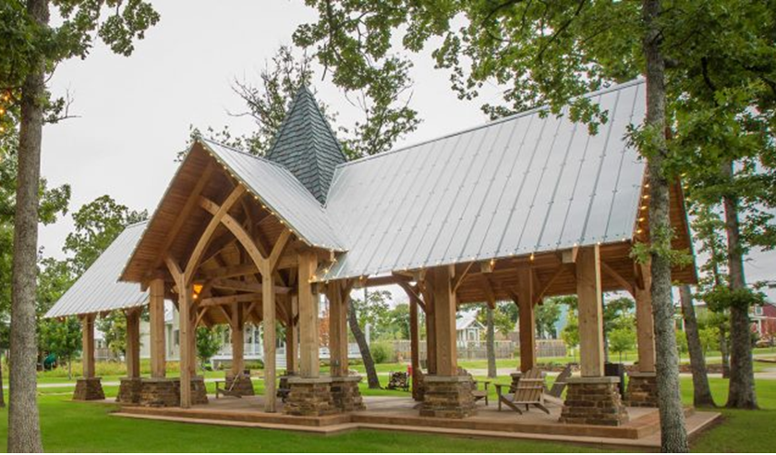
Civic Lot -Inspirations
Pavilion – Carlton Landing, Lake Eufala, Oklahoma

Slide 39
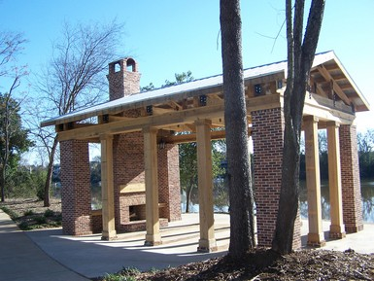
Civic Lot -Inspirations
Pavilion and Civic Green – Hammonds Ferry, North Augusta, SC

Slide 40
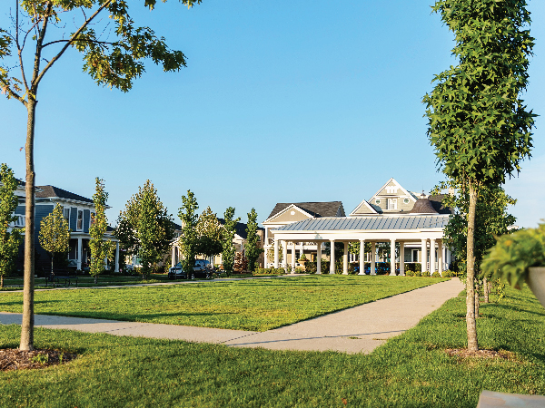
Civic Lot -Inspirations
Pavilion and Civic Green, Norton Commons, Prospect (outside of Louisville), KY

Slide 41
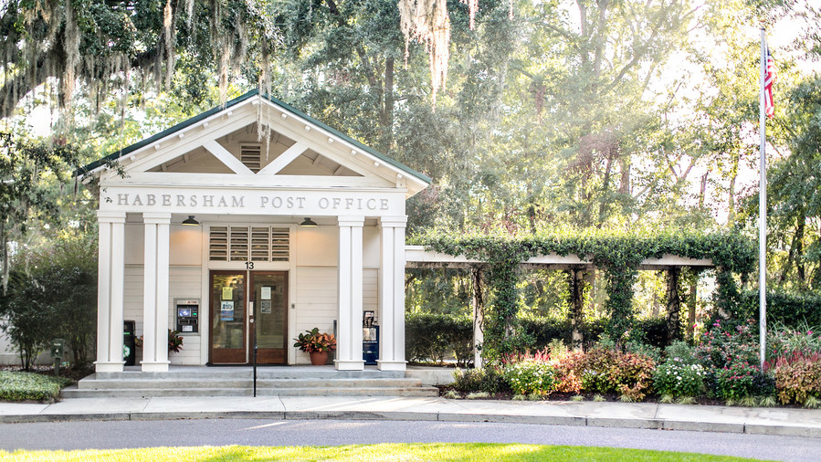
Civic Lot -Inspirations
Post Office – Habersham Post Office, Beaufort, SC

Slide 42
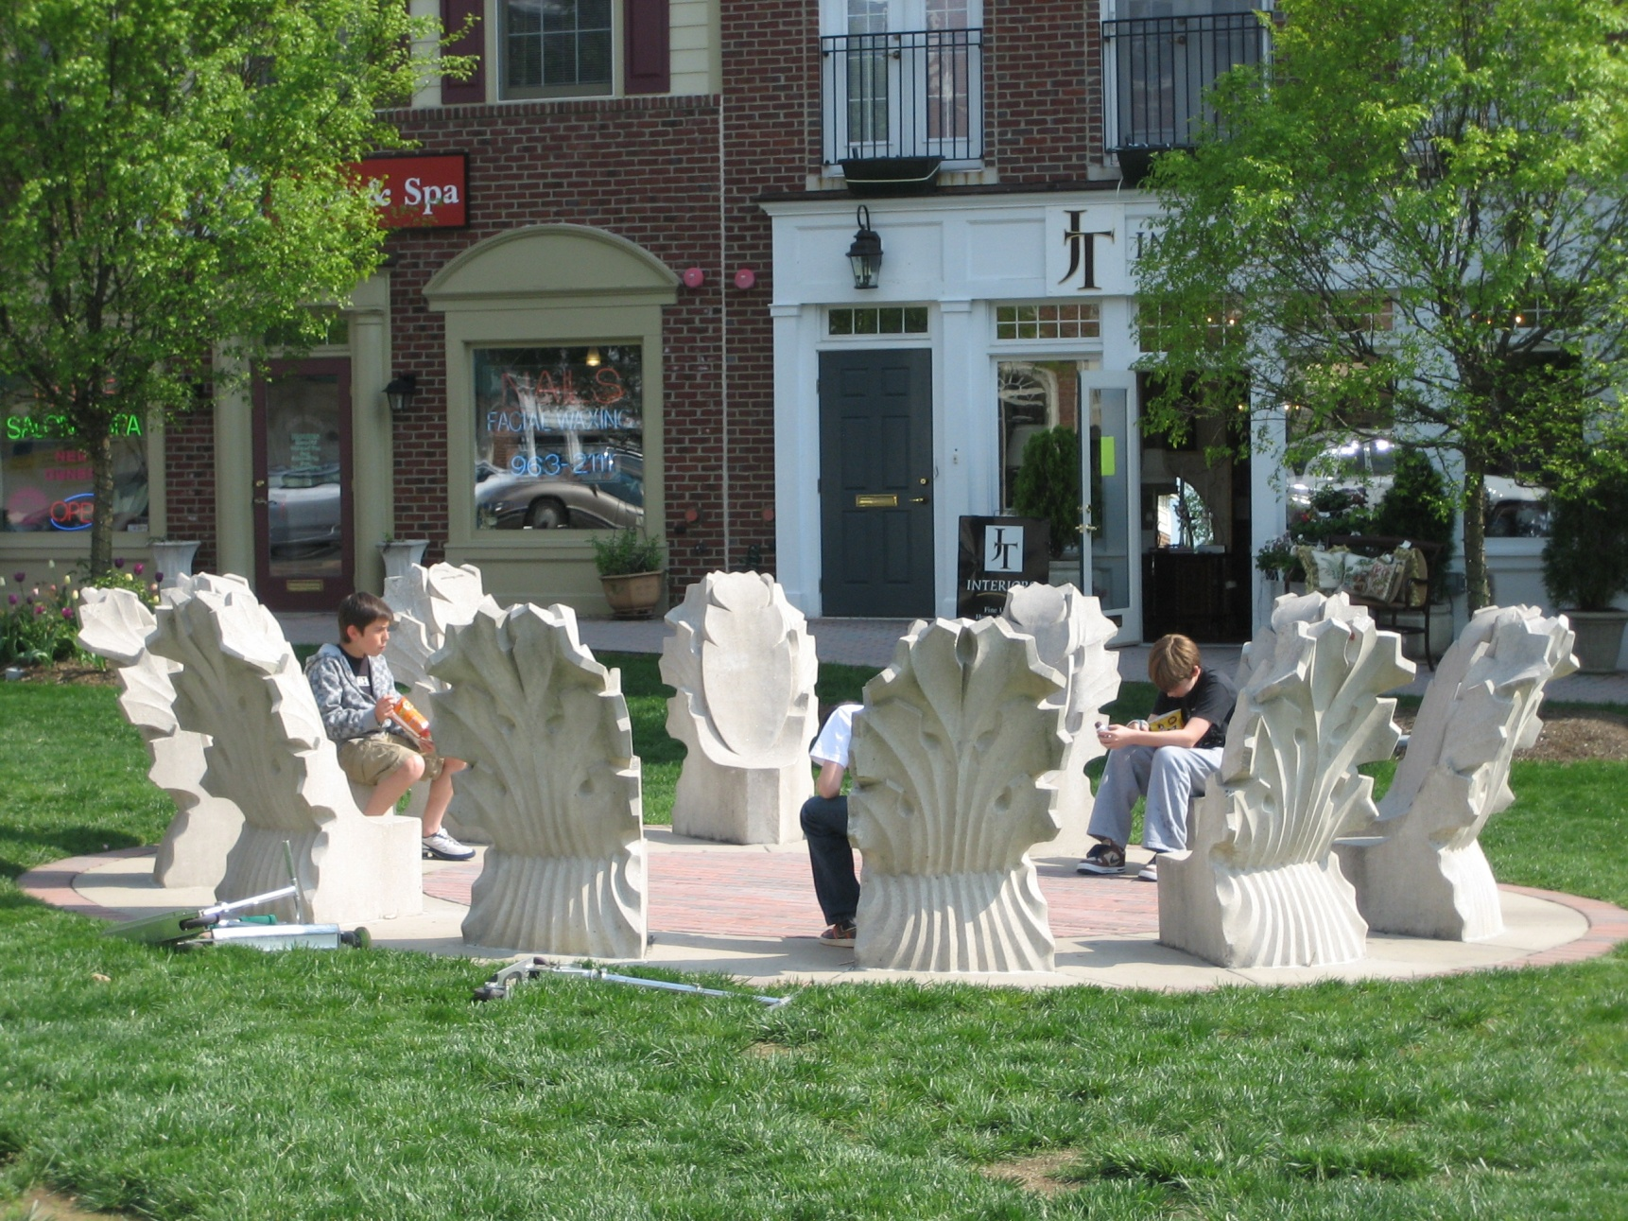
Civic Lot - Inspirations
Chair Circle in the Civic Green – Kentlands, Gaithersburg, MD

Slide 43
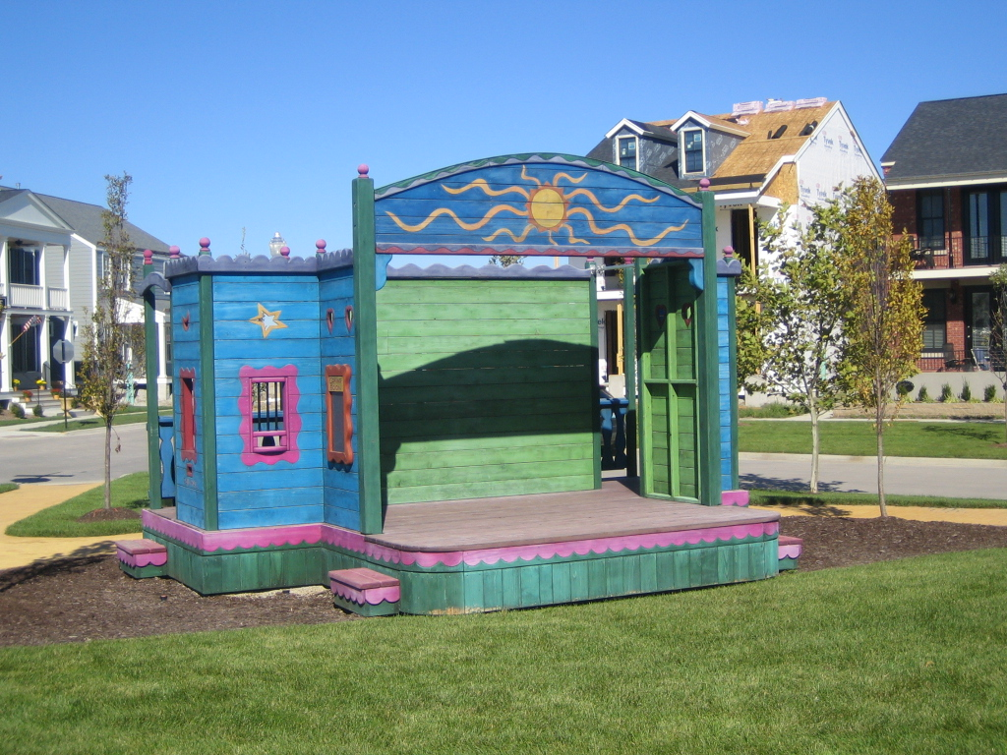
Civic Lot -Inspirations
Children’s Theater in a civic green, New Town at St. Charles, St. Charles, MO

Slide 44
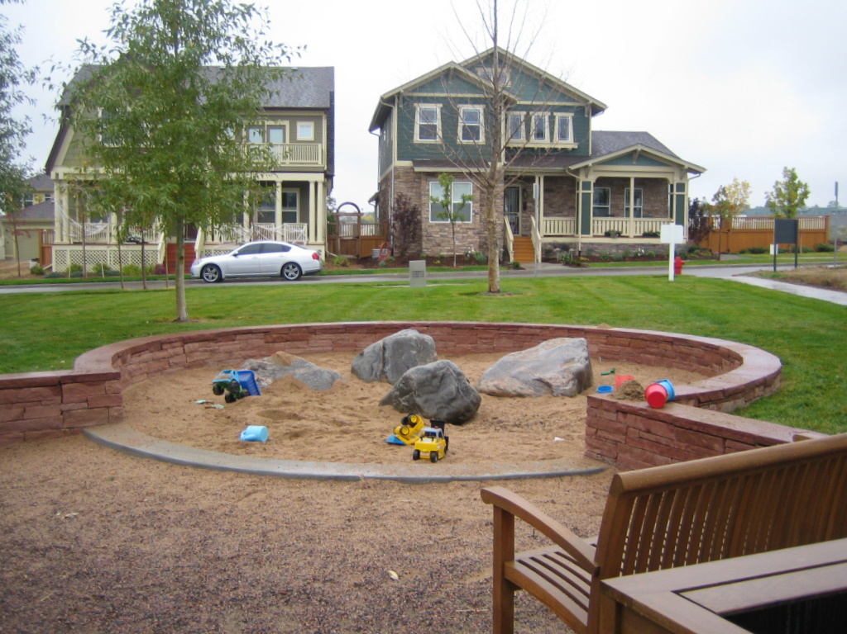
Civic Lot -Inspirations
Tot Lot, Bradburn in Westminster, CO

Slide 45
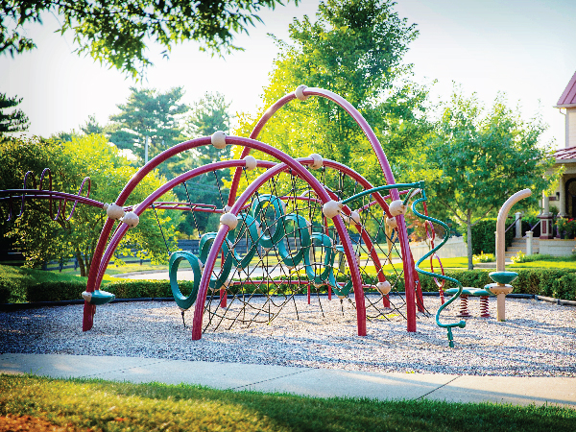
Civic Lot -Inspirations
Playground, Norton Commons, Prospect (outside of Louisville), KY

Slide 46
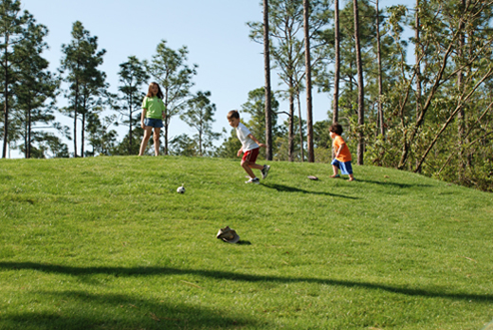
Civic Lot -Inspirations
Just a simple hill . . . . Or a digging hill like in Carlton Landing

Slide 47
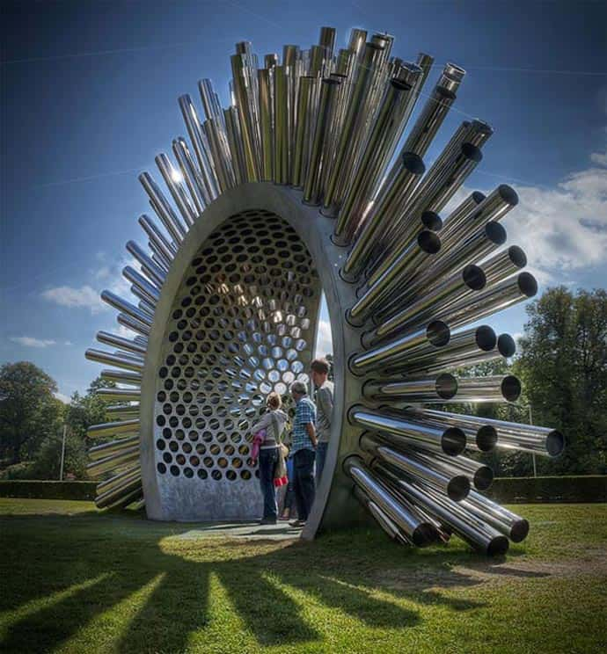
Civic Lot -Inspirations
Aeolian Harp – a wind powered instrument

Slide 48
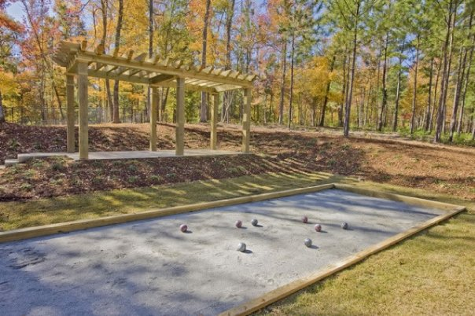
Civic Lot -Inspirations
Just simple games

Slide 49
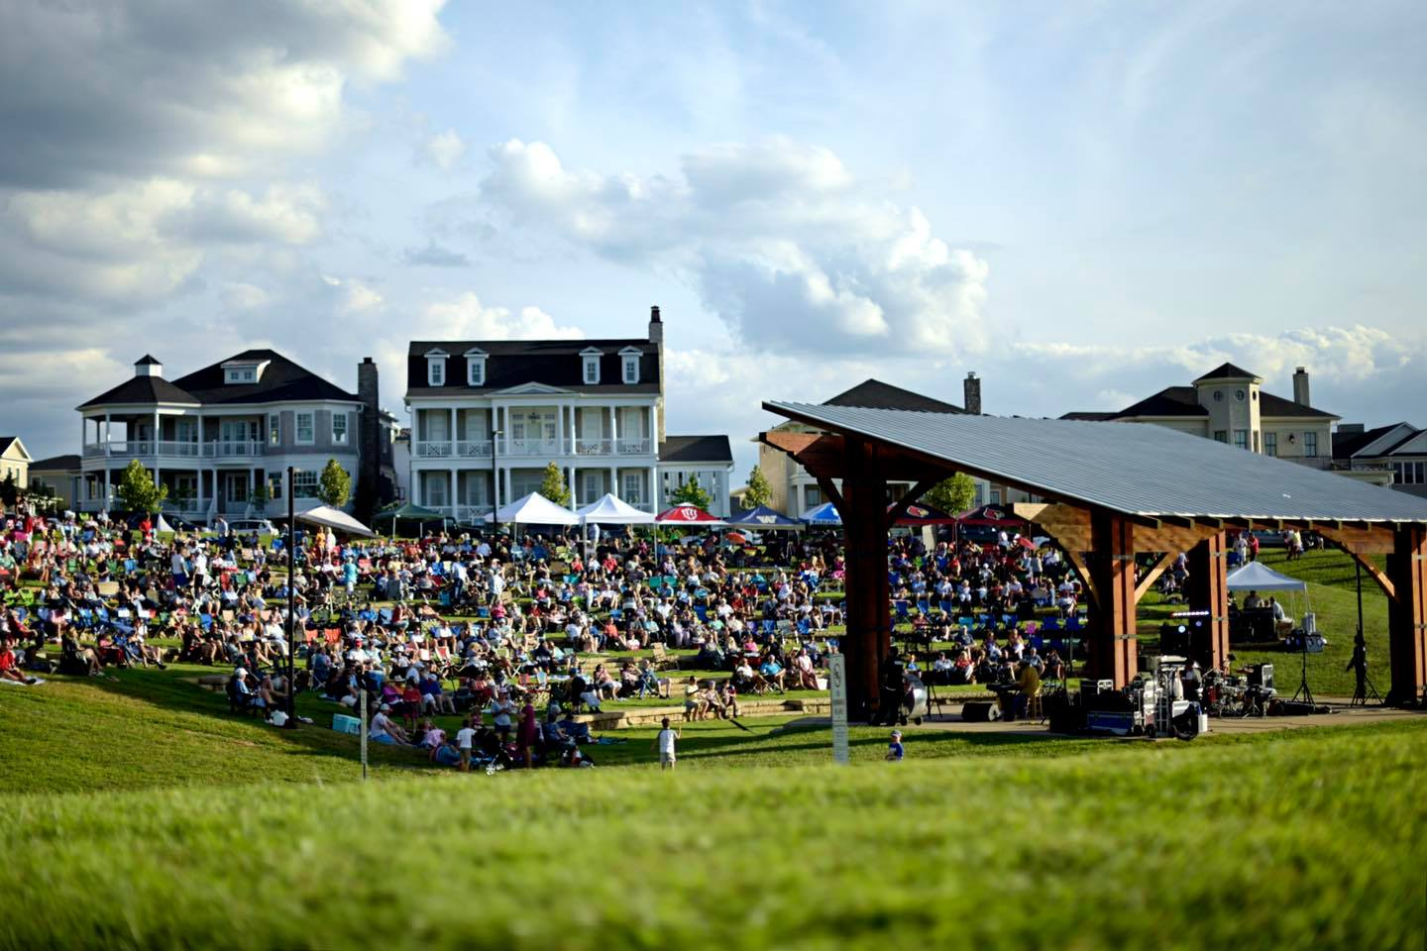
Civic Lot -Inspirations
Amphitheater, Norton Commons, Prospect, (outside of Louisville), KY

Slide 50
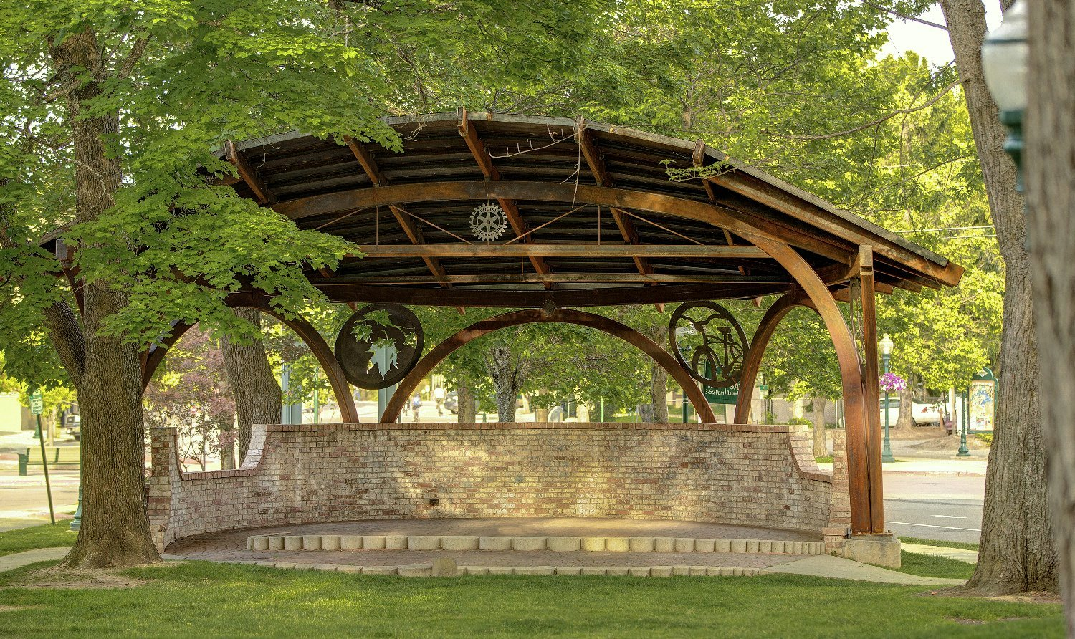
Civic Lot -Inspirations
Bandstand, Band Shell

Slide 51
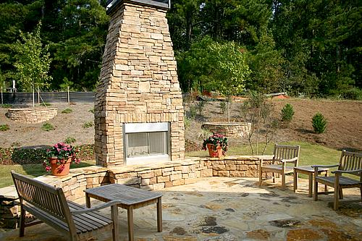
Civic Lot -Inspirations
Outdoor Fireplace

Slide 52
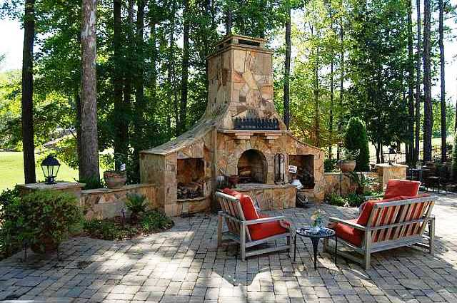
Civic Lot -Inspirations
Outdoor Fireplace – if one is good. . . TWO is better

Slide 53
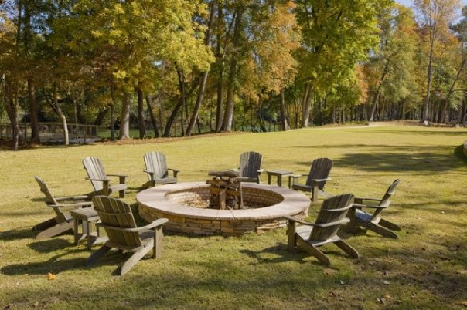
Civic Lot -Inspirations
Simple Fire Pit

Slide 54
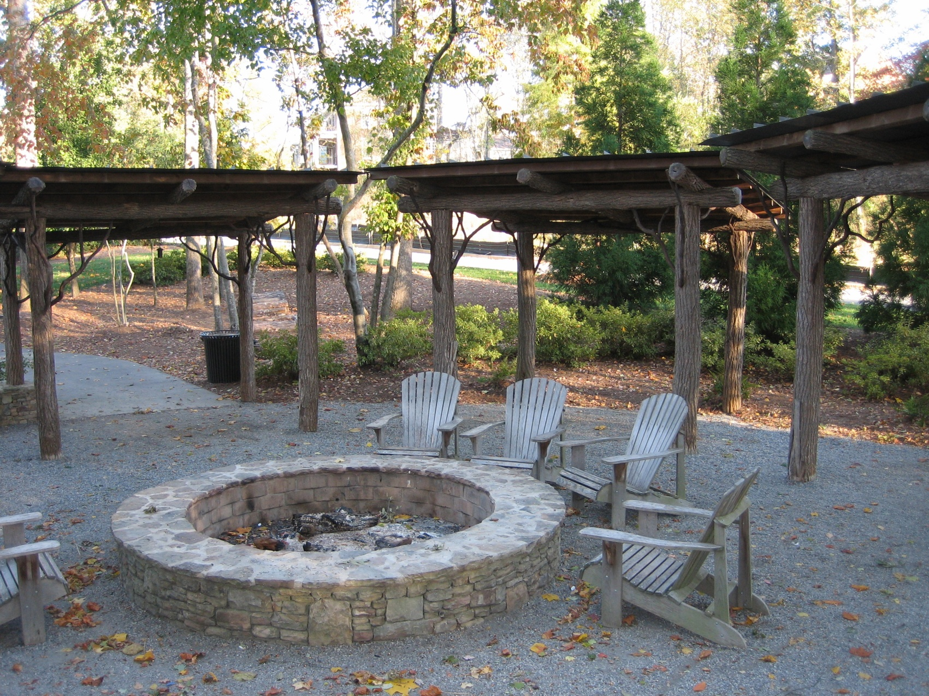
Civic Lot -Inspirations
Fire Pit in Vickery, Cumming, GA

Slide 55
Civic Lot -Inspirations
Outdoor Swing, Serenbe near
Atlanta, GA
Outdoor Swing, Charleston, SC

Slide 56
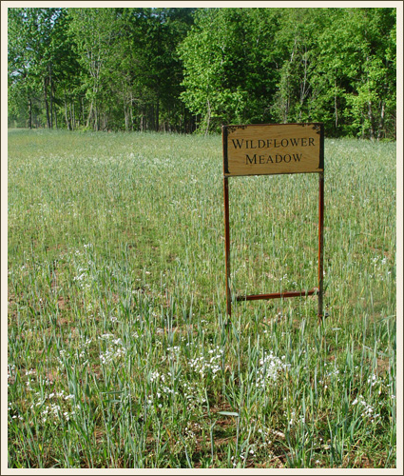
Civic Lot -Inspirations
Wild Flower Meadow, Serenbe
Near Atlanta, GA

Slide 57
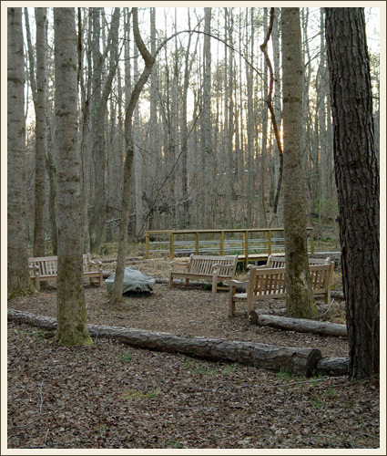
Civic Lot -Inspirations
Woodland Seating Area with
Fire Ring in Serenbe
Near Atlanta, GA

Slide 58
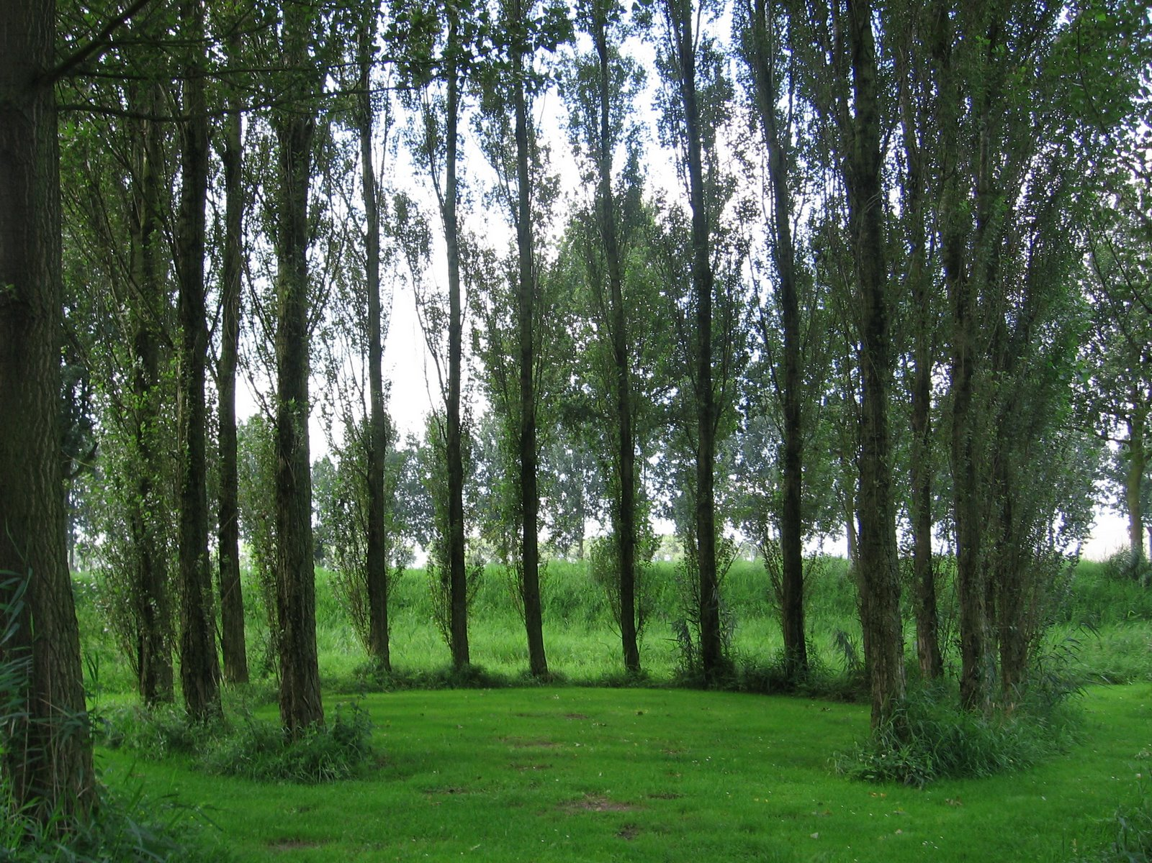
Civic Lot -Inspirations
Tree Circle

Slide 59
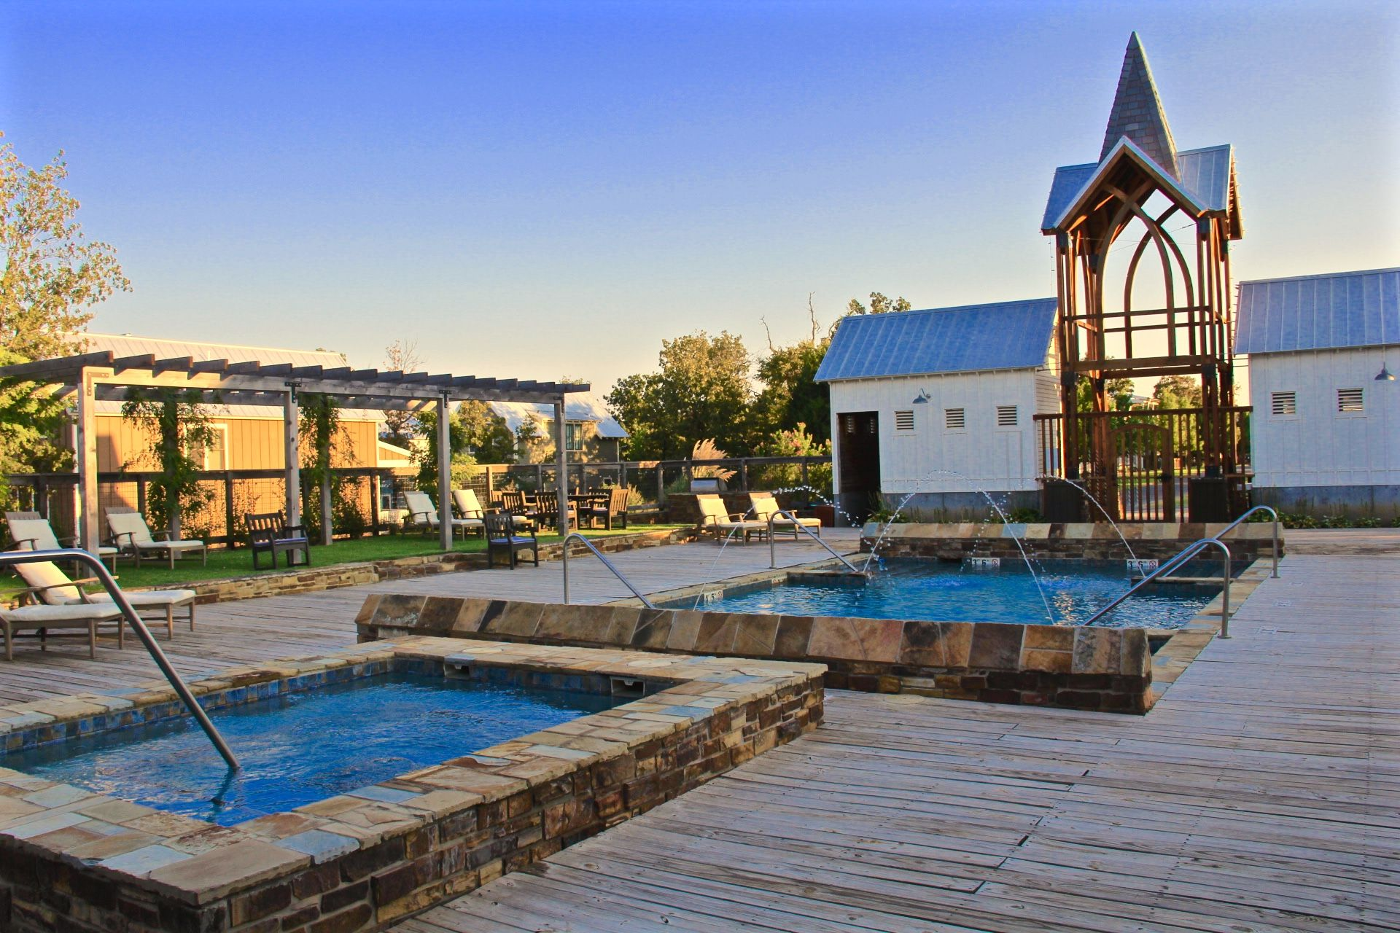
Civic Lot -Inspirations
Pools and Pool House – Carlton Landing, Lake Eufala, Oklahoma

Slide 60
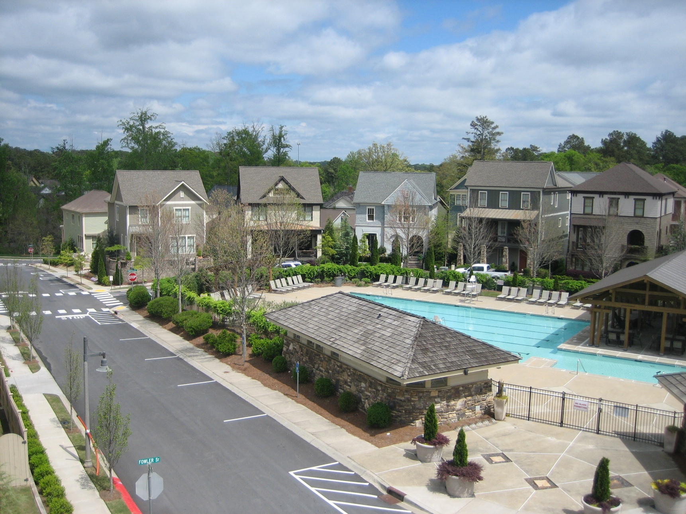
Civic Lot -Inspirations
Pool, Pool House and Pavillion, Woodstock Downtown, Woodstock, GA

Slide 61
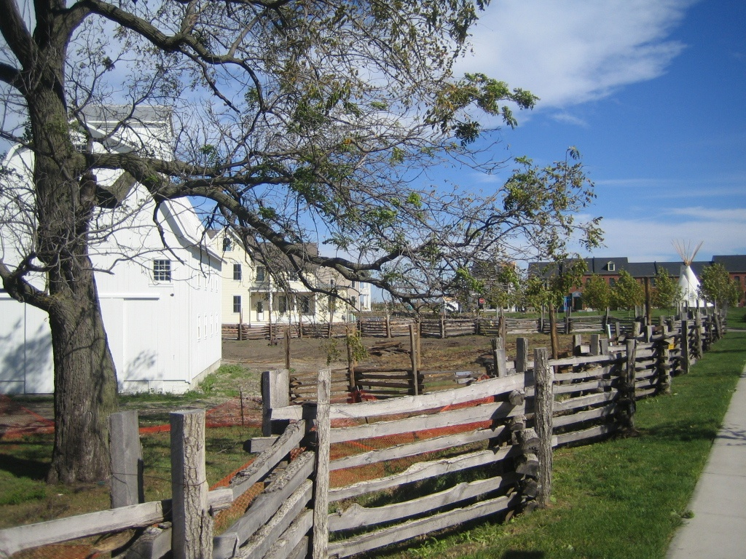
Civic Lot -Inspirations
Organic Farm, New Town at St. Charles, St. Charles, MO

Slide 62
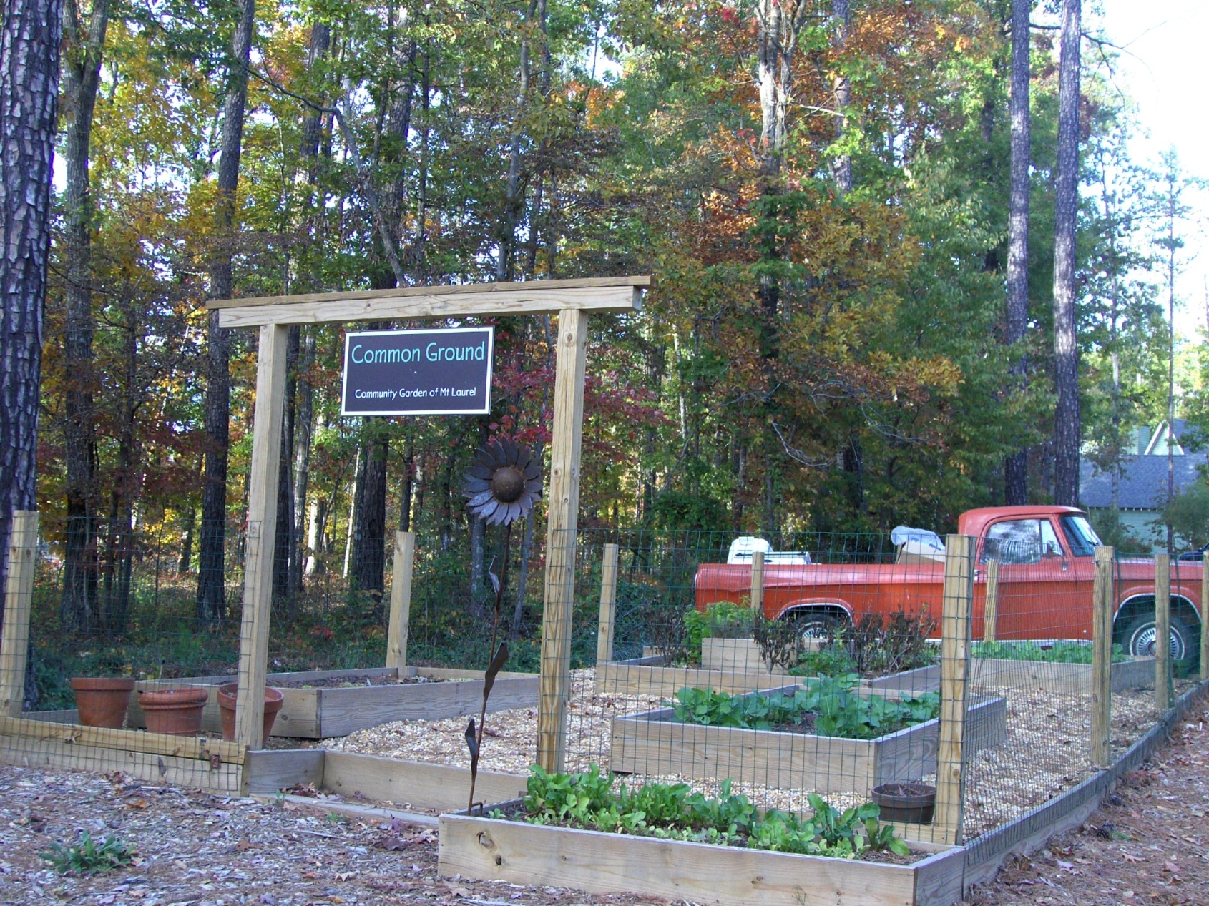
Community Lot -Inspirations
Community Garden - Mt. Laurel in Birmingham, AL

Slide 63
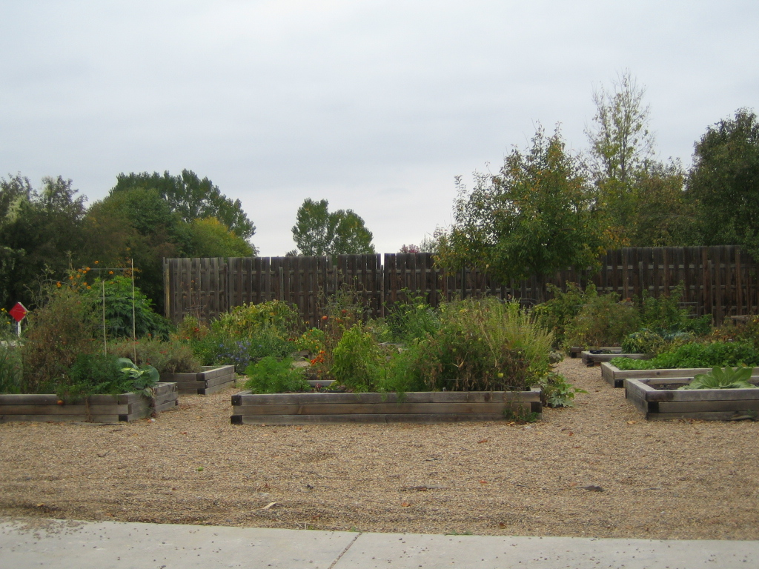
Community Lot -Inspirations
Community Garden – Prospect in Longmont, CO

Slide 64
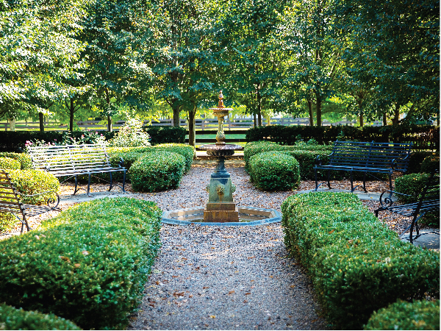
Civic Lot -Inspirations
Formal Rose Garden, Norton Commons, Prospect (outside of Louisville), KY

Slide 65
Civic Lot -Inspirations
Orangery

Slide 66
Civic Lot -Inspirations
Dog Park, Norton Commons has three, Prospect, (outside of Louisville), KY

Slide 67
Civic Lot – Inspirations – And Now for Something Completely Different
Ferris Wheel and Hammocks – Wheeler District, Oklahoma City, Oklahoma

Slide 68
Village Center Alternatives . . . . If you must!
Pop Up Stores, Carlton Landing, Lake Eufala, OK

Slide 69
Village Center Alternatives . . . .
Pop Up Stores, New Town at St. Charles, St. Charles, MO – facing the street

Slide 70
Village Center Alternatives . . . .
Pop Up Stores, New Town at St. Charles, St. Charles, MO – back facing the green

Slide 71
Village Center Alternatives . . . .
Food truck court

Slide 72
Village Center Alternatives . . . .
Food truck court and an Airstream BAR!

Slide 73
The Take Away . . . .
If you do not have a critical mass of nearby homes (at least 2,000) and a visible location with good parking on a through street, it is probably better to pass on a for profit village center. Forego the village center unless it is a pure amenity or legacy project – in which case, good for you!
My take away: Absent the factors above, just make your new traditional neighborhood amenities compelling, intriguing, unique, plentiful, fanciful, beautiful, well executed and fun. Then neither you nor your residents will ever miss not having a town center.

Slide 74
Thank You for your Interest and Attention

Slide 75
Herb Freeman, NTBA Board Member; NTBA Fall 2019 Roundtable Planning Committee, NTBA 2020 Virtual Roundtable Presenter
Herb Freeman is Chief Operating Officer and Director of Builder Services for NP Dodge Real Estate Sales, Inc. in Omaha, Nebraska and has been in the real estate business since 1972. Herb is a past president and current director of the Omaha Area Board of REALTORS®, a past president and current director of the Nebraska Realtors Association and is the immediate past president and director of the Great Plains Realtors Multiple Listing Service.
Herb has an MBA from the University of Nebraska. He is a past Commissioner on the Nebraska Real Estate Commission and is a Director of the Nebraska Investment Finance Authority (NIFA), both gubernatorial appointments. He is also a principal member of The Realty Alliance, a member of the Congress for the New Urbanism and an officer and director of the National Town Builders Association.

Slide 76
Contact Information
Herb Freeman
Full Circle Ventures, Inc.
16510 State Street
Bennington, NE 68007
cell 402.689.4000
email herb@FullCircleVentures.com
See also: www.Leytham.com

Slide 77
Leytham . . . A New Traditional Neighborhood
Northwest corner of
168th and State Streets
160 Acres
Bennington Schools
No. of
Lots
Single Family 514
Multi-Family 16
Flex Building 20
Private Lots 550
Civic Lots 6
Total Lots 556
Note: Creating a new traditional neighborhood is an evolving and ongoing process. Accordingly, all site plans, land uses, layouts, diagrams, schematics, home
elevations and floor plans, renderings, features, facilities, and amenities are conceptual in nature and are subject to cancellation, refinement, change and/or revision without notice.

Slide 78
Leytham Green Spaces – 21% Green Space –
What is the Program for that 33 Acres?
Acres
Natural 17.71
Civic 4.17
Outlots 11.01
Total 32.89
Percent 20.82%

