Slide 1
Top Tips for Successful Sales and Marketing

Slide 2
Do Your Homework
What is your market area?
Who are your buyers?
Do they want what you’re selling?
What are you competing against?
What is the absorption capacity?

Slide 3
Establish Your Products and Pricing
Mix it Up
Keep it Tight
Time it Right
Have a Phasing Plan

Slide 4
Never Forget to Build Value

Slide 5
Create a Marketing and Sales Plan
Strategy
Branding / Messages
Timing
Sales Goals
Revenue
Expenses

Slide 6
Structure & Control Your Sales Program
Centralized Sales?
Out-sourced Sales?
Welcome Center and Builder Sales Teams?

Slide 7
Hire Smart – It’s Your Money We’re Talking About!
Sales people are not created equally
Can your manager manage – time, people, tasks?
Credentials count
Self-motivated? Team oriented? Hungry?
Ditch the drama….and the Divas!
Does the sales team push YOU?

Slide 9
Consider Compensation Structures
% of Sales?
Flat Fee?
Non-recoverable Draw Against Commission?
Stretch Compensation?
Pooled Commission?
Salary/Commission Blend?

Slide 10
Establish Your Processes
Listing process
Lead Follow-up
Contract Process
Build Process
Closing Process

Slide 11
Sales Manuals Protect Your Business
Set Expectations
Job Descriptions
Policies & Procedures
Product Knowledge
Talking Points

Slide 12
Figure Out Your Sales Center
Story Telling
Flow
Multiple Stations
Privacy
Back of the House

Slide 13
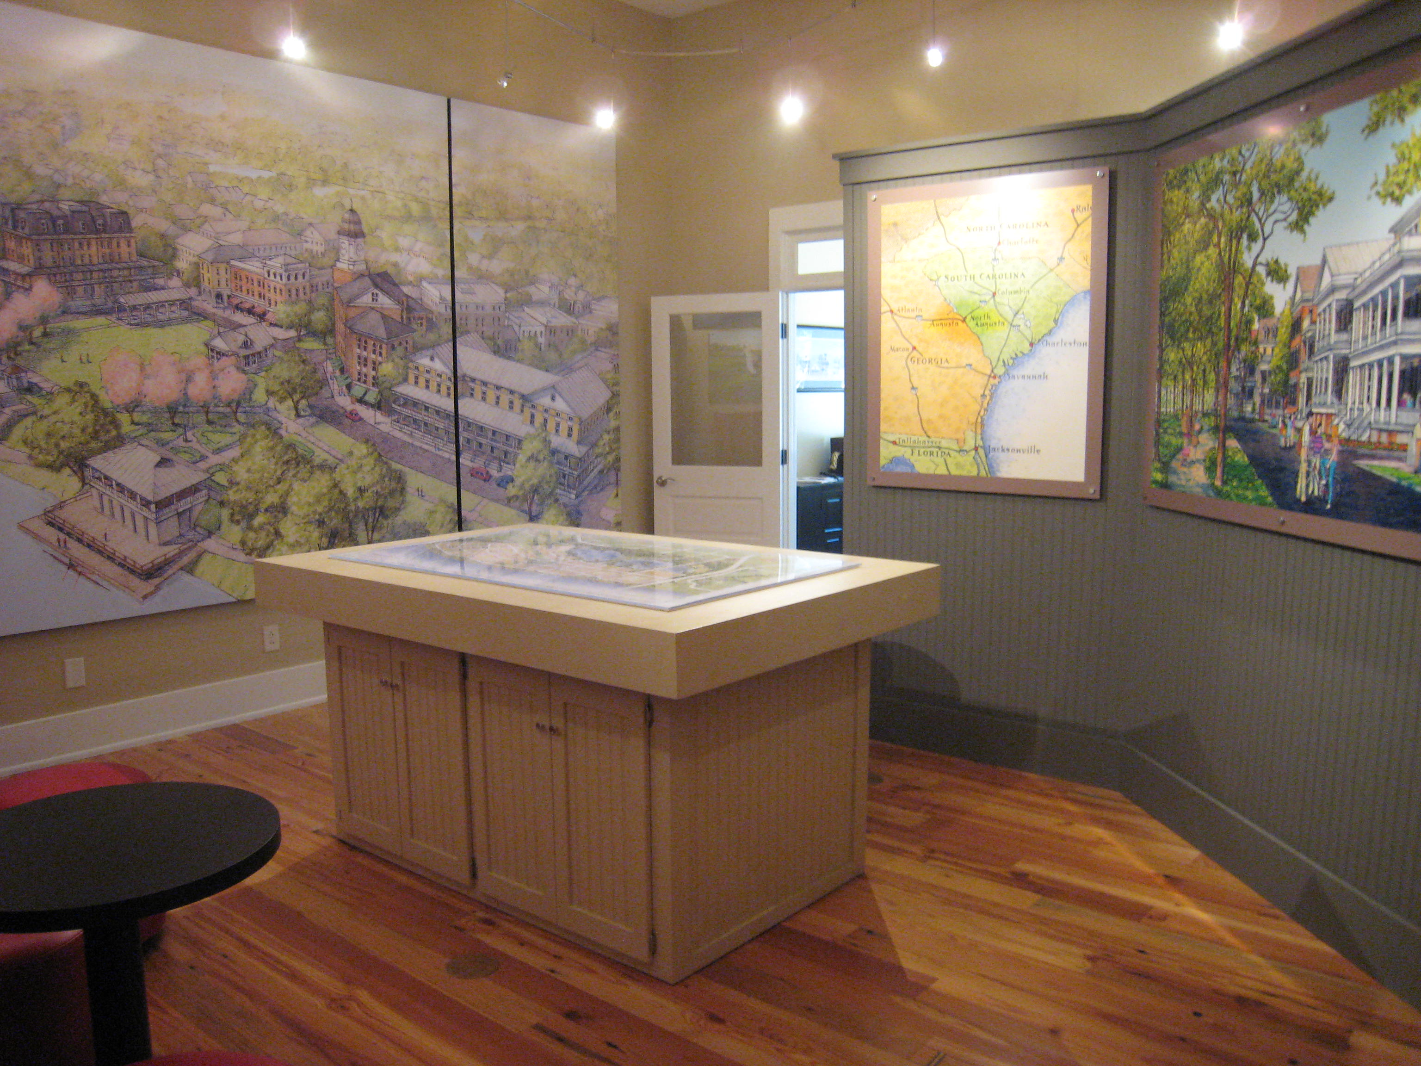

Slide 14
Have Your Sales Tools Ready
Website
Collaterals
Marketing Tactics
Sales Center
Model Homes
Contracts

Slide 15
Don’t Ruin Your First Impression
Safe
Clean
Attractive
Know the Facts
Be Responsive

Slide 16
Structure Accountability
CRM
Department Head Meetings
Sales Meetings
Deliverables and Due Dates
Clear Communication
Honest Feedback

Slide 17
Customer Relationship Management “CRM”
Contacts
Traffic
Sales Activity
Research
Staff Activity
Cheap Marketing

Slide 18
Help Your Team SELL
Staff as Needed
Clear Direction
Prioritize Tasks
Focus on Selling
Support & Responsiveness
Training & Exposure

Slide 19
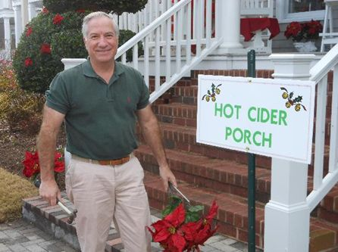
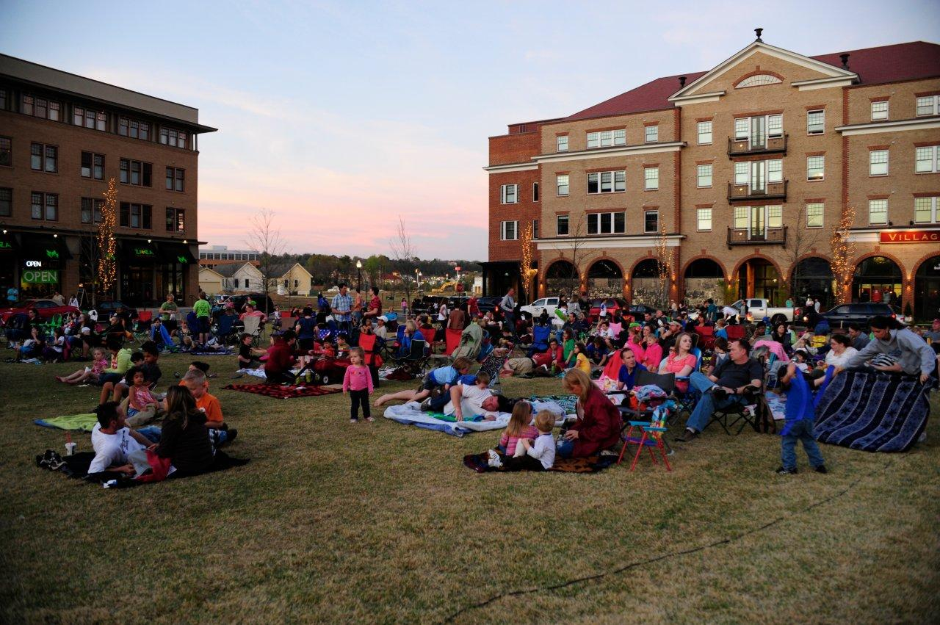
Deliver the Brand Promise and Drive Traffic

Slide 20
Applause for a Job Well Done!!!!

