Slide 1
Miami 21
First Decade in Action
Elizabeth Plater-Zyberk
NTBA
April 2019
Notes:
AIA_Miami21_100611
1

Slide 2
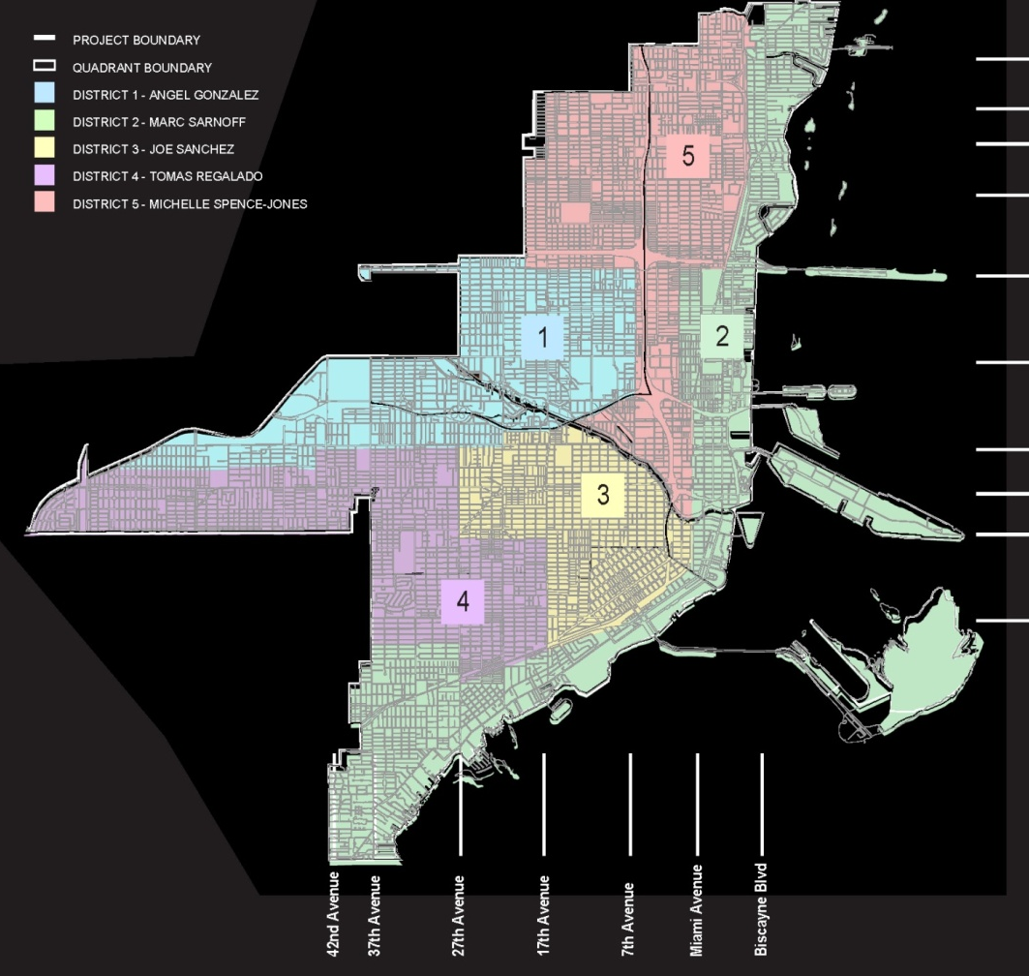
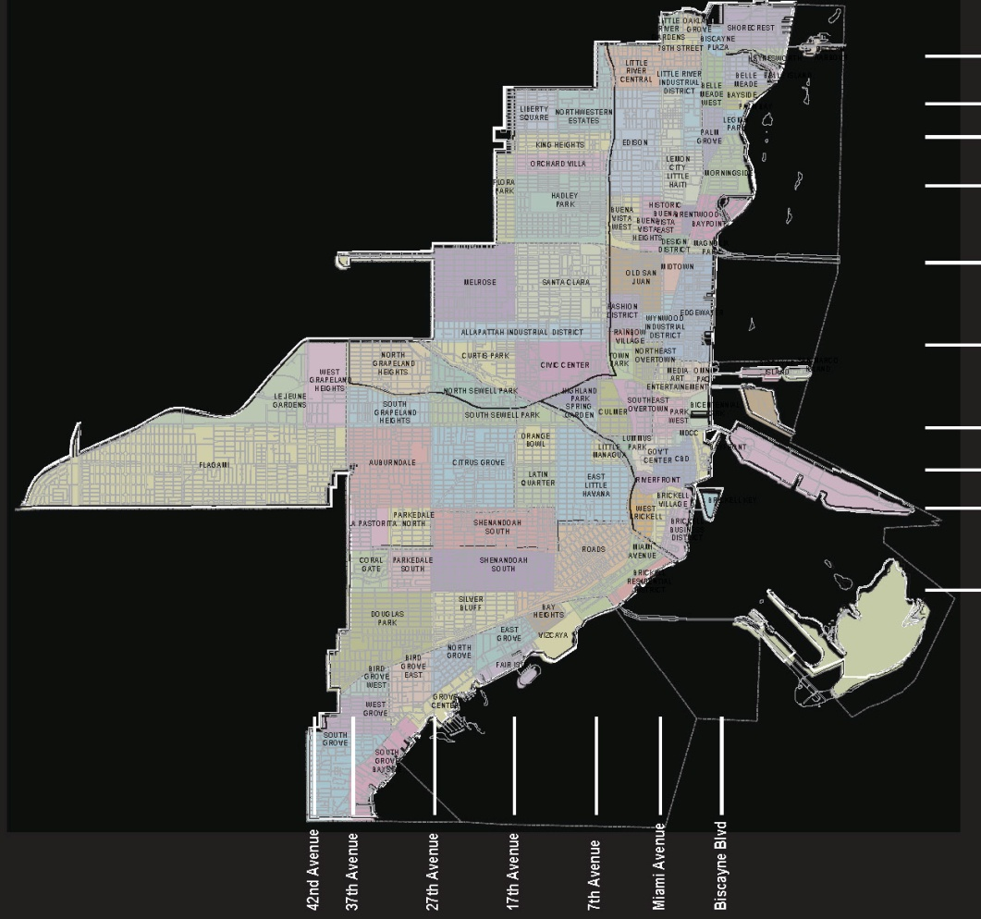
DISTRICTS & NEIGHBORHOODS
Notes:
AIA_Miami21_100611
2

Slide 3
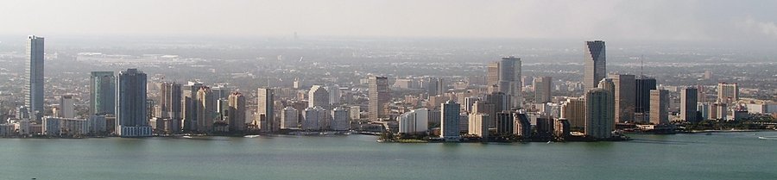
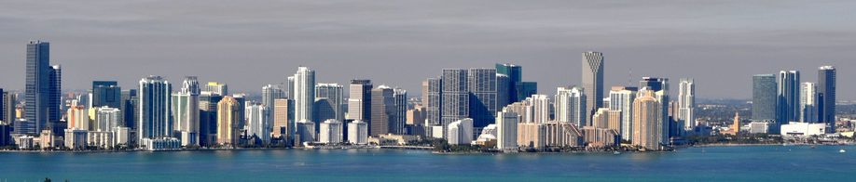
DOWNTOWN MIAMI 2004 - 2010

Slide 4
WHY MIAMI 21?
Planning not just zoning – a planning guide, more than a regulation
Outdated zoning code - unpredictable, segregated uses, auto-oriented
Protect neighborhoods – preservation of character, appropriate transitions,
predictable height
Vibrant commercial streets – encourage economic development, focus for neighborhoods
Predictable future for the City – emphasis on public realm, pedestrian friendly, public benefits, sustainability
Notes:
AIA_Miami21_100611

Slide 5
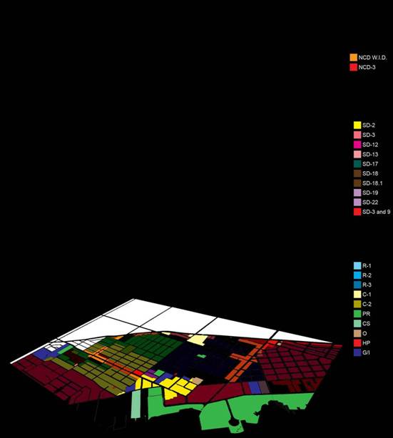
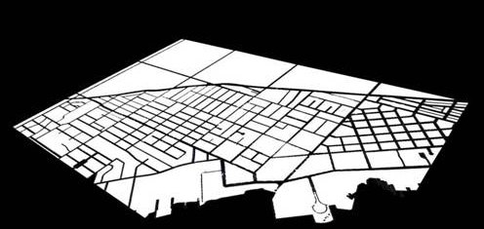
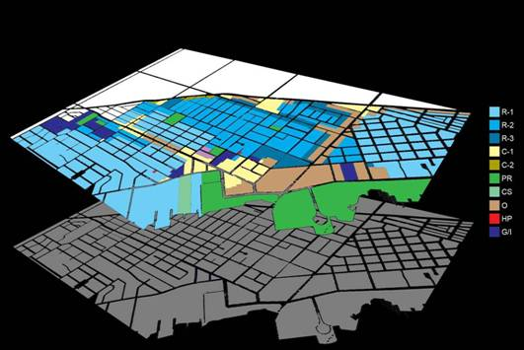
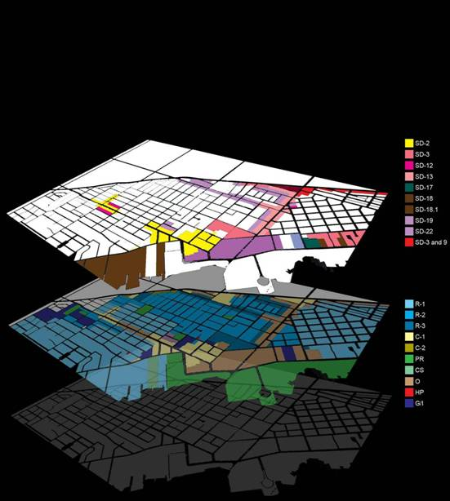
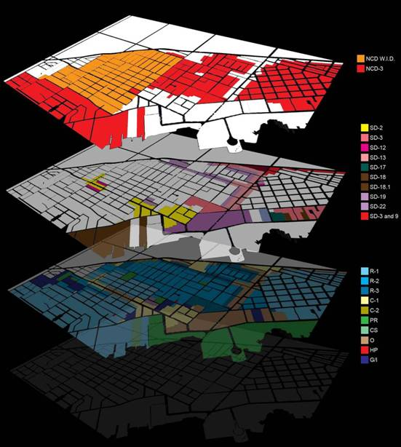
COMPLEXITY OF EXISTING ZONING
Notes:
AIA_Miami21_100611
5

Slide 6
SMART GROWTH PRINCIPLES
Compact urbanism
Transit oriented
Mixed-use neighborhood centers
Sense of community
Green building
Open space preservation
Form based codes
Notes:
AIA_Miami21_100611
6

Slide 7
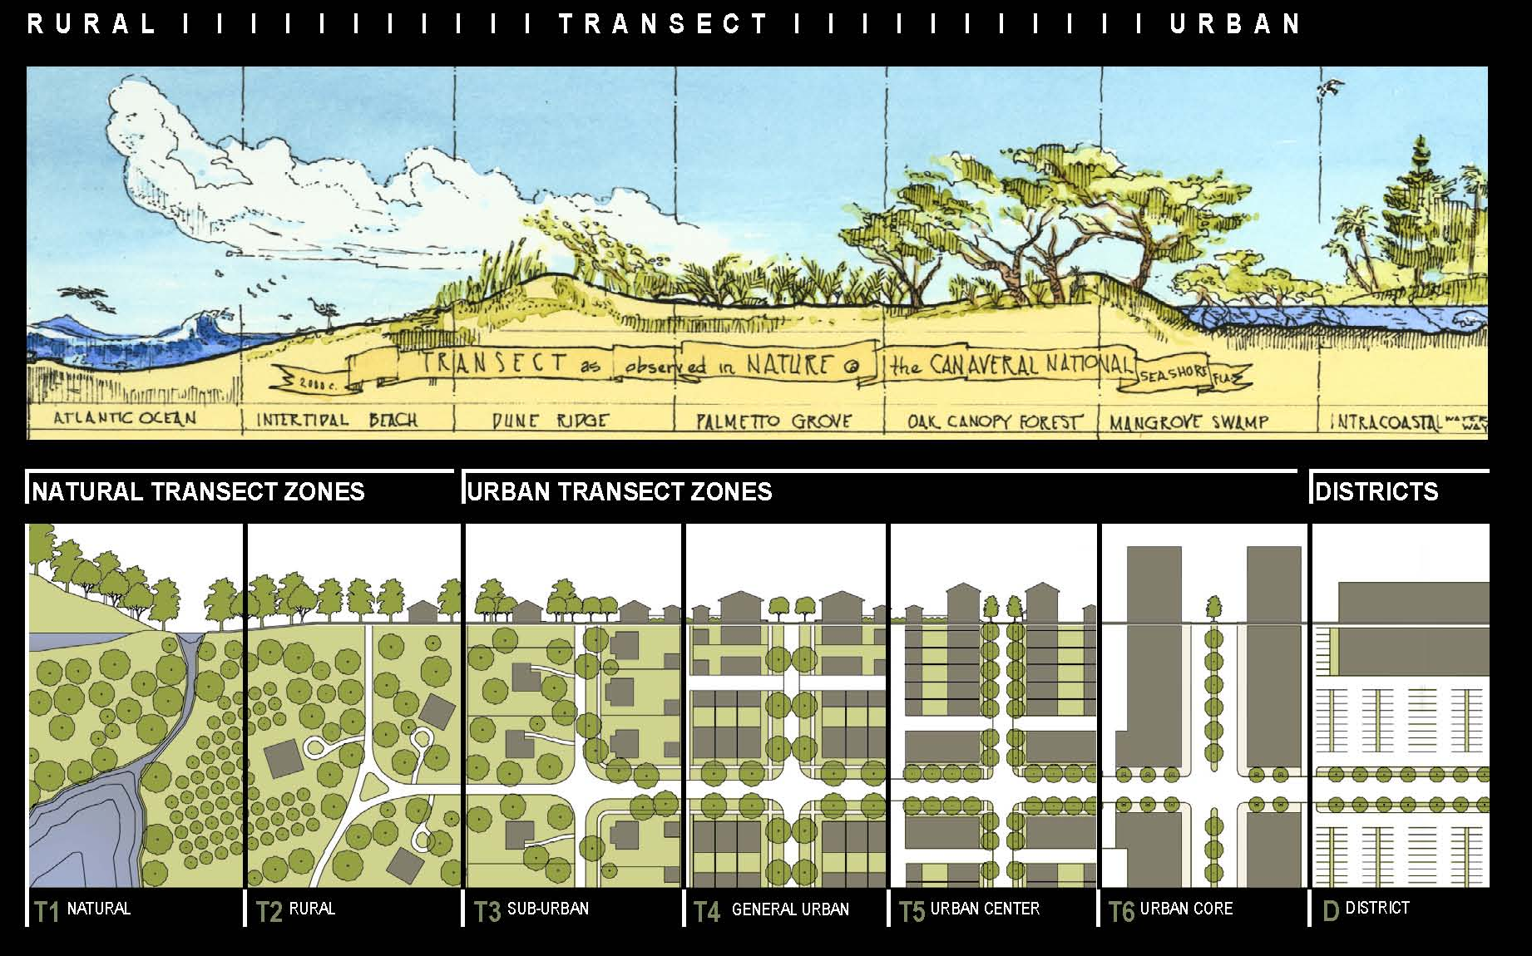
MIAMI 21 VISION STRUCTURE
City of neighborhoods and corridors
Form-based code to produce quality public realm
Rural to urban transect structures diversity of character and appropriate transitions in density
Notes:
AIA_Miami21_100611

Slide 8
Conservation and Development
(finishing school for the older adolescent)

Slide 9
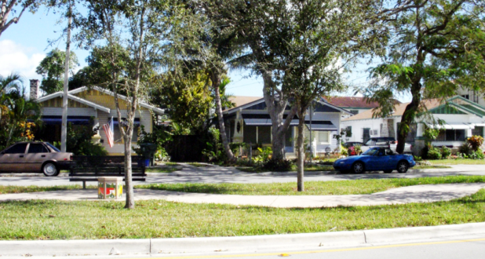
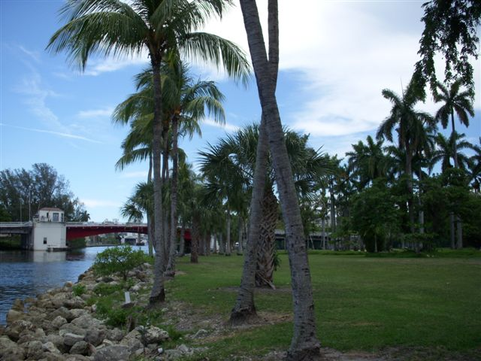
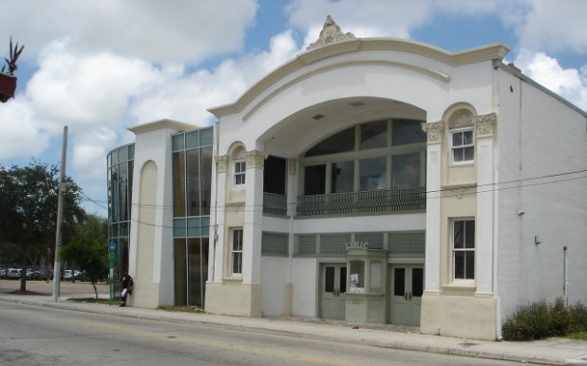
MIAMI 21: CONSERVATION
Preserve Neighborhoods
Parks and Natural Environment
Historic Preservation
Notes:
AIA_Miami21_100611
9

Slide 10
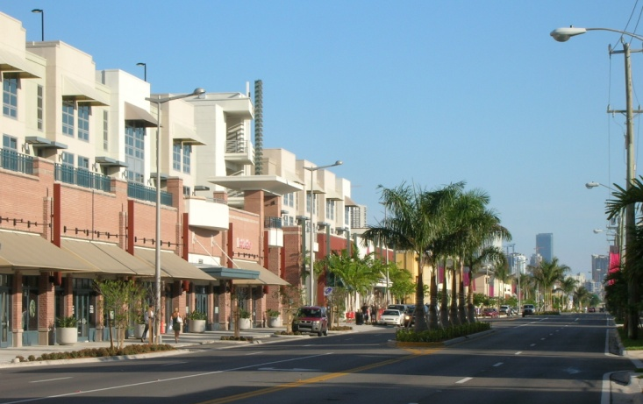
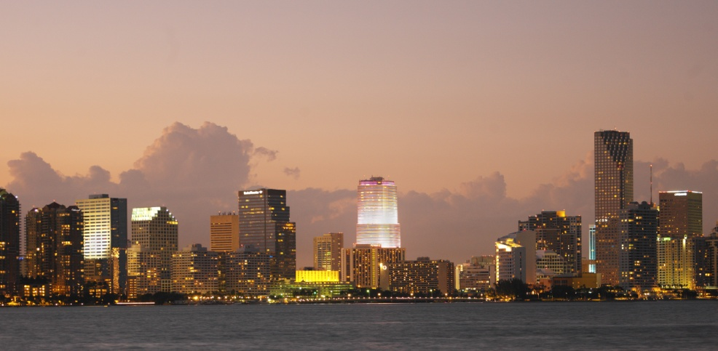
MIAMI 21: DEVELOPMENT
● Corridors as neighborhood centers
● Downtown as focus for region’s economy and culture
Notes:
AIA_Miami21_100611
10

Slide 11
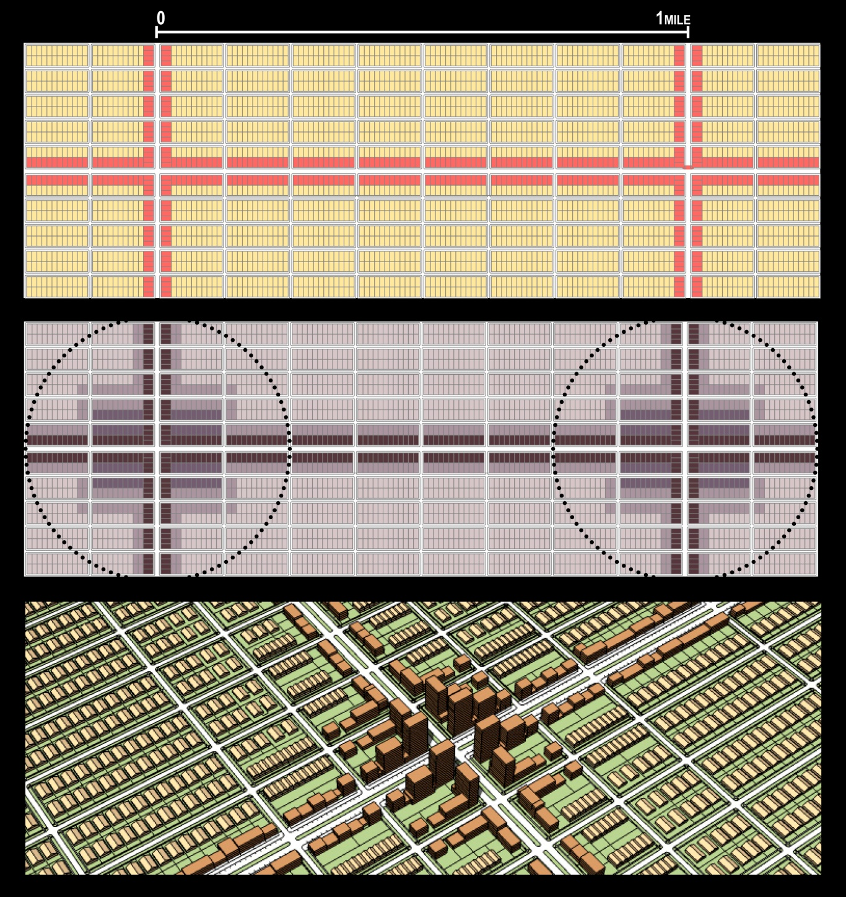
TRANSFORMING COMMERCIAL CORRIDORS TO TRANSIT-ORIENTED NODES OF DENSITY
Notes:
AIA_Miami21_100611
11

Slide 12
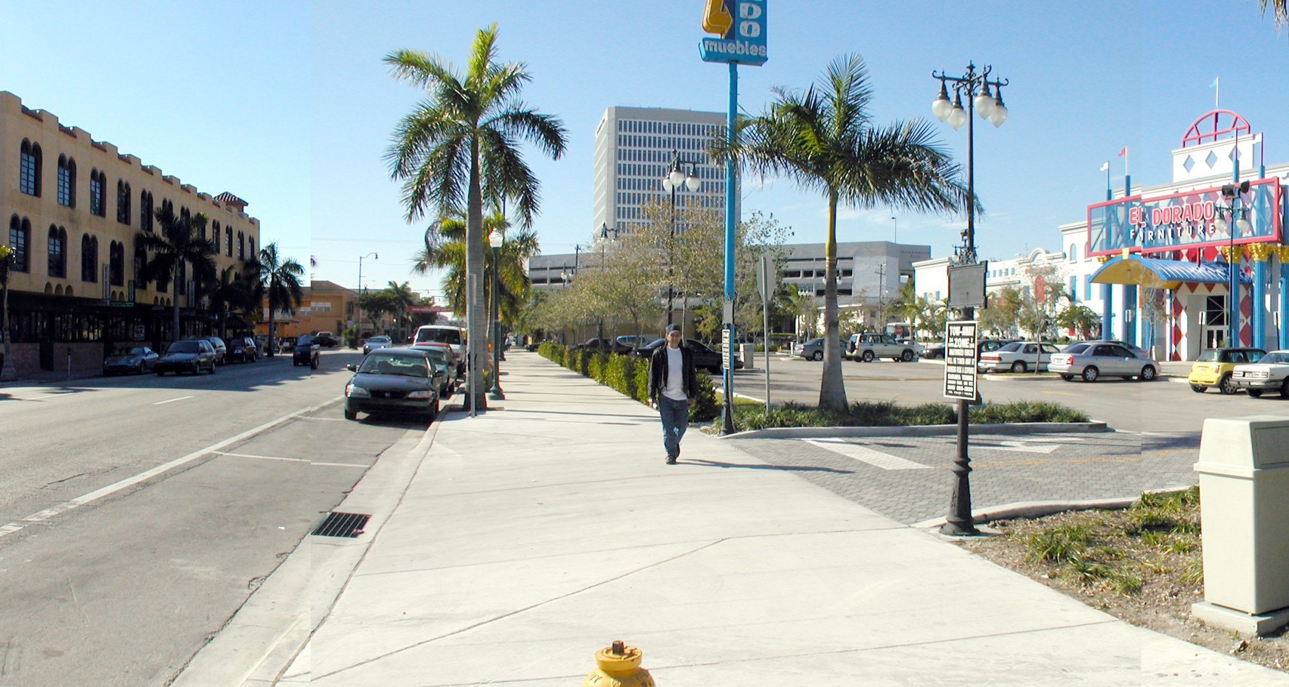
FORM BASED CODE
Notes:
AIA_Miami21_100611
12

Slide 13
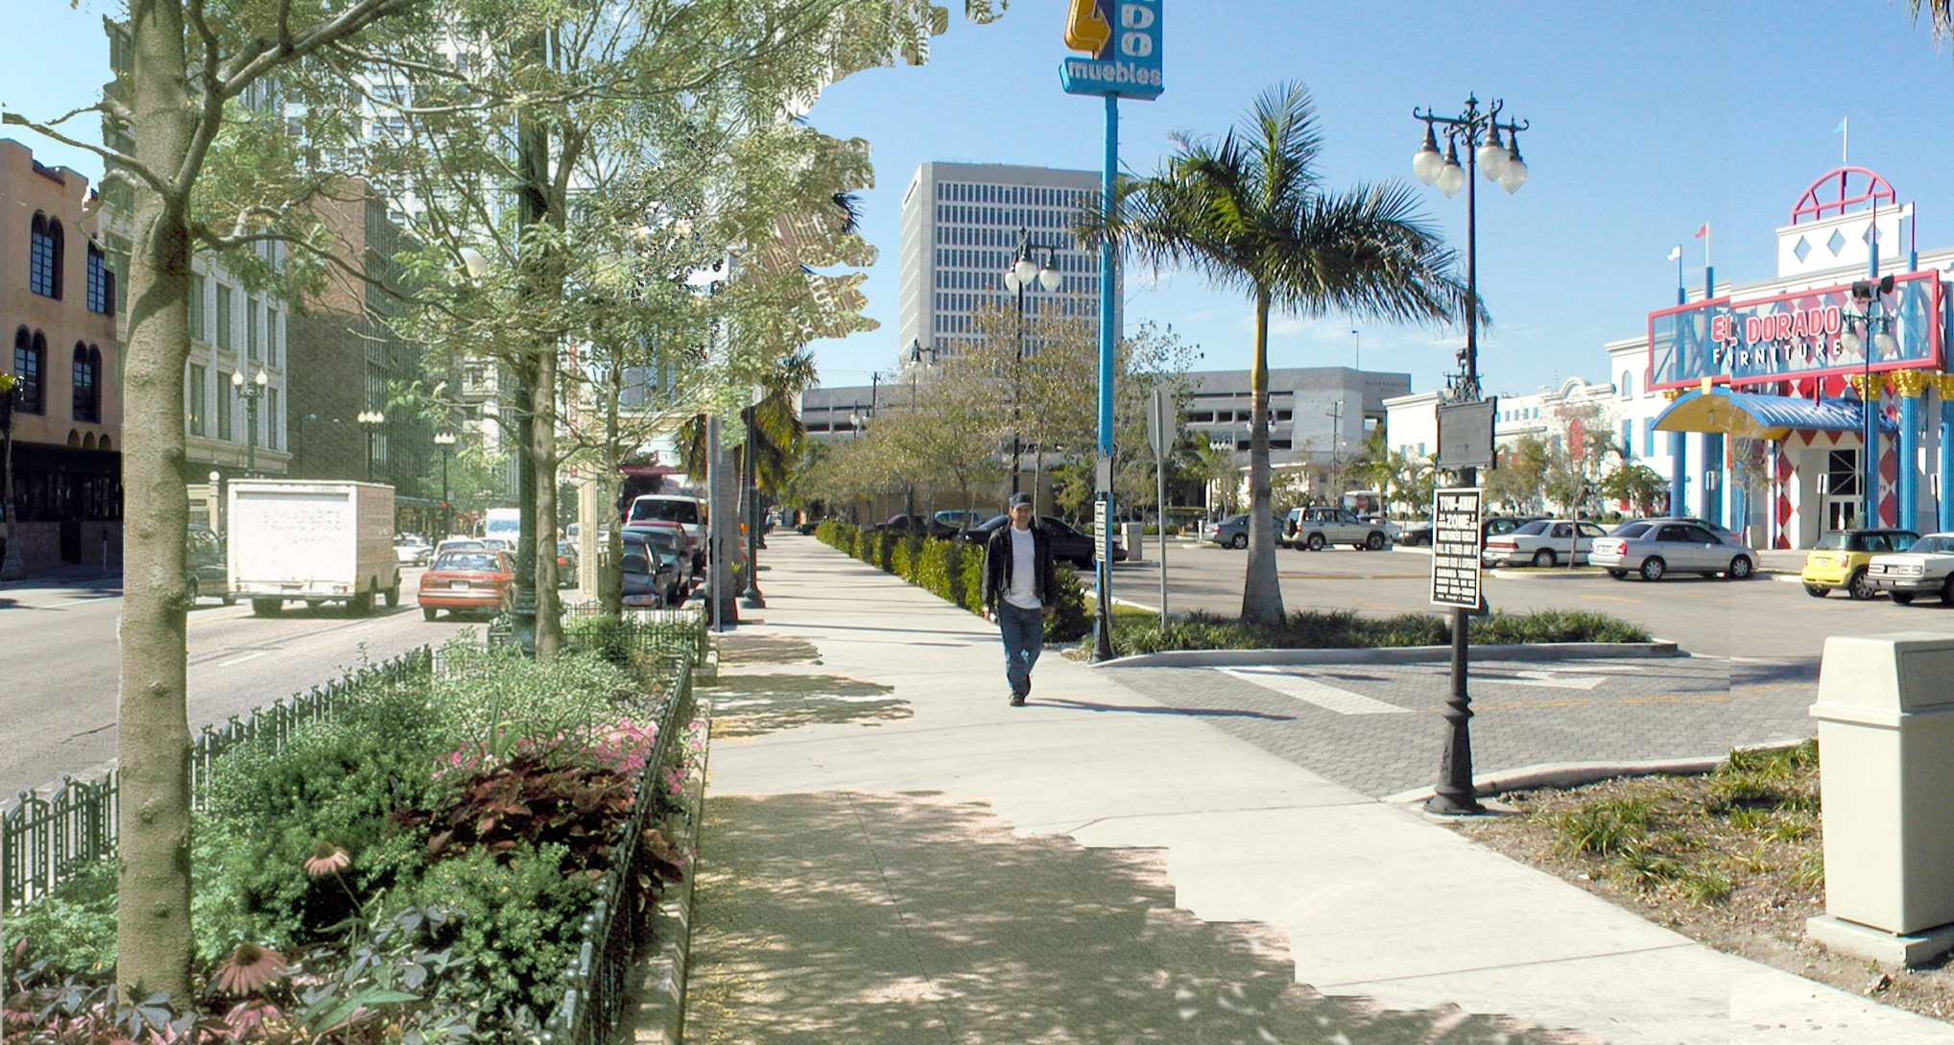
FORM BASED CODE
Notes:
AIA_Miami21_100611
13

Slide 14
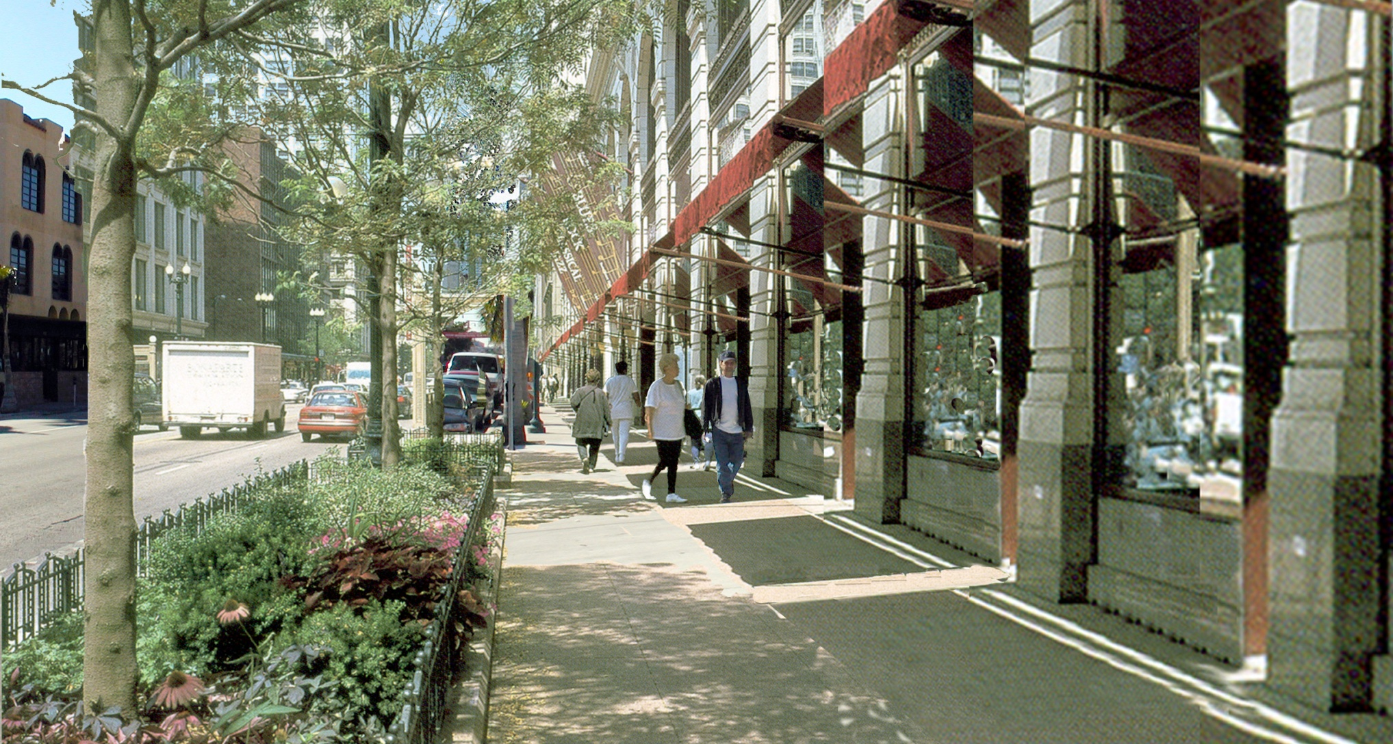
FORM BASED CODE
Notes:
AIA_Miami21_100611
14

Slide 15
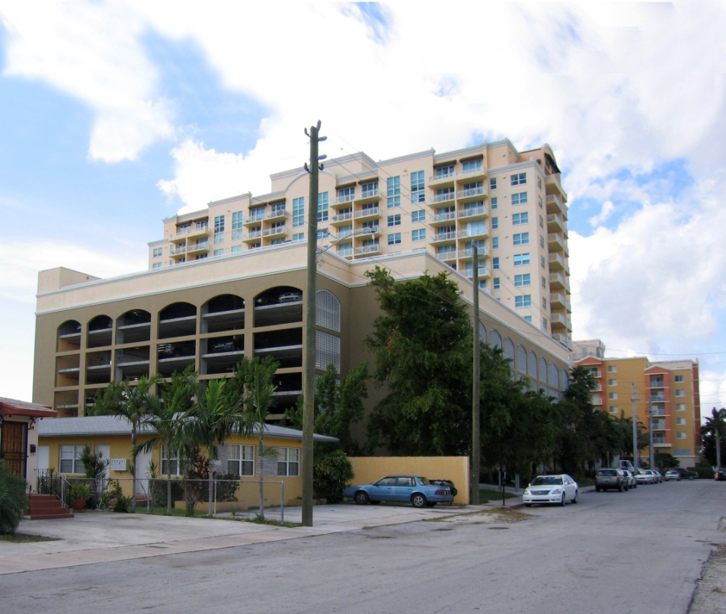
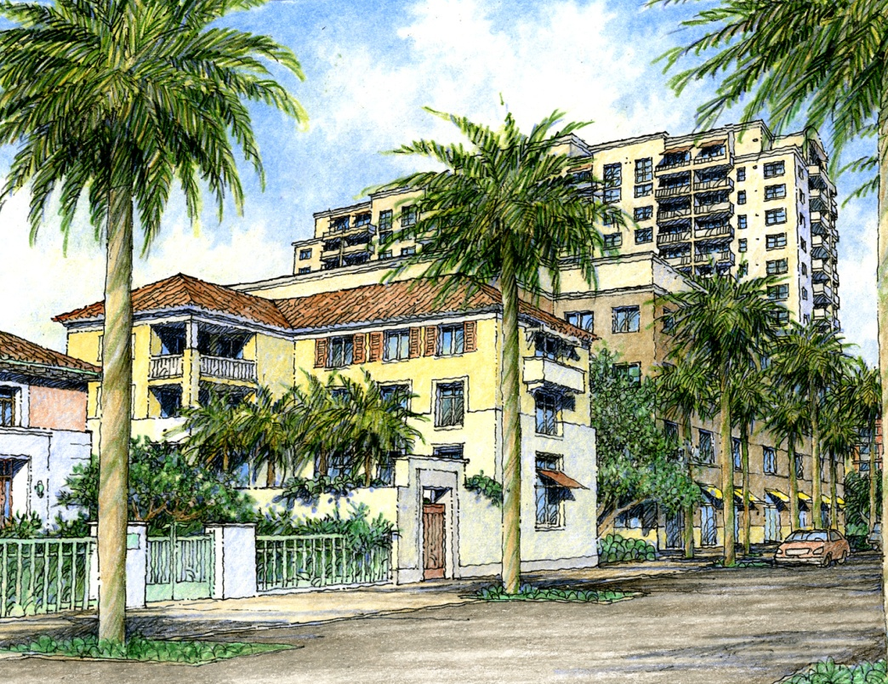
PEDESTRIAN FRIENDLY FRONTAGES
Existing Condition
Transition Illustration
Notes:
AIA_Miami21_100611
15

Slide 16
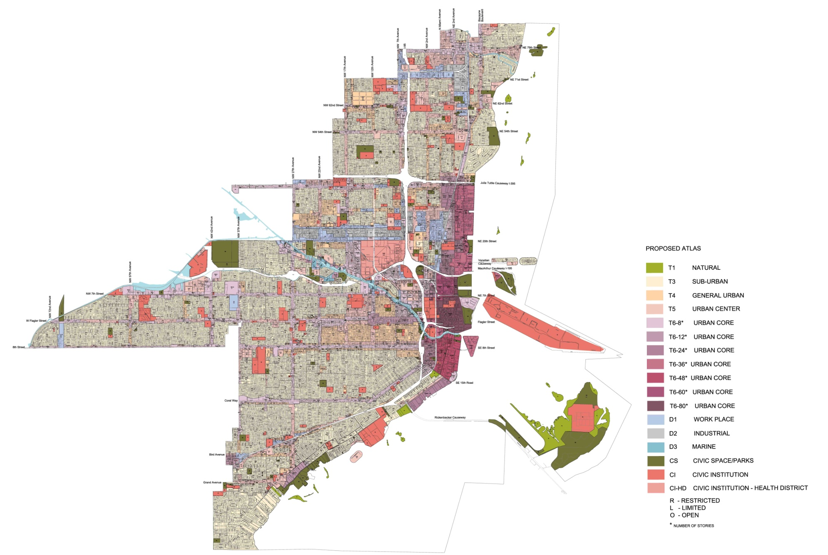
ZONING ATLAS
Notes:
AIA_Miami21_100611

Slide 17
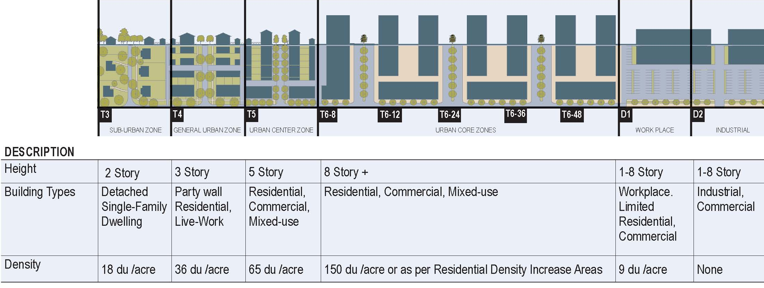
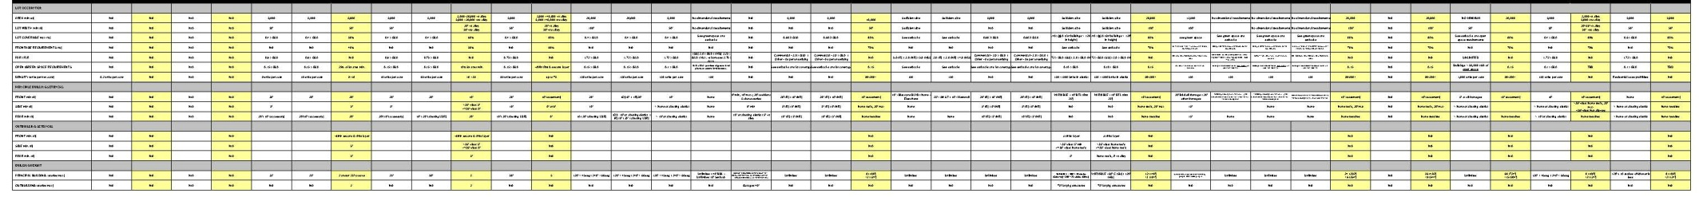
SUMMARY OF TRANSECT ZONES & CONVERSON
Notes:
AIA_Miami21_100611
17

Slide 18
SMARTCODE TAILORED FOR MIAMI
T3 improvement of former R-1
T4 & T5 – new transitional types
T6 – multiple high-rise types
D – industrial live/work, work-live
FLR (remnant of FAR)
Parking reductions: TODs & adaptive re-use
Benefits – TDR et al
Special Area plans
Supplementary Regs – hard fought history
Table 12 – old design review criteria for public hearings
Procedures – additional public involvement
Notes:
AIA_Miami21_100611

Slide 19
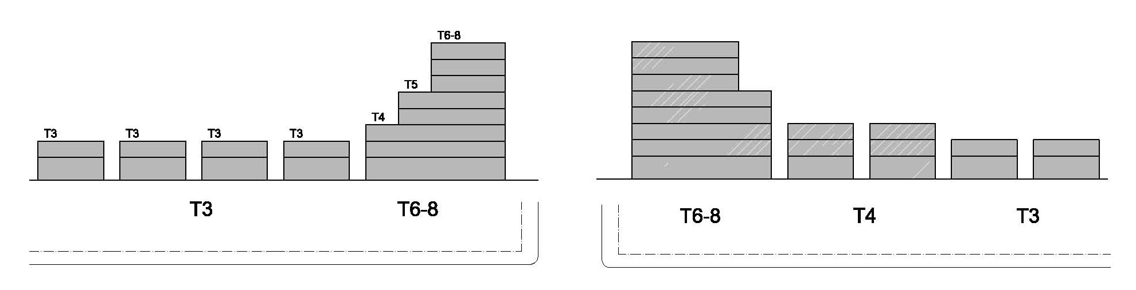
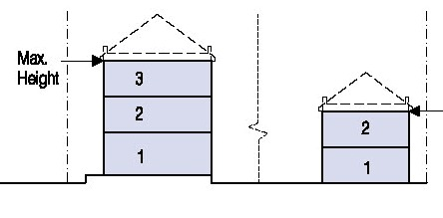
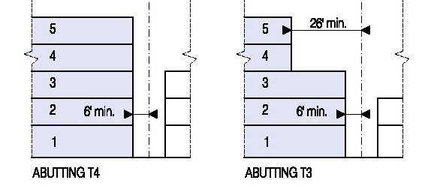
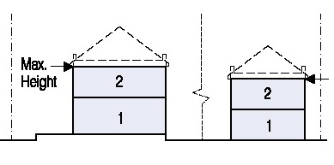
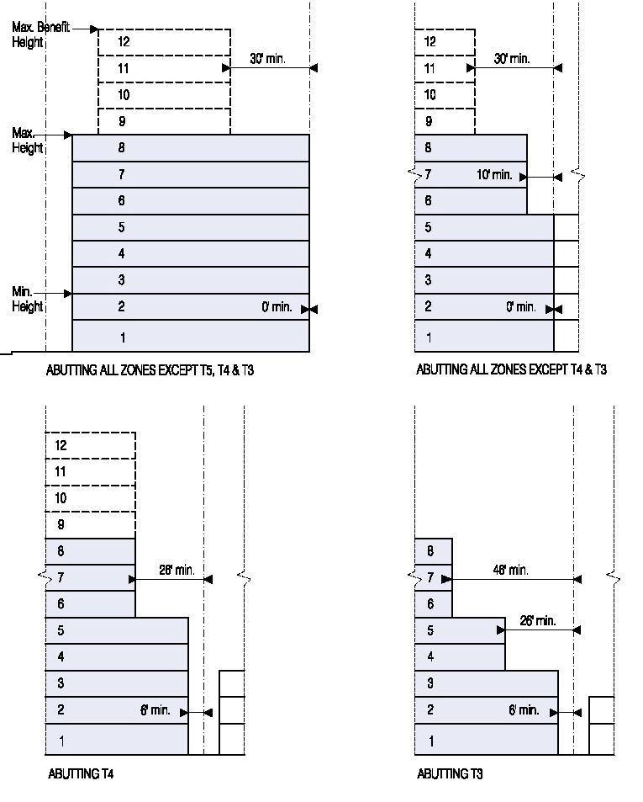
TRANSITIONS ACROSS THE TRANSECT
T3 T4 T5
Net lot area
+ half of R.O.W
+ 90’ on the water
Net lot area
+ half of R.O.W
+ 90’ on the water
+ GLA from adjacent property
Net lot area
+ half of R.O.W
+ 90’ on the water
+ GLA from adjacent property
+ PUD Bonus
T6
Notes:
AIA_Miami21_100611
19

Slide 20
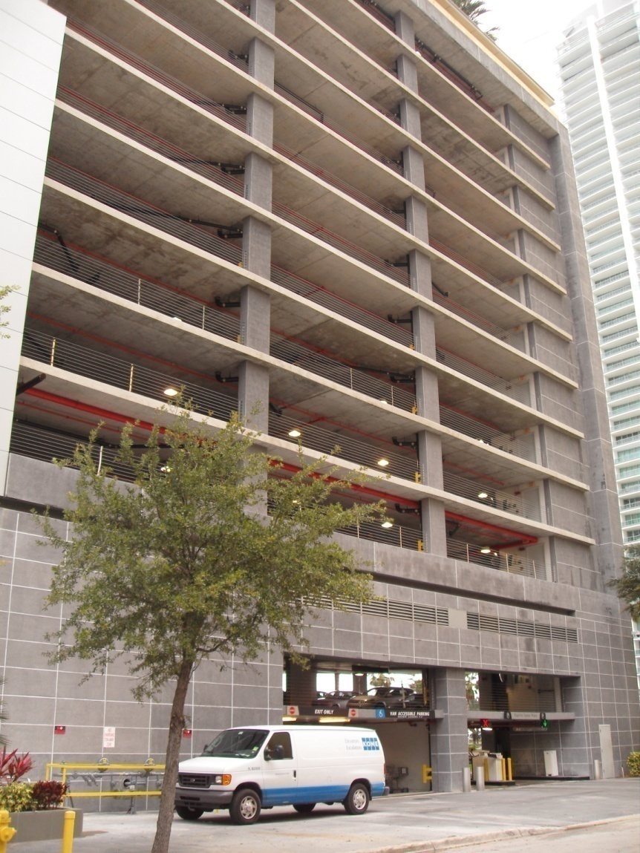
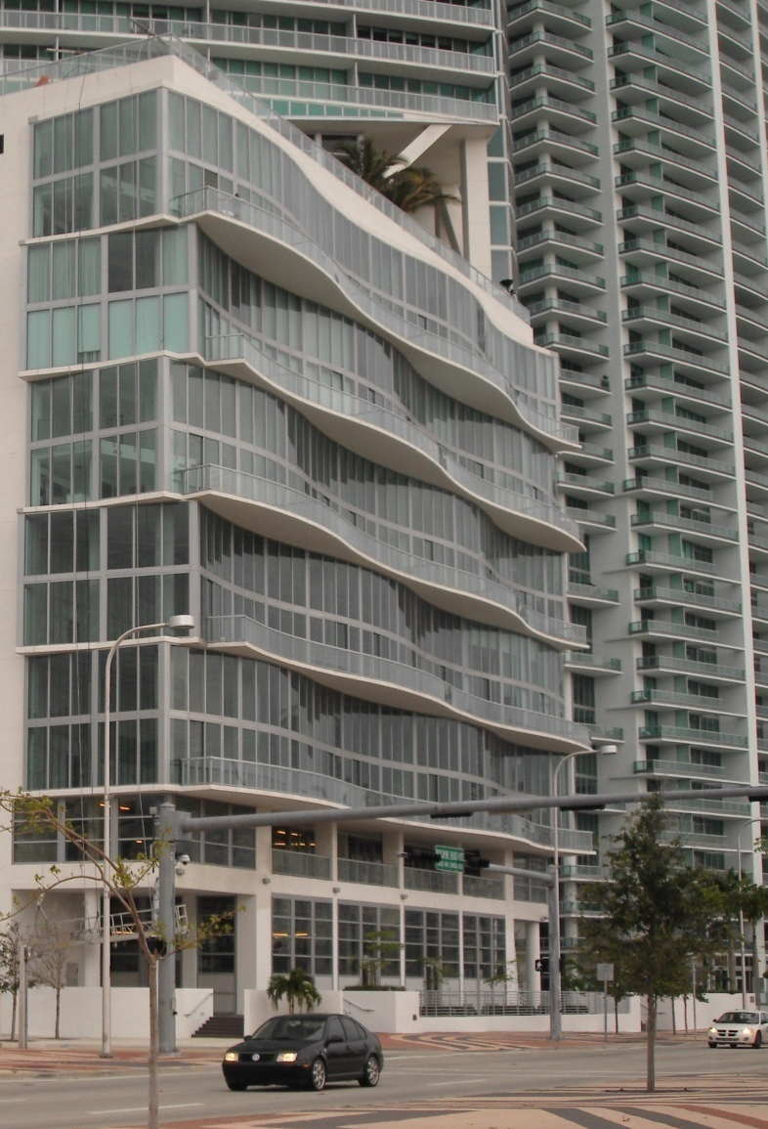
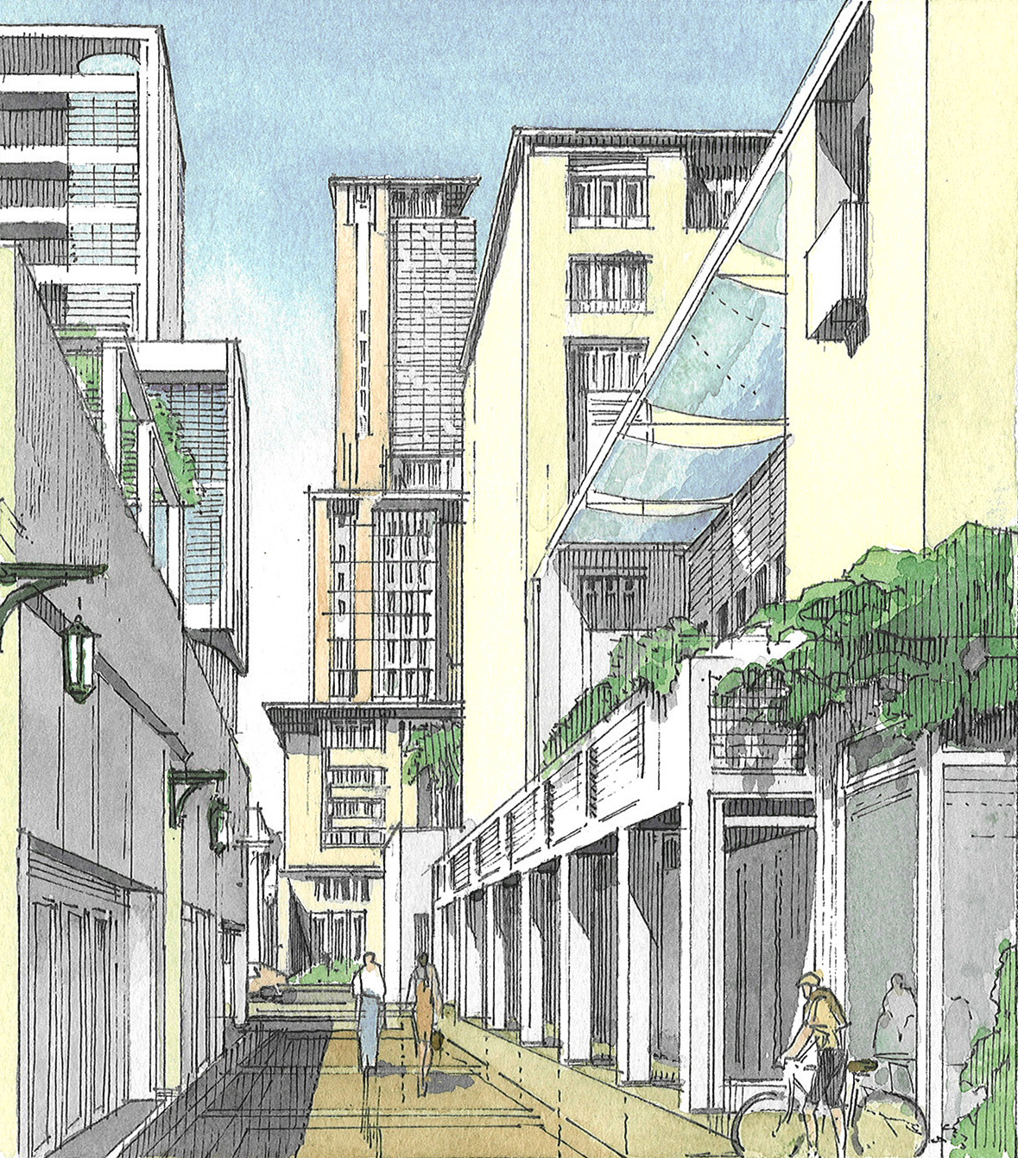
PUBLIC REALM IMPROVEMENTS THROUGH PRIVATE PROPERTY REQUIREMENTS
Notes:
AIA_Miami21_100611
Blank wall instead
20

Slide 21
PUBLIC BENEFITS
Growing infrastructure needs greater than City’s capacity to provide them:
  Affordable/ Workforce housing to support jobs base
  Waterfront access and parks to support growing residential base
  Historic preservation of buildings and sites to support unique character and touristic value
  Green Building
  Brownfield redevelopment
  Civic / Civil Support spaces
Notes:
AIA_Miami21_100611
21

Slide 22
SPECIAL AREA PLANS
Site area must be 9 acres minimum
Requires a detailed master plan with specific guidelines
Allows flexibility within transect regulations
Provides public benefits
Requires a public hearing
Design District, Brickell City Center
(Design District, Brickell City Center, Allapattah)
Notes:
AIA_Miami21_100611
22

Slide 23
MIAMI 21
Successes:
Outbuildings
McMansion reduction
Less pavement
Liners
Height in stories
Urban sidewalks
Less parking for TOD & re-use
Pedestrian passages reduce block size
Predictable volume
Some good downzoning
Historic preservation & TDRs
Failures:
Transect based street standards excluded
More public hearings
Too much upzoning
Some unnecessary downzoning
Long vesting
Non-conformities loosened
Not enough parking reduction
Housing benefits unknown
Frontage designs not upheld
Floor plate restriction too lenient
Lewis Stroud & Deutsch, PL
Notes:
AIA_Miami21_100611

Slide 24
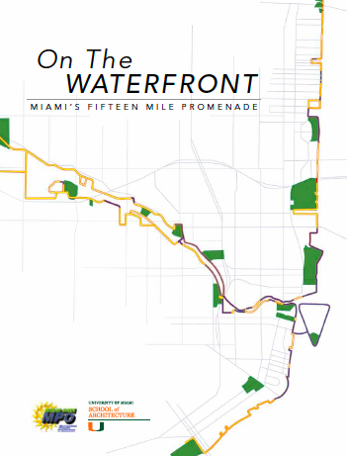
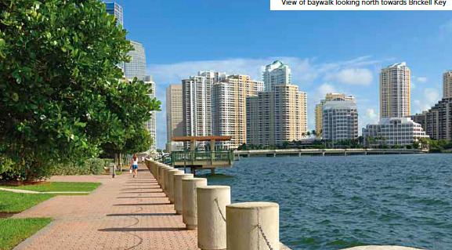
MIAMI 21 - A WALKABLE CITY

