Slide 1
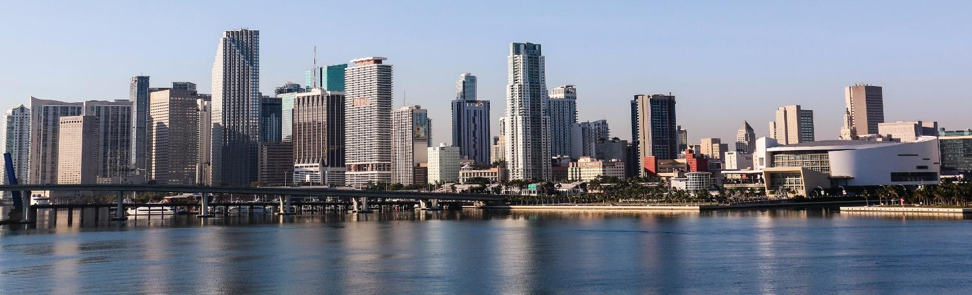
The Ebb and Flow of Miami 21 in Downtown

Slide 2
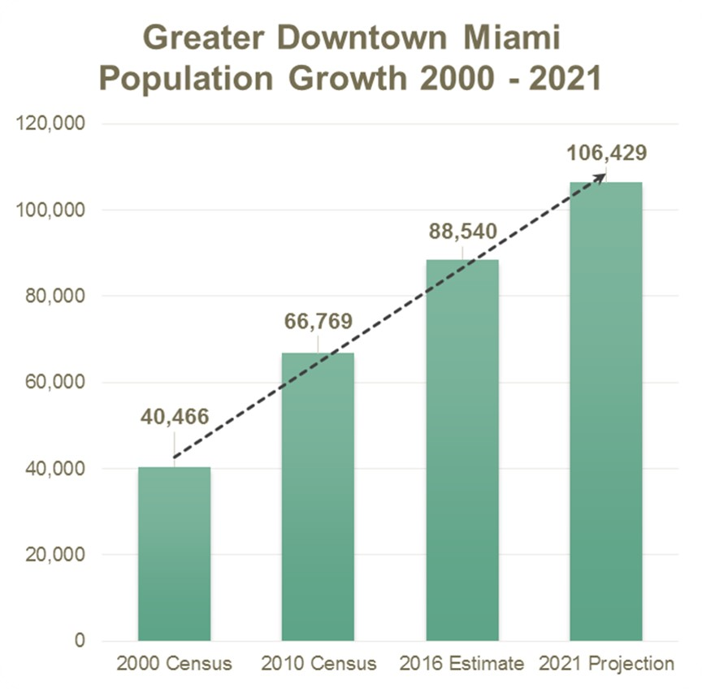
Growing Downtown Miami
Since 2009 Taxable Value Doubled: $9.8B - $19.8B
Biscayne Green demonstrated that the Downtown Miami community desires community spaces for families, children, and dogs. Our play area featured a safe and fun imagination playground made out of recycled and non-standard materials recreating outdoor experiences. With over 11,000 households with dogs in Downtown and no dog parks within walking distance, the dog park was widely praised and we even featured a ‘puppy brunch’, which proved to be a very successful event.

Slide 3
Downtown Miami:
The Magic City in Context
Florida is 3rd most populous US State at 21.3 M
Miami is the 7th largest US Metro at 6.2 M
#1 Happiest place to work (Forbes)
Greater Downtown is truly dense, urban, and tropical

Slide 4
250,000
college students in Miami today.

Slide 5
Miami ranks
for students per capita.
#7
Notes:
Students per capita

Slide 6
South Florida
Ranked #1
for startup creation

Slide 7
Dense and Connected: One Large TOD

Slide 8
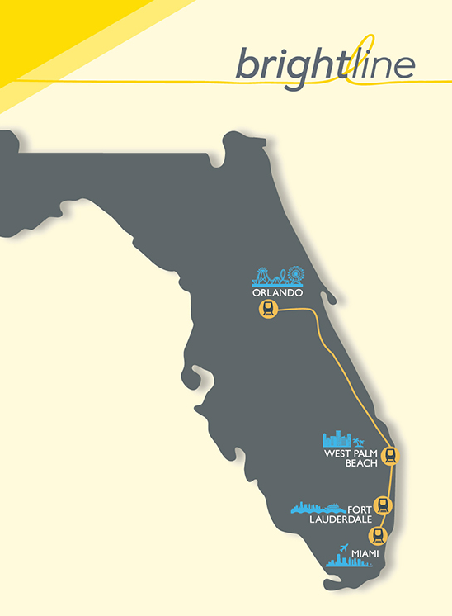
Brightline

Slide 9
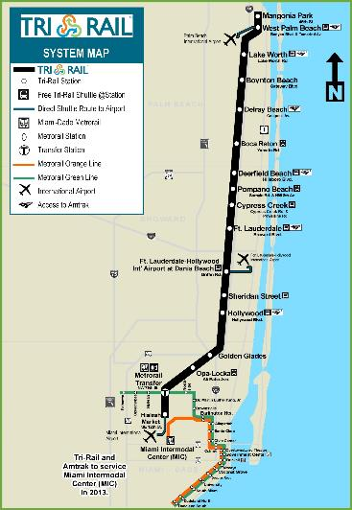
Tri-Rail
Delray
EC
..
lil l
Tri -Rail and Amtrak to service Miami lntermodal Center( MtC)
in 2013.

Slide 10
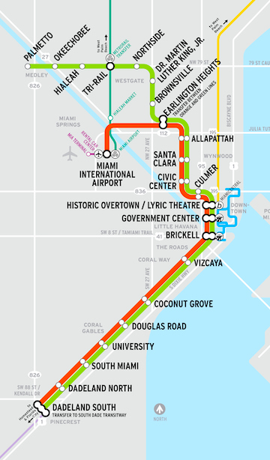
MetroRail
-
Palmetto Nll'thside
--..@ ^{Hia l•}® Tri-Rail^{®t,}•
® Dr. Marlin IJJ!her King Jr.
Okeechobee
0
Miami International Airport
Bricla!II
_{i} - G1<1., Lir1e (?almeHo to llllde llndS 01Jth)
i'I - O•Hae U111( 0edellnd Sou thl <> MIA)
S 3·M l!l.lj ·I!]
Cl•..• • OJTDO,I• •• ... .,
...... ._,.,_ GI •.
Qsi.m
® Stat.lanw hParklll!lFllciitin
Stat ioi,·d hOvuri9 hVl.ori9 •Tfflfl Pwkl'\t

Slide 11
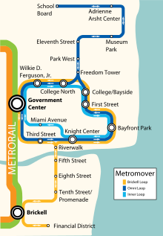
MetroMover
Park West
AMERICAN
AIRLINES ARENA
Freedom Tower
PORT OF MIAMI
BAYSIDE
MIAMI-DADE TRANSIT
Wllkle D.
Ferguson, Jr.
MARKETPLACE
Metromover
College/Bayside
Government
System DOWNTOWN
Center
First Street
BAYFRONT
Miami Avenue
Knight Center
PARK
Bayfront Park
- IMM£R
LOOP
OMH OP
BH.l[U LOOP
OMNINIOBll!tKHL
LOOPSOJMB NEO
Fifth
Street
-
JIO
Eighth
Street
-
-
- -- SJ,\JllN
BRICKELL
-- iW: :JH,t
-- • MCTIIJRAl

Slide 12
-.a- --
Free Trolleys
WATSON
ISi.AHO
PORTMIAM
0_{o} °""9'DM­IIf
Q M.a-nel\Wli
o M.'lrp,,t •
Q OMN SCllOII
o w--c-,..
_{o}o r..t
o ,.­
e, ..,..
a1-­
<_I> ...
G r iet SIMl
a,i ...wm1(tf(le
!111:ld lw 'o.

Slide 13
Autonomous Vehicle Development
Miami selected as first city in the US to deploy its team for large-scale testing

Slide 14
Miami-Dade Ranked
#1
in US for Emerging Tech Hubs

Slide 15
Miami-Dade
#2
in US for Tech Job Creation

Slide 16
Miami:
5th
best city for doing business
Notes:
U.S. Census

Slide 17
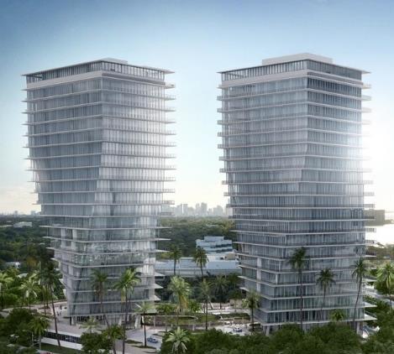
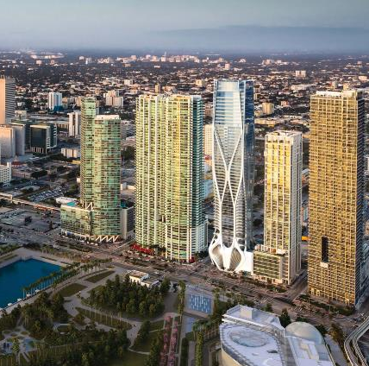
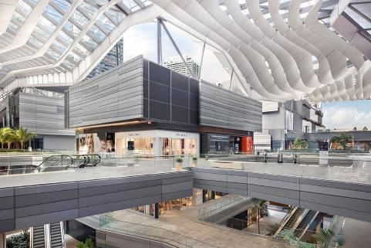
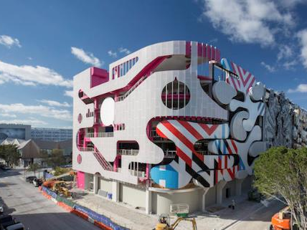
World’s Most Innovative Architects Recreating Miami Skyline

Slide 18
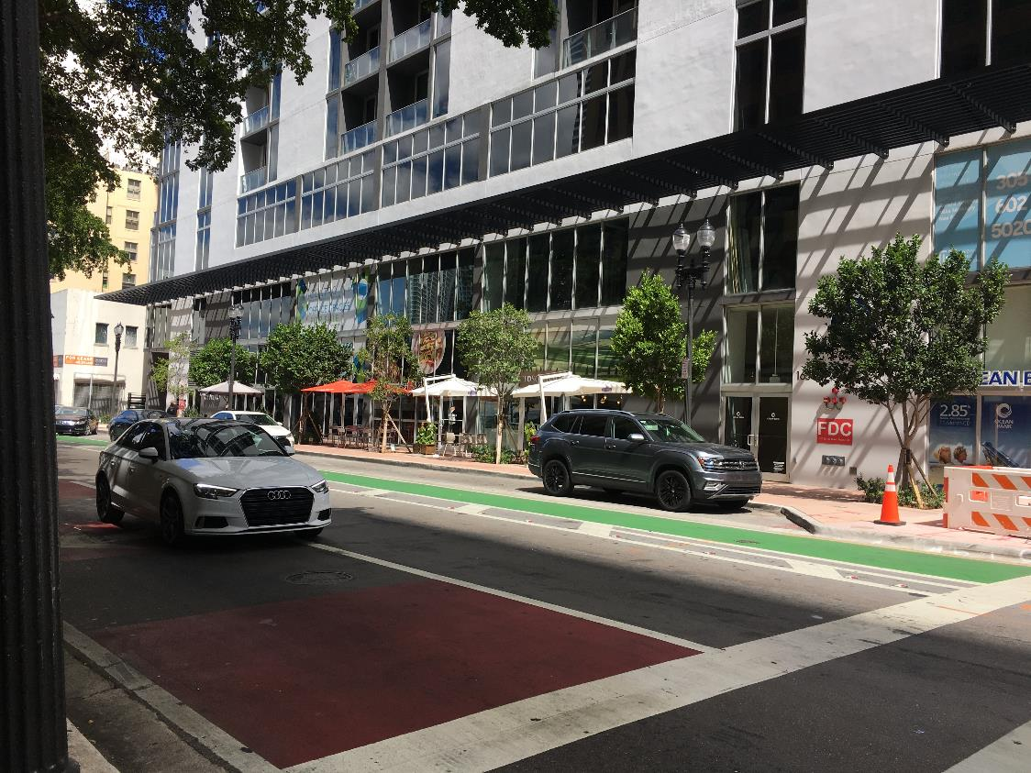
Creating Complete Streets

Slide 19
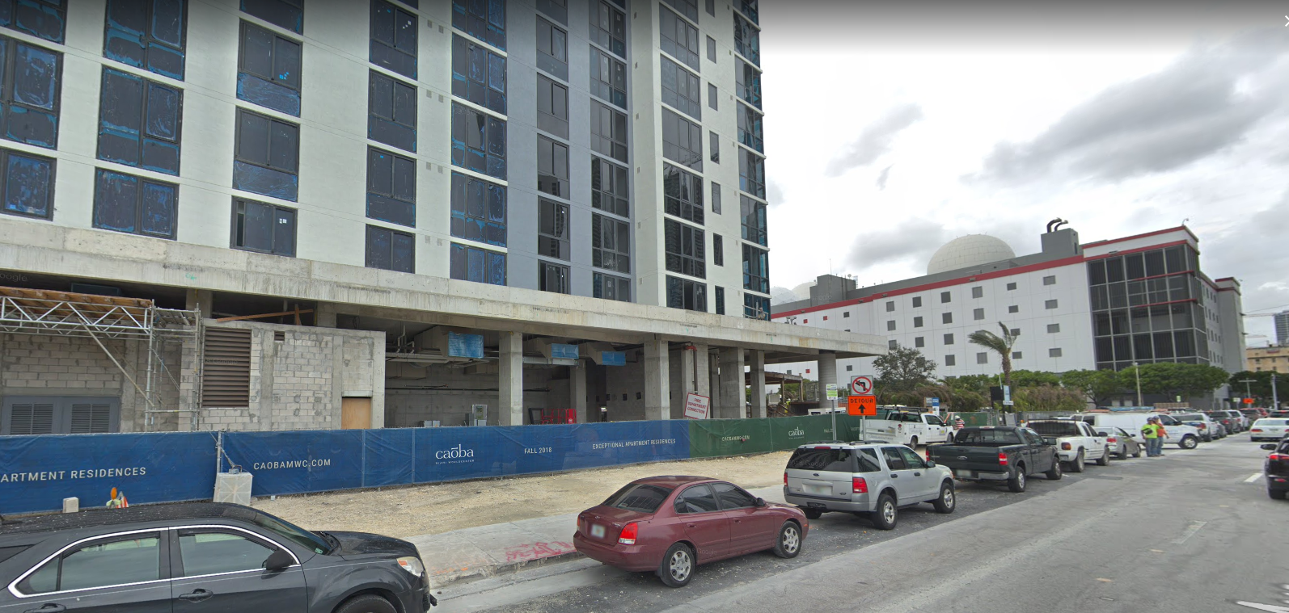
Wider Sidewalks

Slide 20
Wider Sidewalks

Slide 21
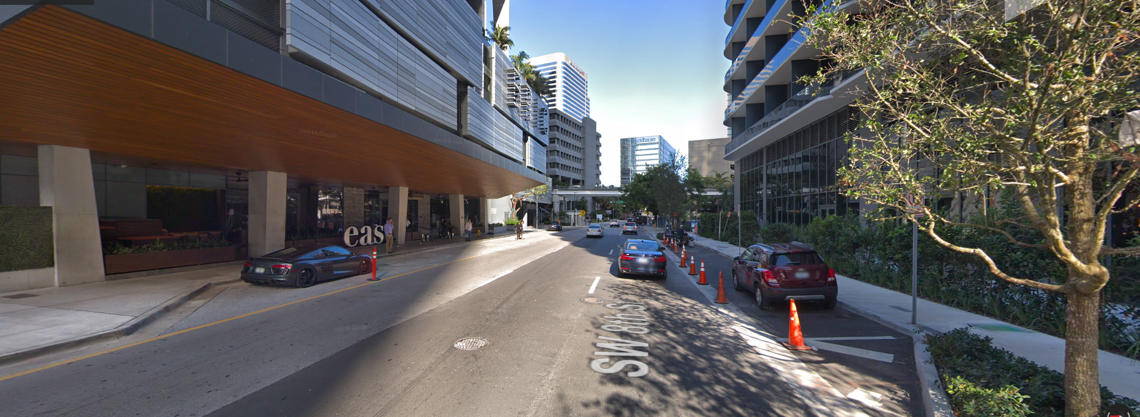
Wider Sidewalks?

Slide 22
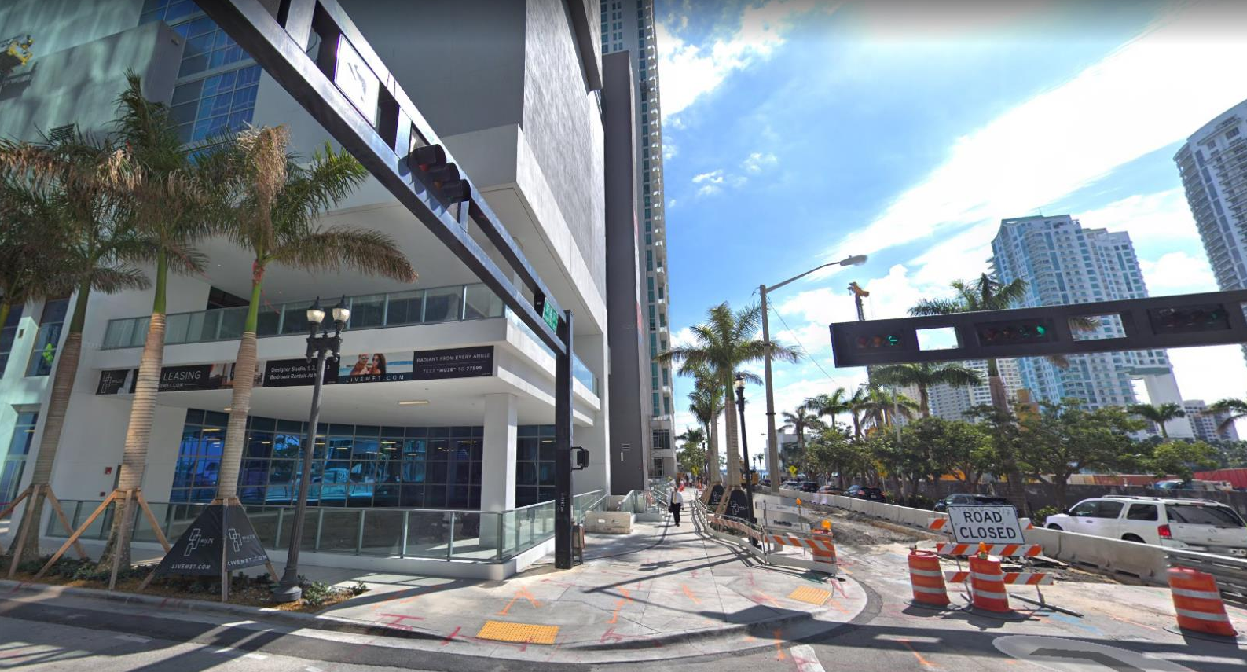
Wider Sidewalks

Slide 23
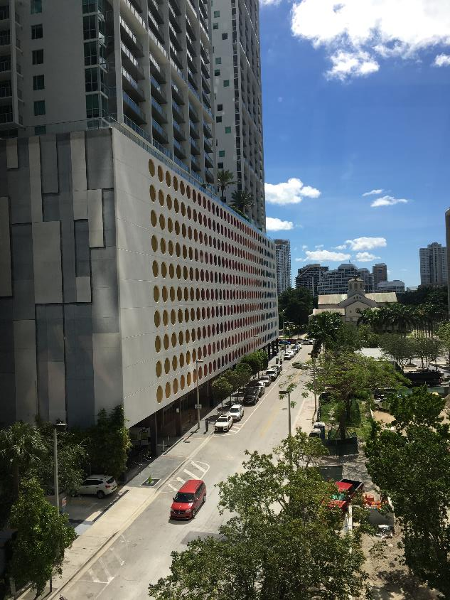
Why Waivers?

Slide 24
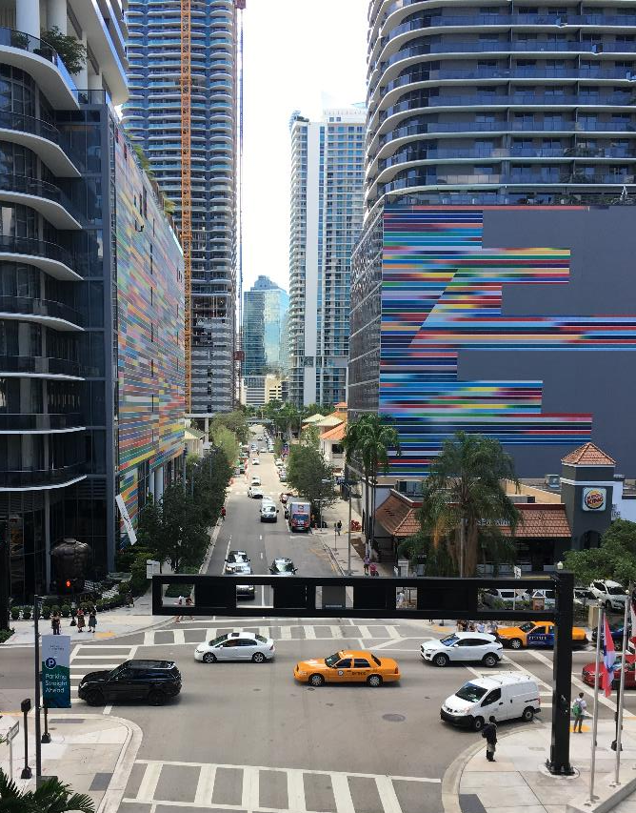
Why Waivers?

Slide 25
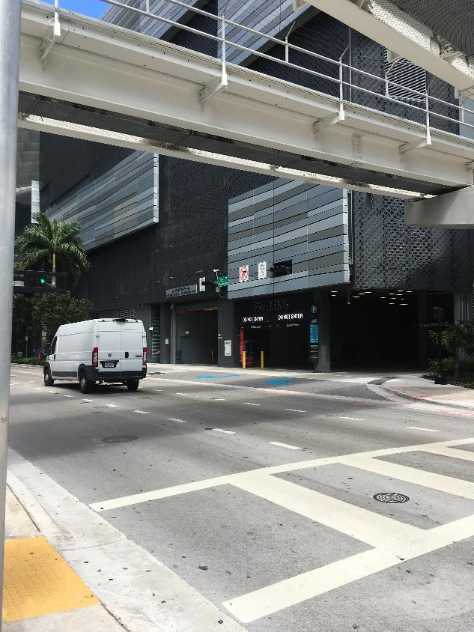
Back of the house =
poor street experience

Slide 26
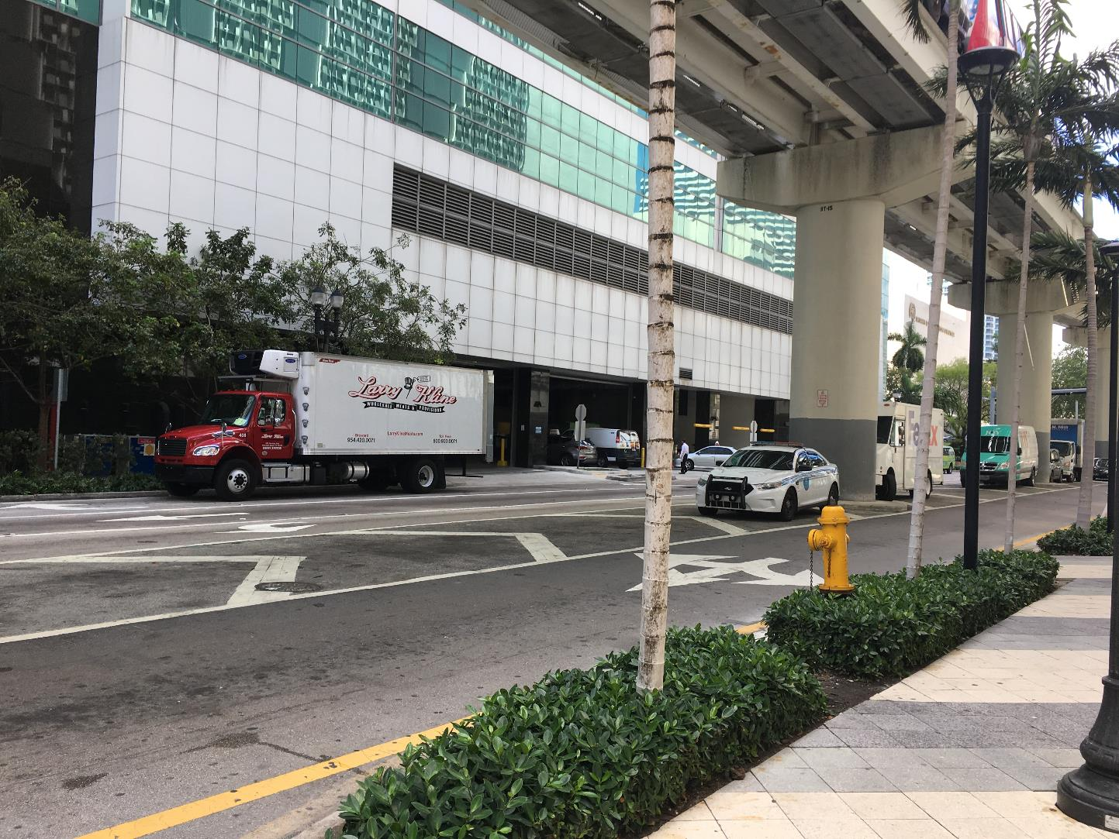

Slide 27
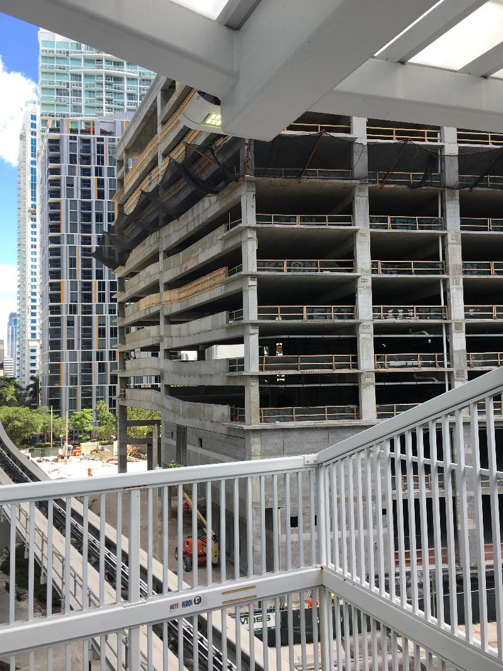
Accommodating cars can kill the street

Slide 28
Downtown: In search of green space

Slide 29
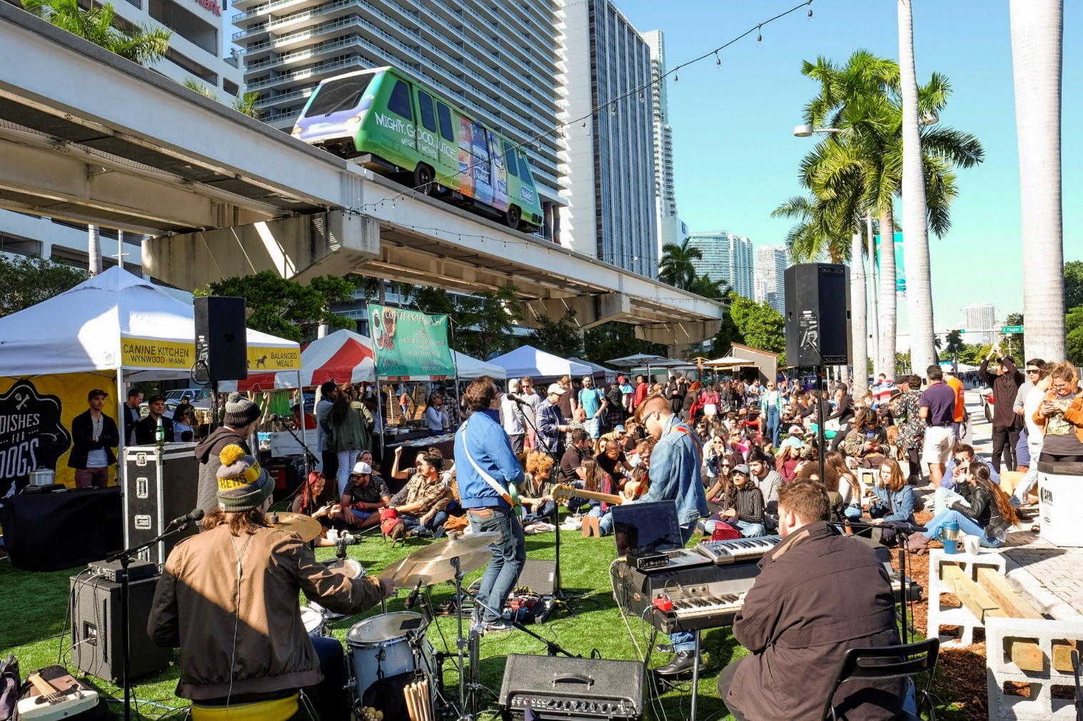
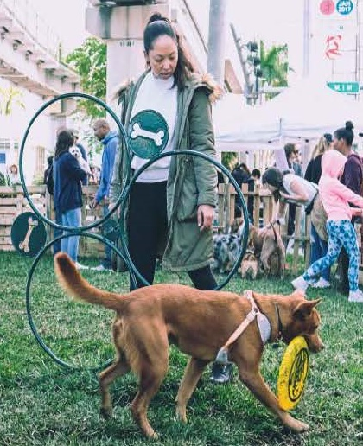
Looking To our Roads to Increase Green Space

Slide 30
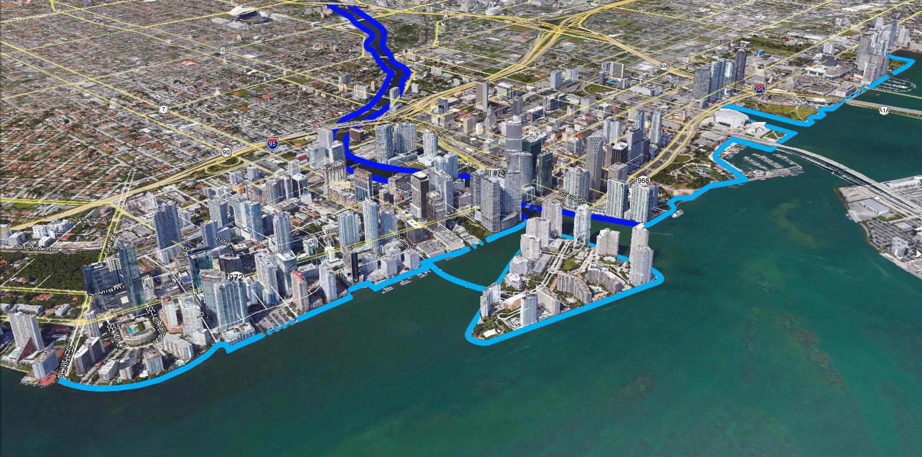
Miami Baywalk and Riverwalk
Sea Isle
Marina
PAMM
AAA
Museum Park
Bayside
Marketplace
Bayfront
Park
Brickell Park
4 Ambassadors
The Mark
On Brickell
Brickell Key
Jade Residences
Brickell
Bay Dr
Biscayne Bay
Baywalk
Riverwalk

Slide 31
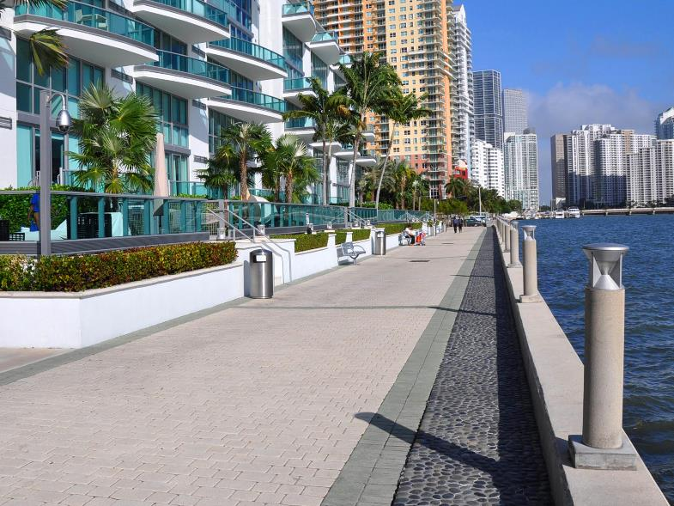
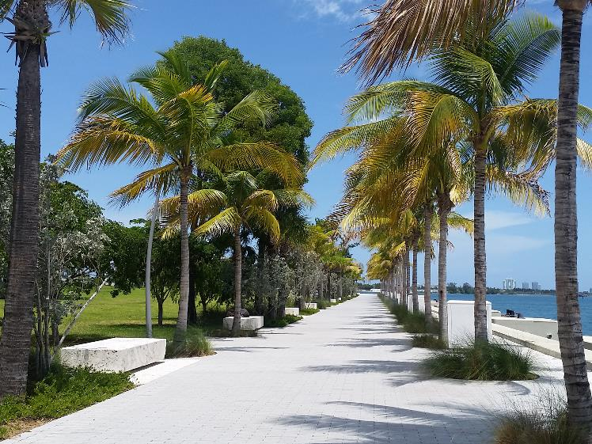
Miami Baywalk

Slide 32
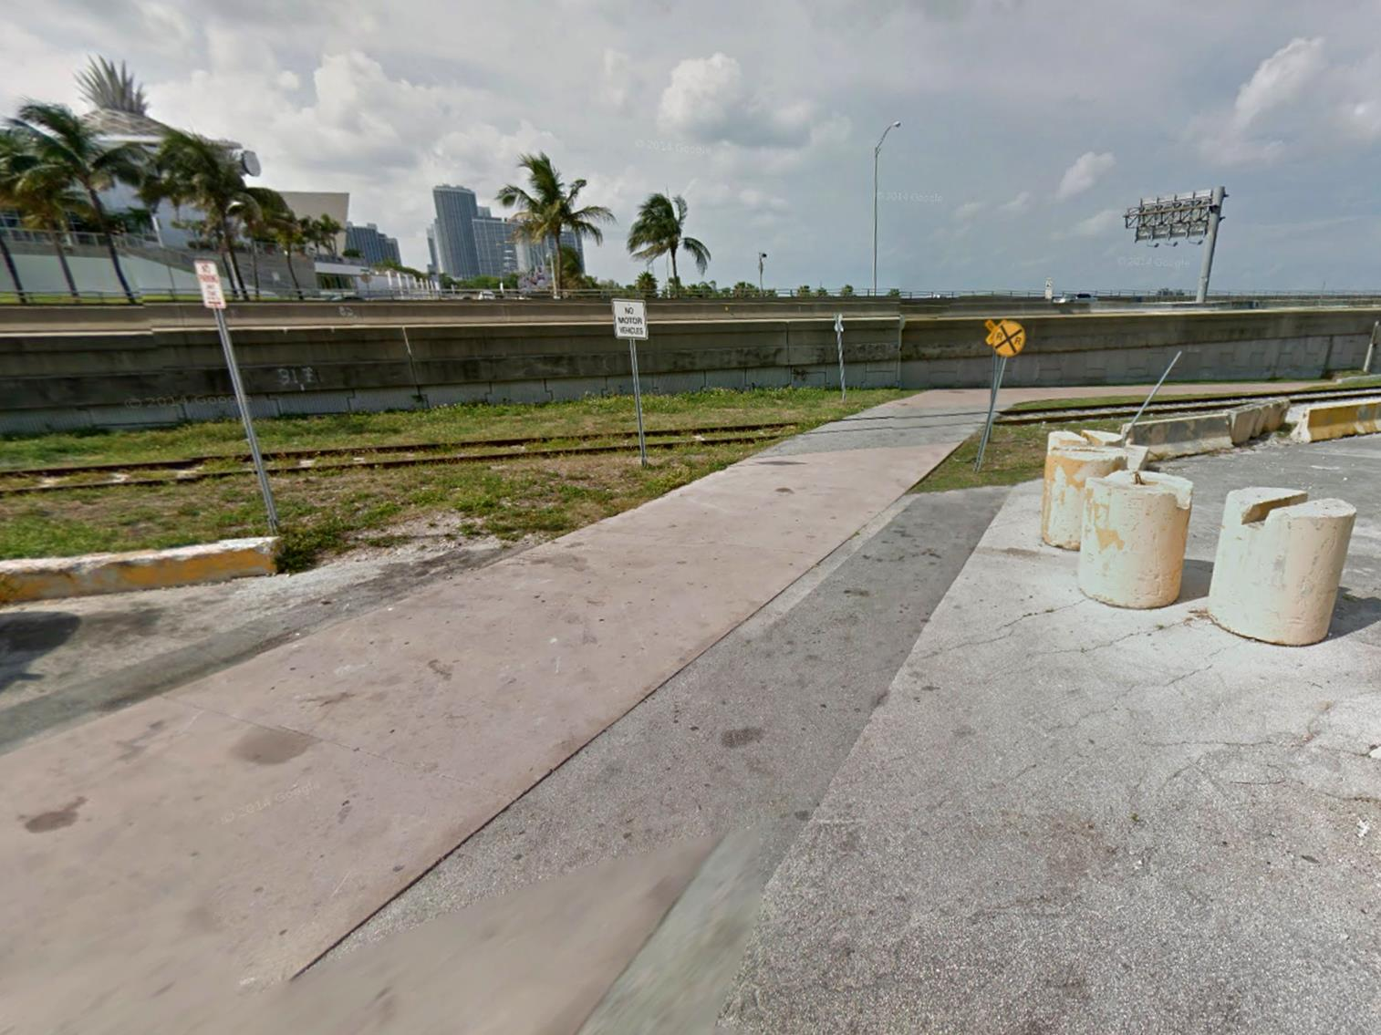
Miami Baywalk?

Slide 33
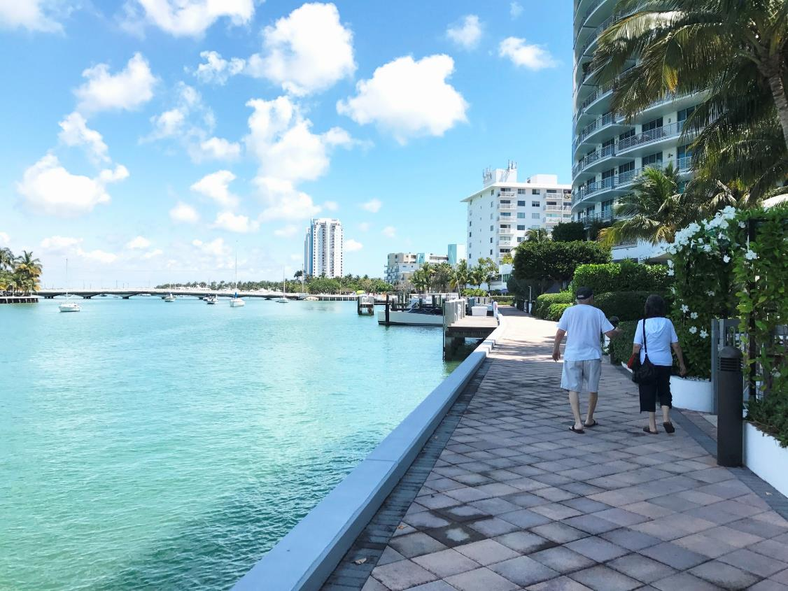
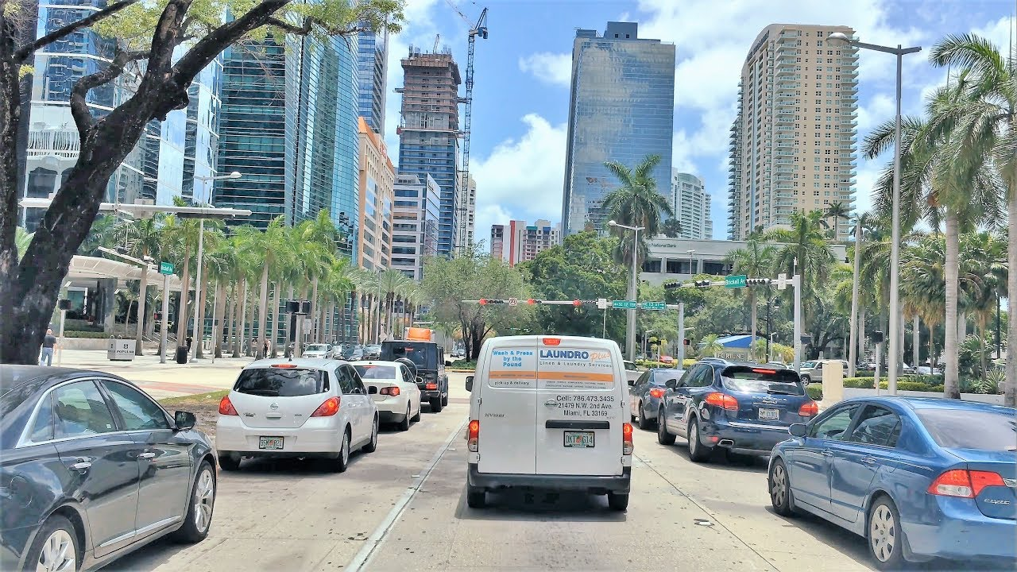
Factoring In Resilience
Raise Elevation of Perimeter Roads
Adapt Underground Utilities
Modify Stormwater Management Infrastructure
Slide Courtesy of Coastal Systems International
Notes:
**

Slide 34
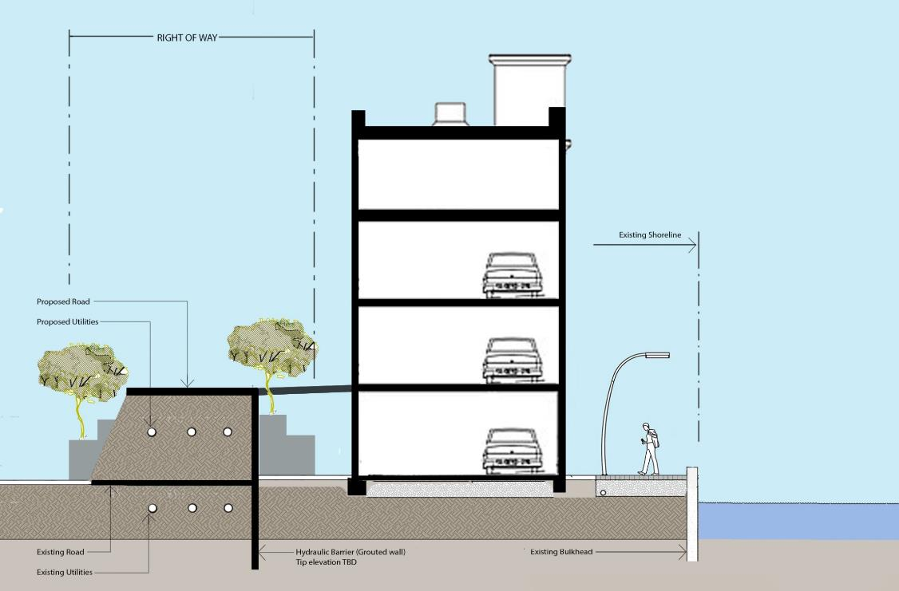
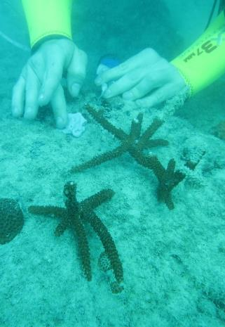
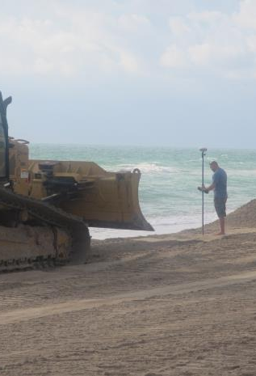
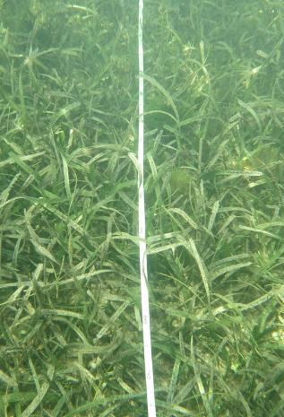
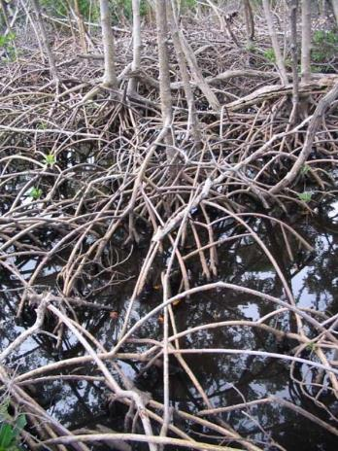
Raise Elevation of Perimeter Roads to Limit Flooding
Existing High-Rise
Existing Baywalk
Slide Courtesy of Coastal Systems International

Slide 35
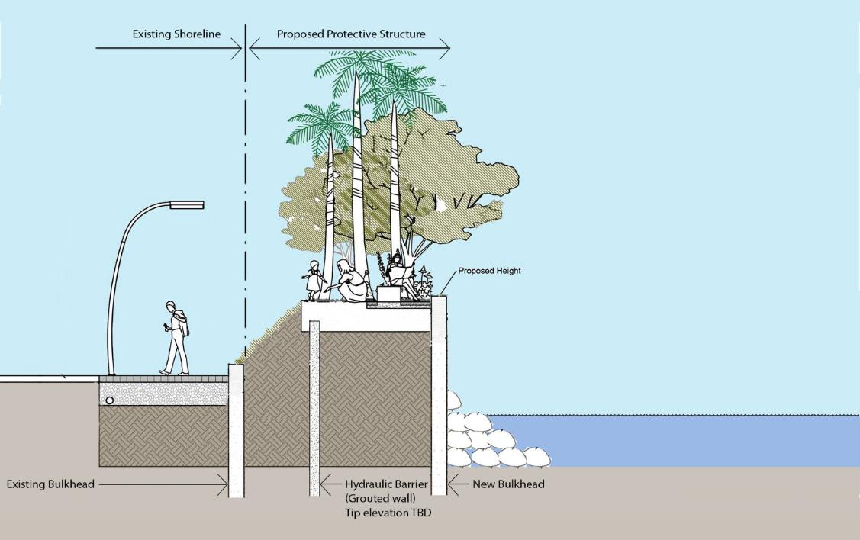
Create Storm Protection Dikes/Walls to Limit Flooding
New bicycle/pedestrian Baywalk
Bulkhead with Hydraulic Barrier
Slide Courtesy of Coastal Systems International

Slide 36
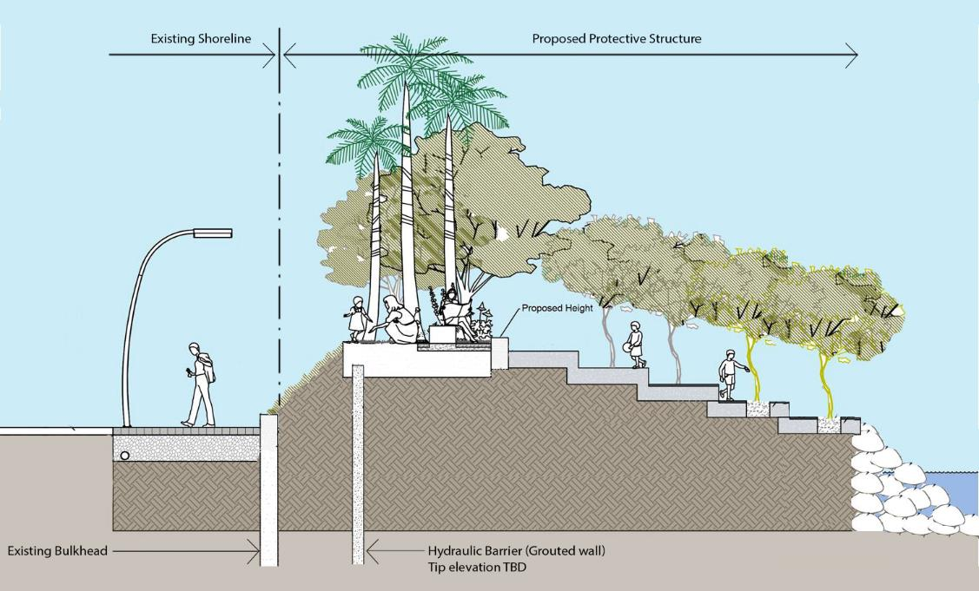
Create Storm Protection Dikes/Walls to Limit Flooding
New bicycle/pedestrian Baywalk
Bulkhead / Stepped Wall with Hydraulic Barrier
Slide Courtesy of Coastal Systems International

Slide 37
Contact:
Patrice Gillespie Smith
Miami Downtown Development Authority (DDA)
pgsmith@miamidda.com

