Slide 1
April 26, 2019

Slide 2
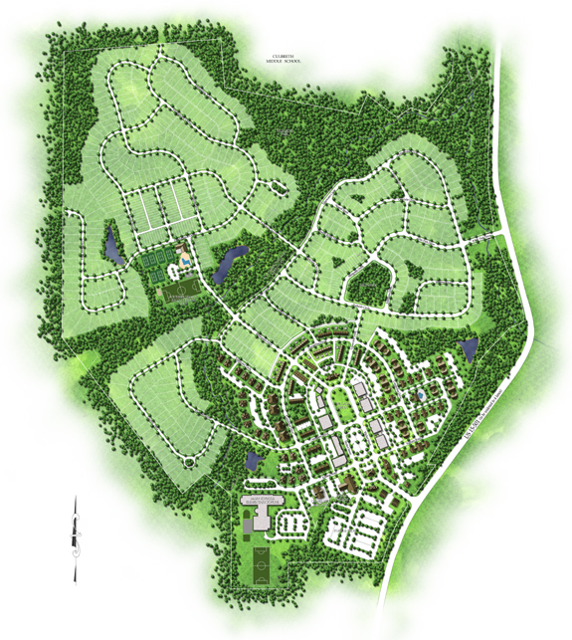
Southern Village
1,150 residences
300 acres total
90 acres of open space
Greenway through the neighborhood
Swim and tennis center
Village Center
$425,300,000 cumulative value
6.9% of property value in Chapel Hill

Slide 3
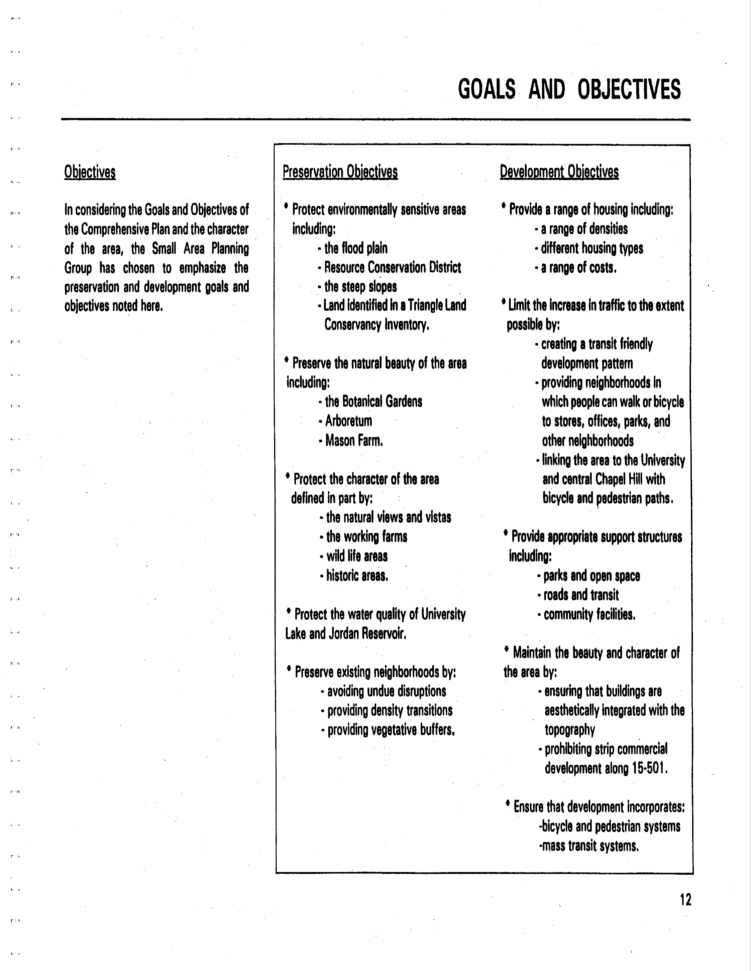
1992 Southern Small Area Plan

Slide 4
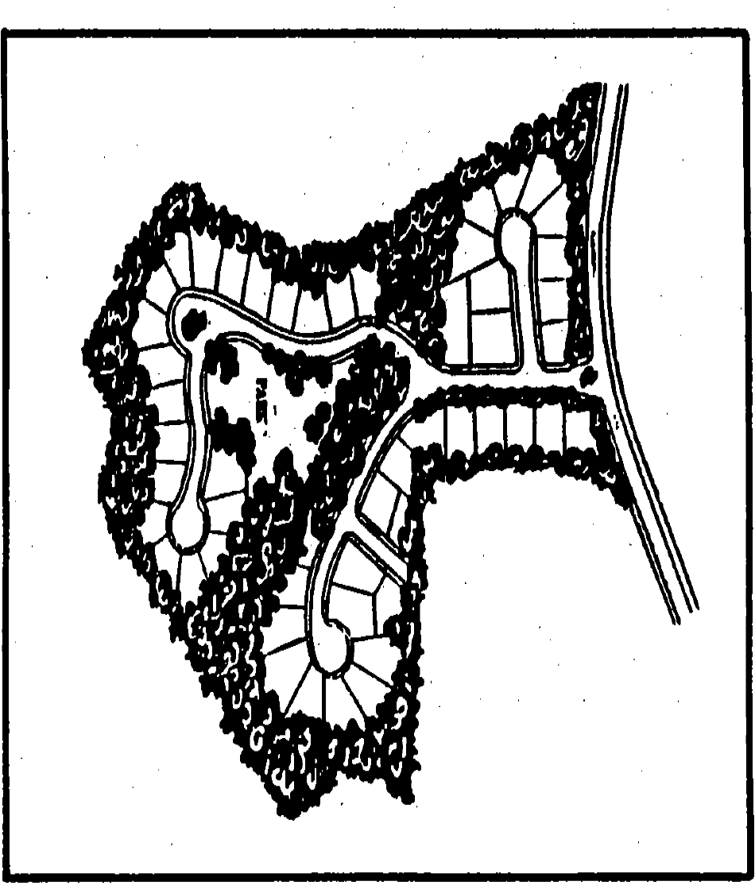
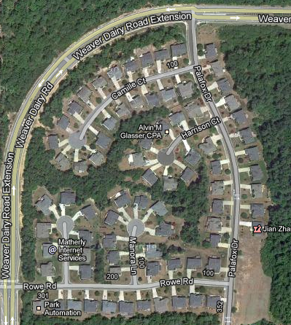
Conventional/Cluster Pattern

Slide 5
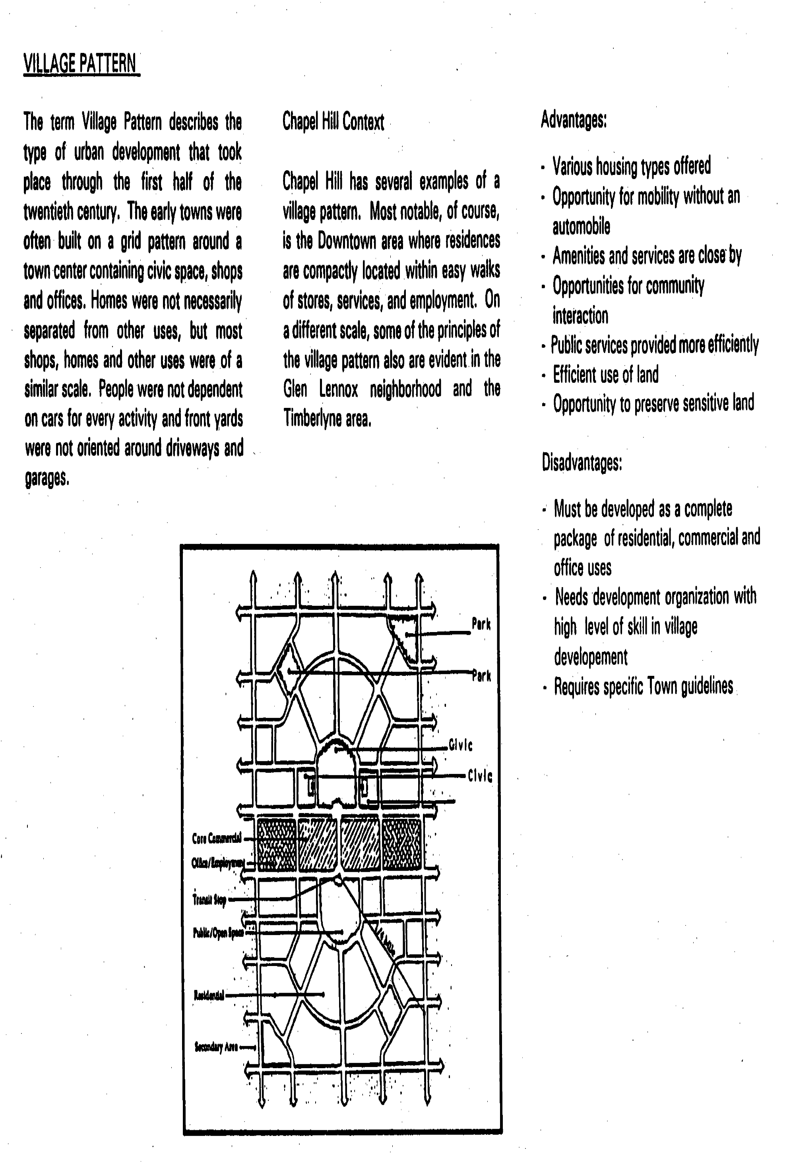
1992 Southern Small Area Plan

Slide 6
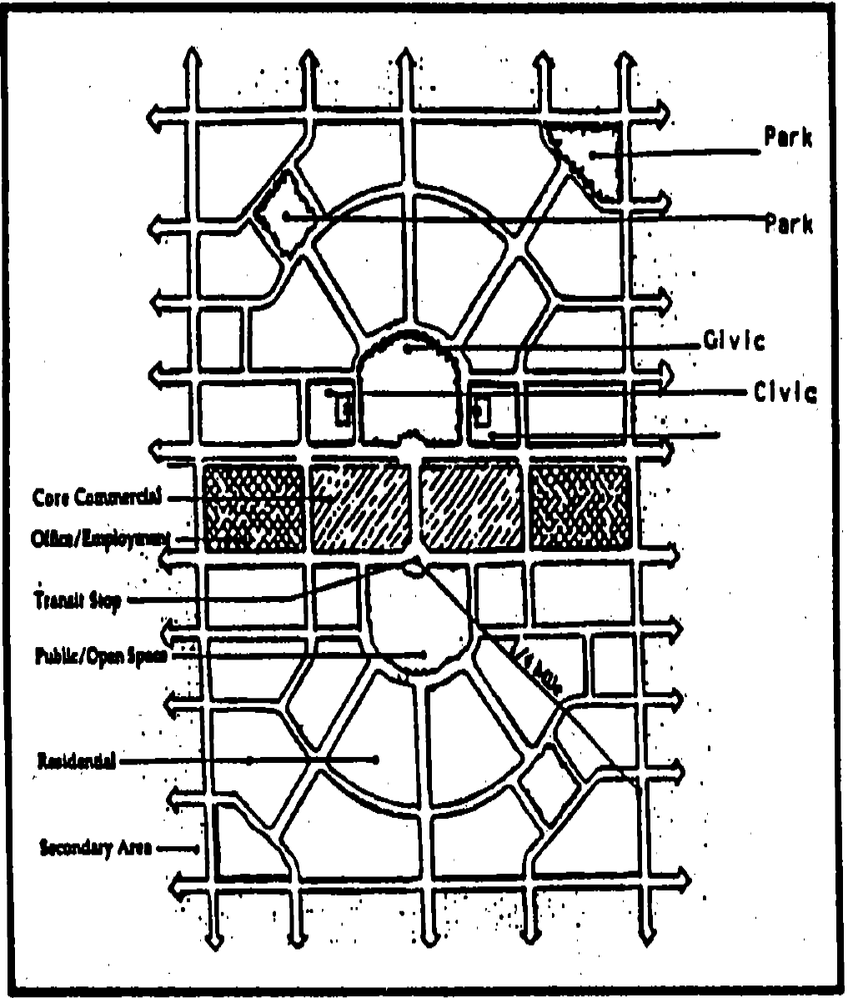
Village Pattern
Conventional Cluster Pattern

Slide 7
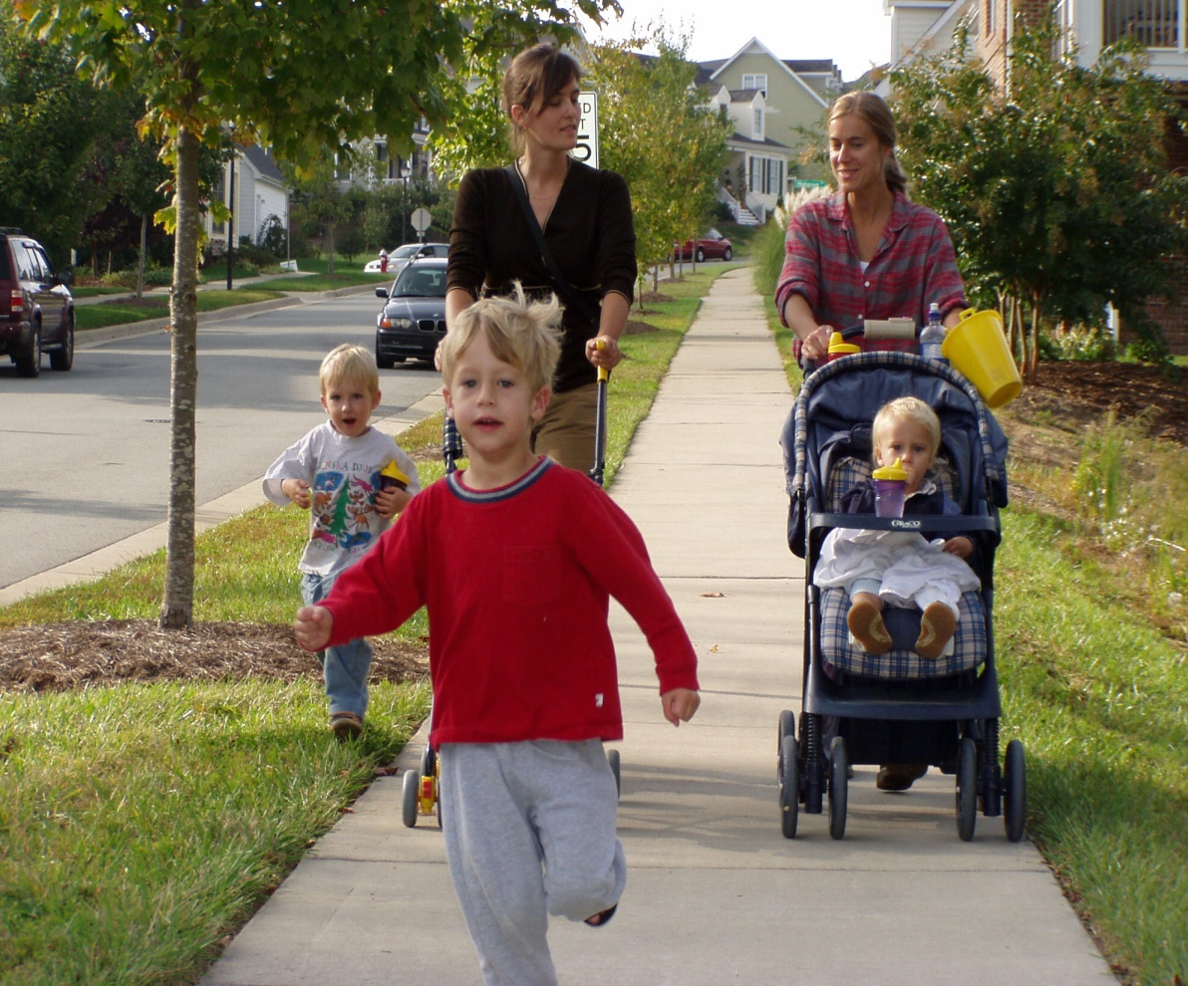
Creating Southern Village
Achieved Town goals through effective design principles
Narrow, low-speed
streets – 26’ wide
Street trees
On-street parking
Front porches
Wide sidewalks
5’ in residential section
21’ in village center

Slide 8
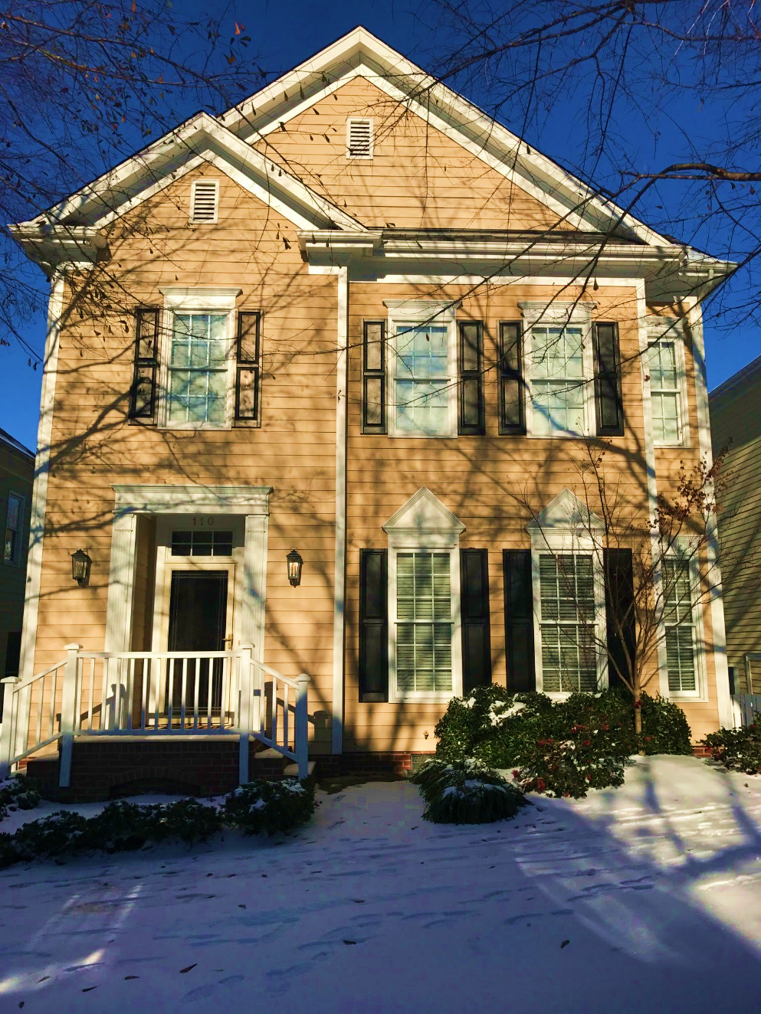
Residential Snapshot
530 single family homes
250 apartments
230 condos
140 townhomes
2017 single family sales report
35 homes sold
24 – average days on market
1 – lowest
80 – highest

Slide 9
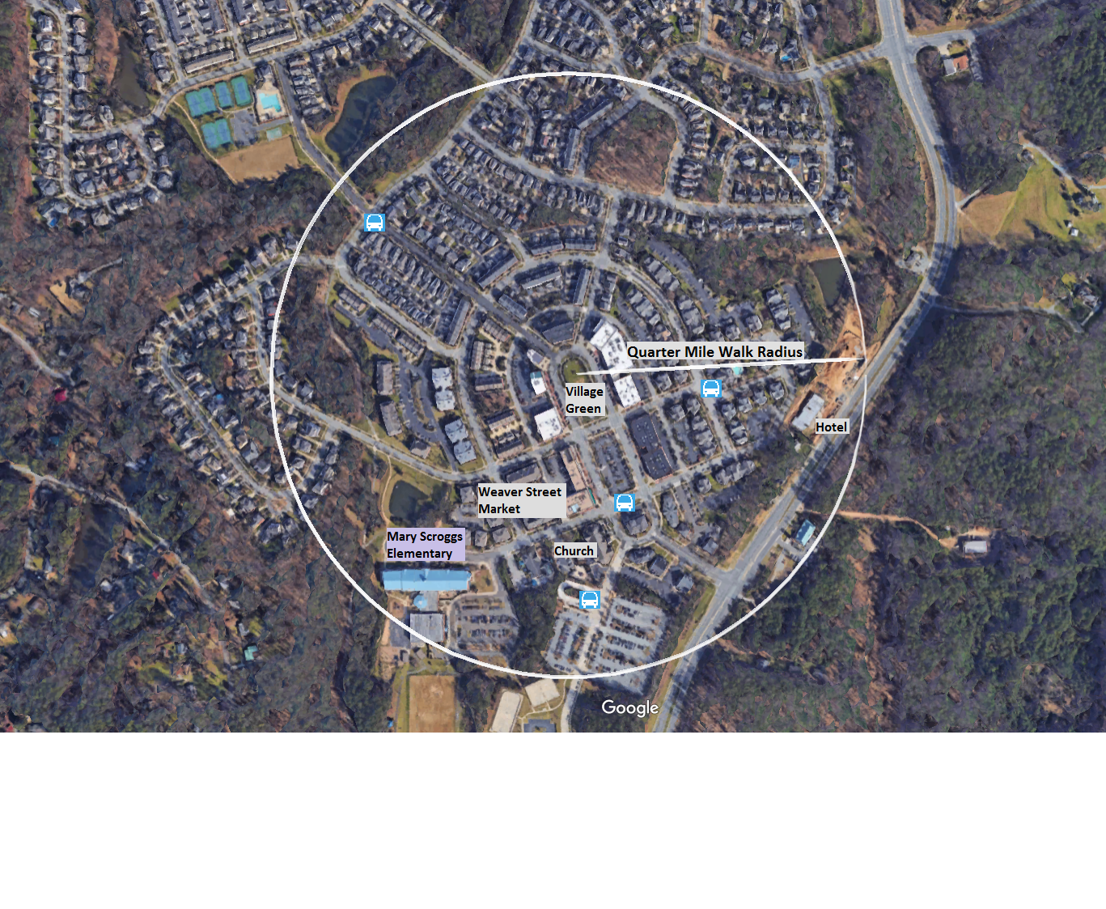
Quarter Mile Walk Radius

Slide 10
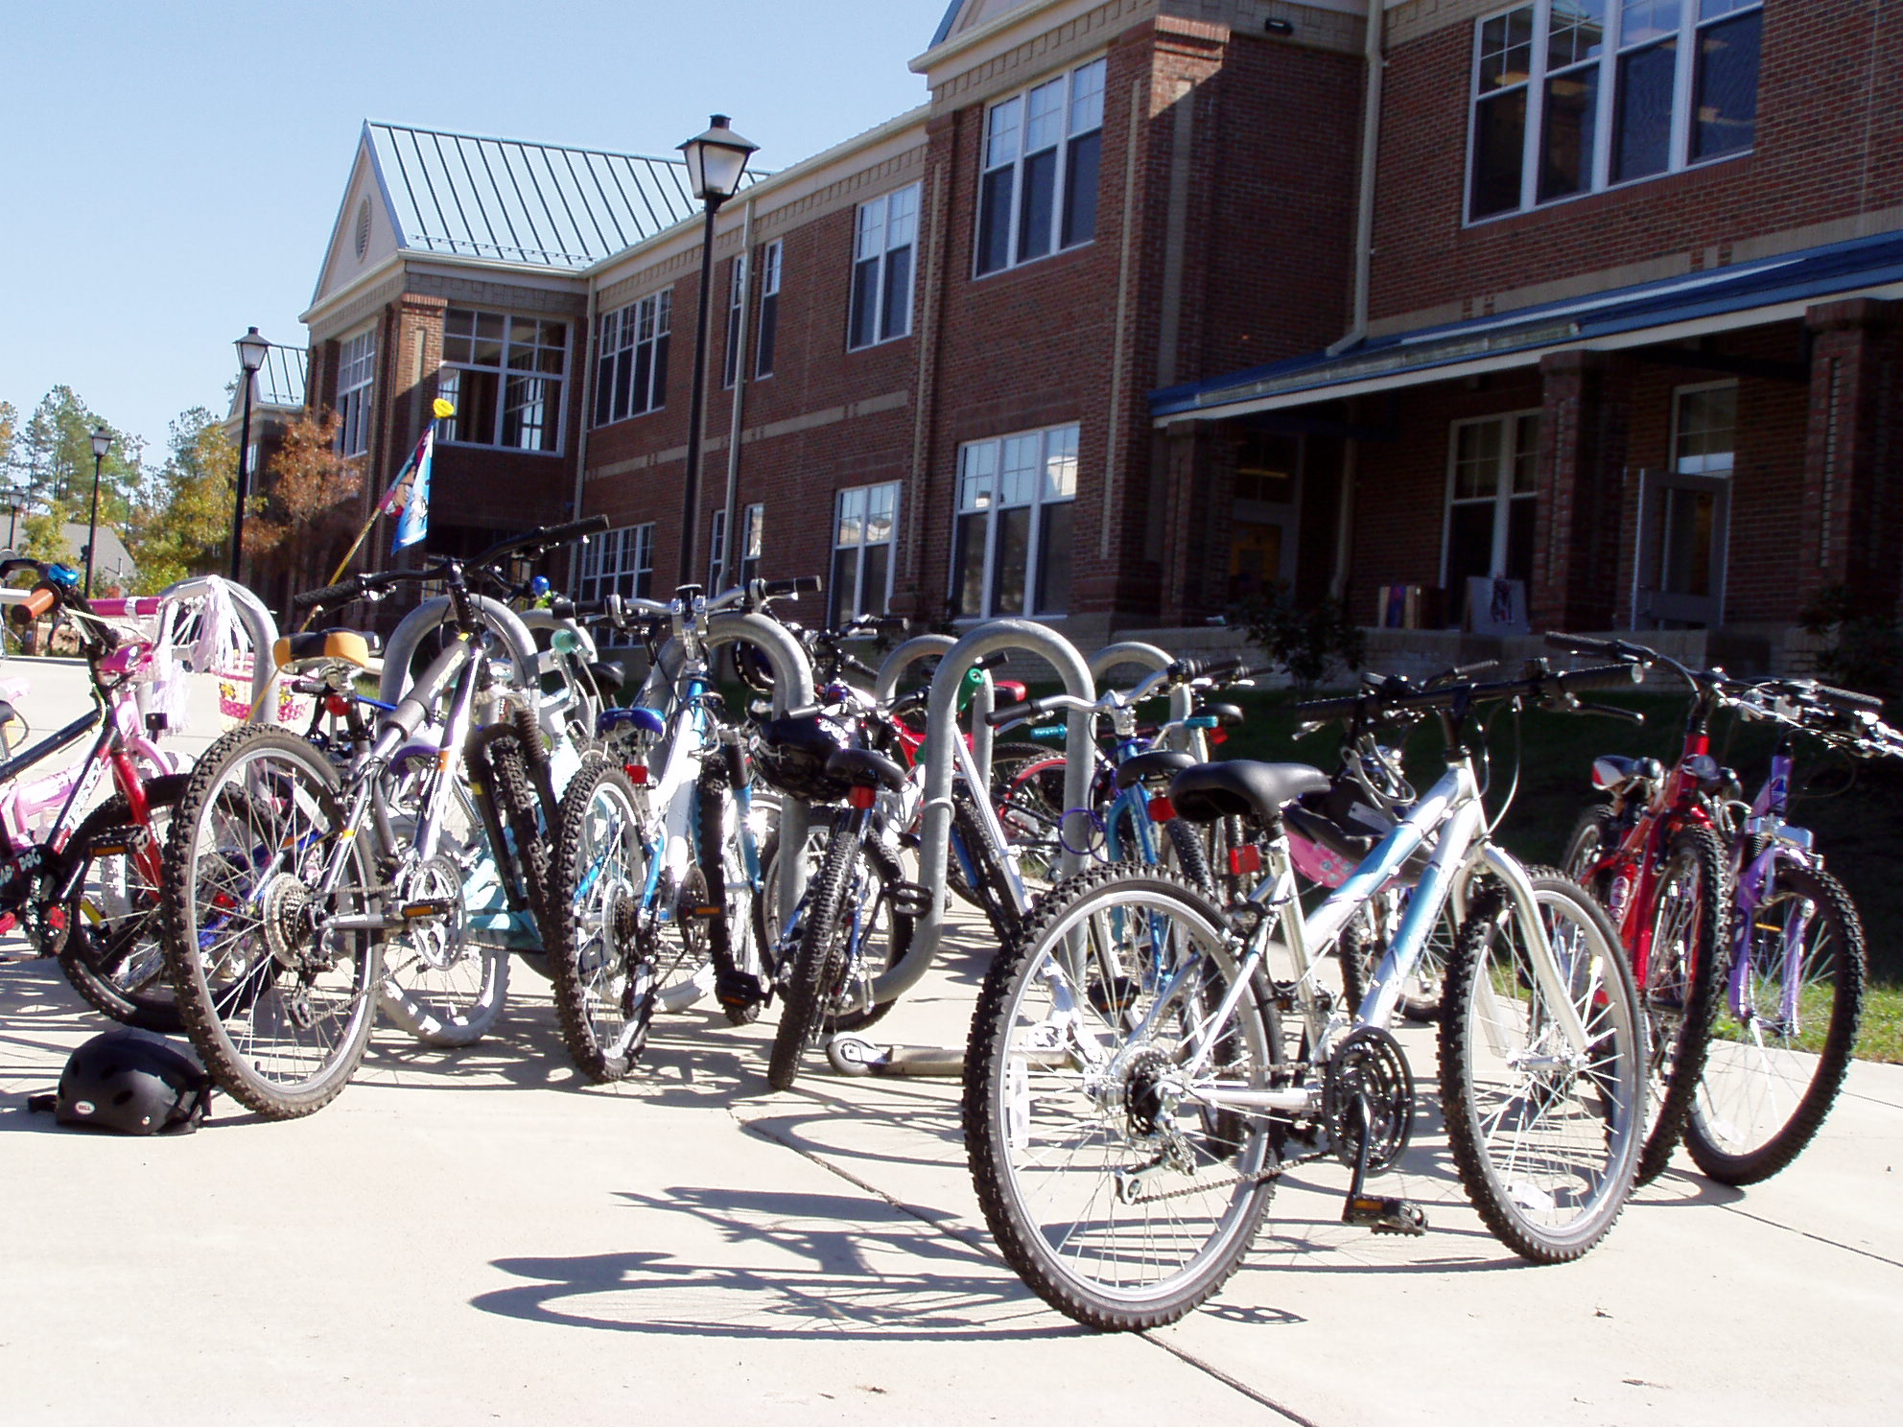
Bike to School

Slide 11
The Village Center
650 households within ¼ mile / 5 minute walk
Variety of architectural styles
Wide range of activities
One building at a time
Sidewalks for people
Buildings at the street
227,000 square feet built
1,000 jobs

Slide 12
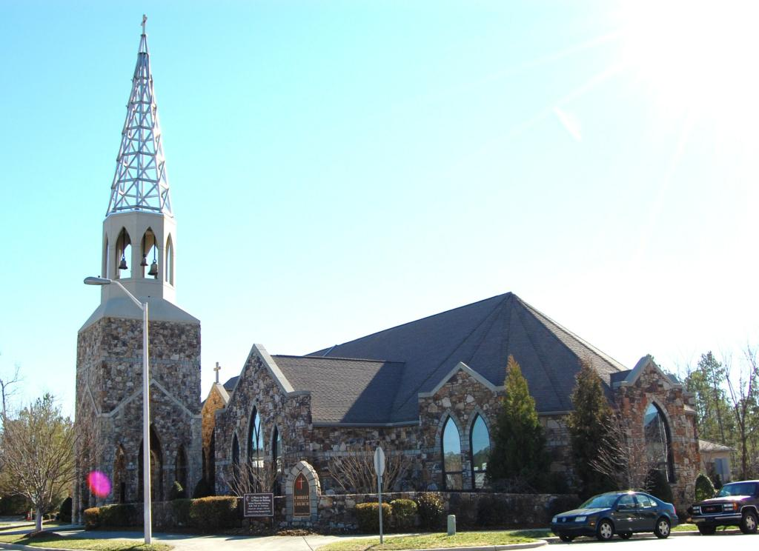
Reviewing our Successes
Village Center, how is it different?
Strong partnerships
Weaver Street Market
Day care
Church
Elementary school
The Lumina Theater
Hyatt Place
Southern Village Apartments

Slide 13
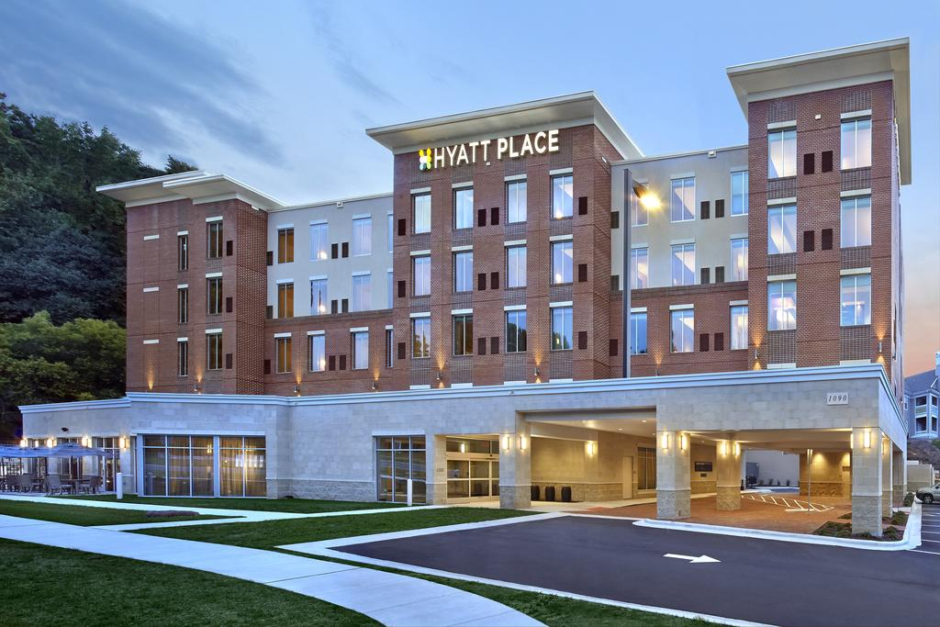
Southern Village Hotel

Slide 14
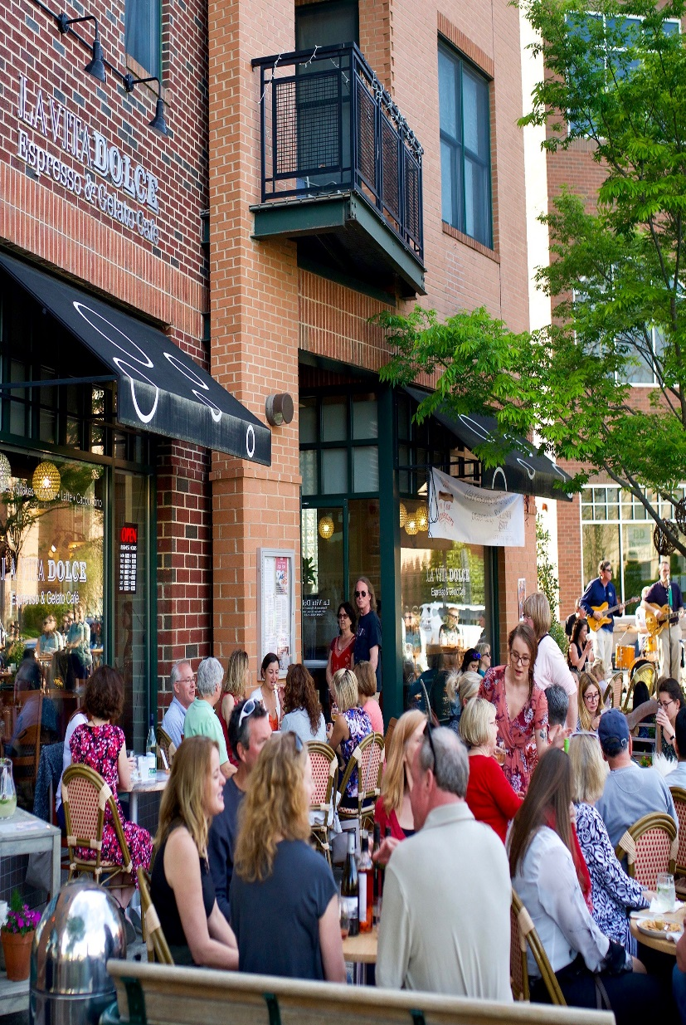
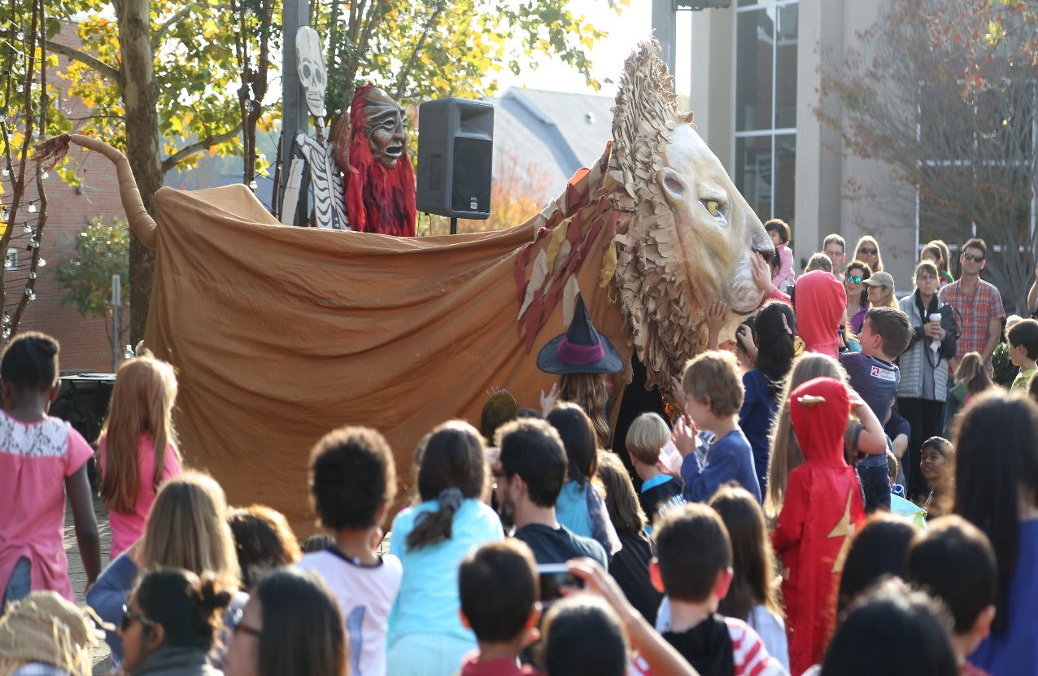
Fostering Vitality
Never a closing time
Events, events & events
Experiences

Slide 15
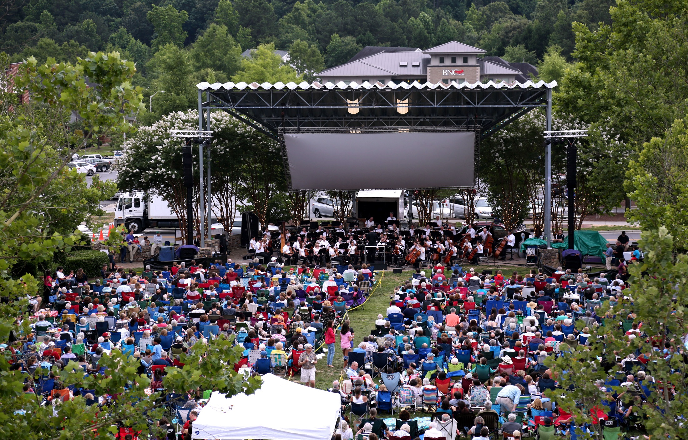
North Carolina Symphony – 17 Years

Slide 16
Incremental Additions
Variety of seating options
“Bryant Park” tables and chairs
Swings
Picnic tables
Benches
Define spaces
Planters
Brick pavers

Slide 17
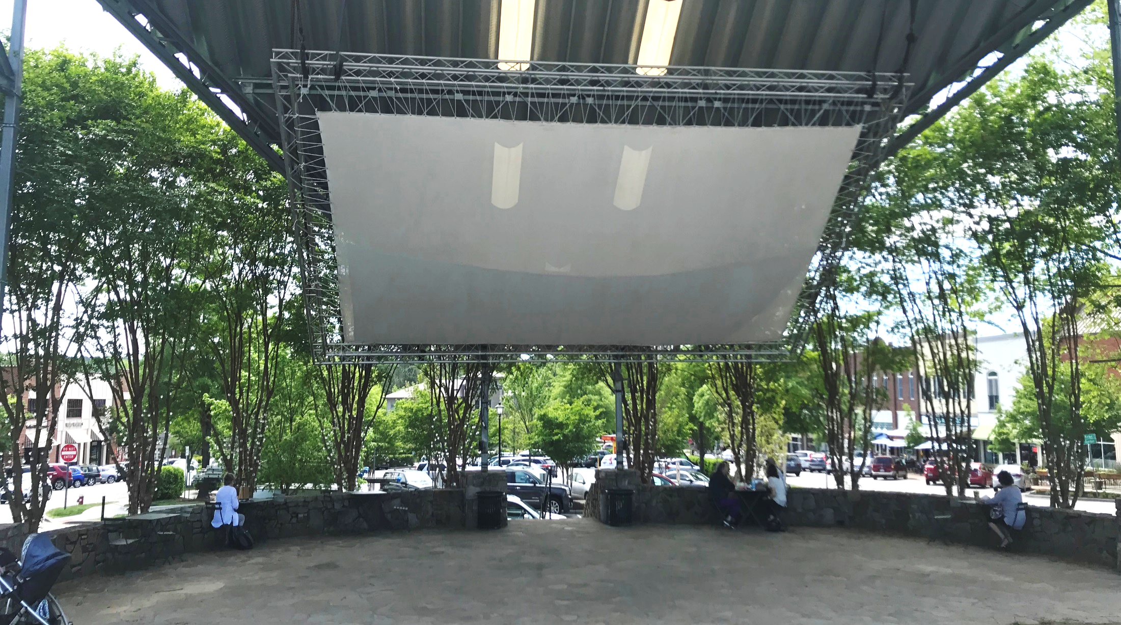
Seating Types

Slide 18
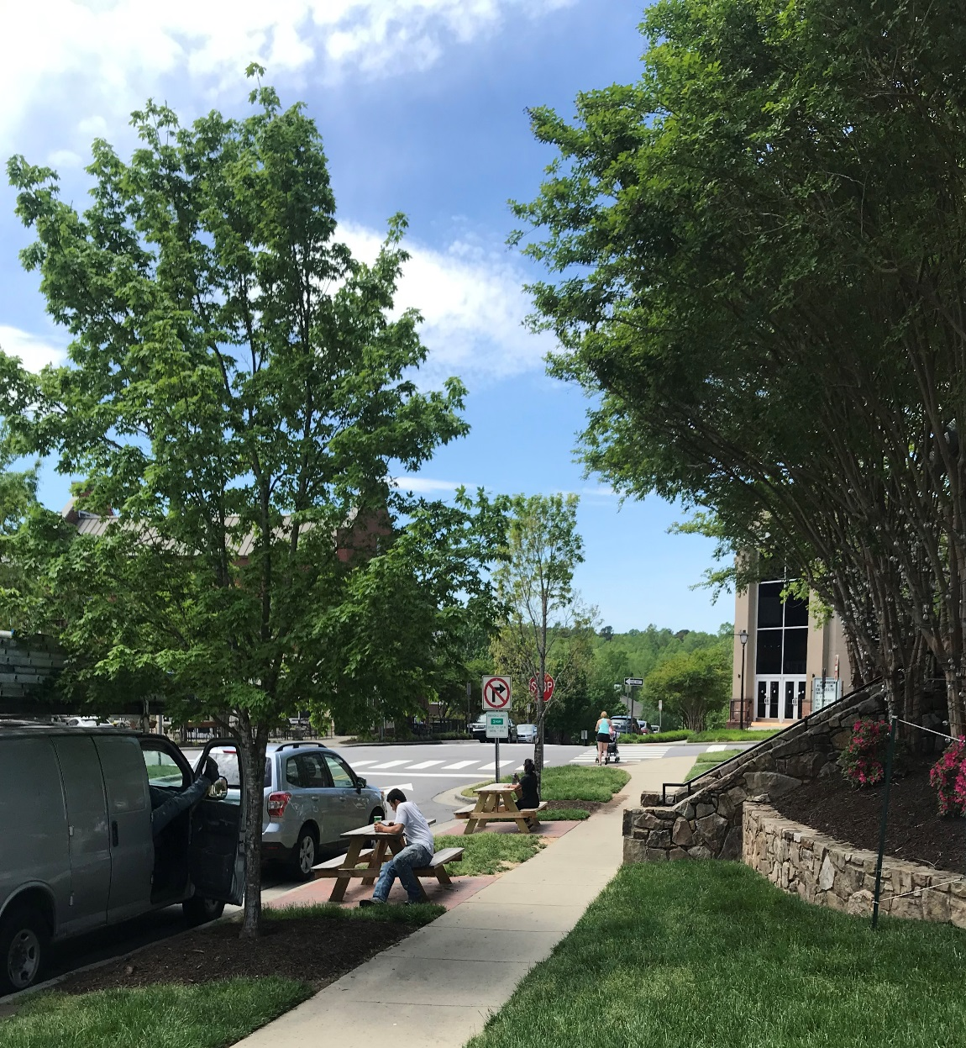
Seating Types and Enhancements

Slide 19
Lessons Learned
Structure Master HOA for Contribution to events budget
SVHOA contributes only $7,500/year ($8 per household) toward events on Market Street
SVHOA also pays $5,000 toward the NC Symphony event
Sales/Transfer fees have been used with success elsewhere
Retain ownership of income producing properties
Look at the pre-1920’s neighborhoods in your area for guidance
Setbacks, types of street trees, etc.

Slide 20
Critical
One mistake that cannot be overcome
Economic cycles here to stay
First 10% - it’s about motion, not money
Flexibility
Uses
Plan
Change is the only constant
Trust
Years to create, a moment to lose

Slide 21
Future Plans

Slide 22
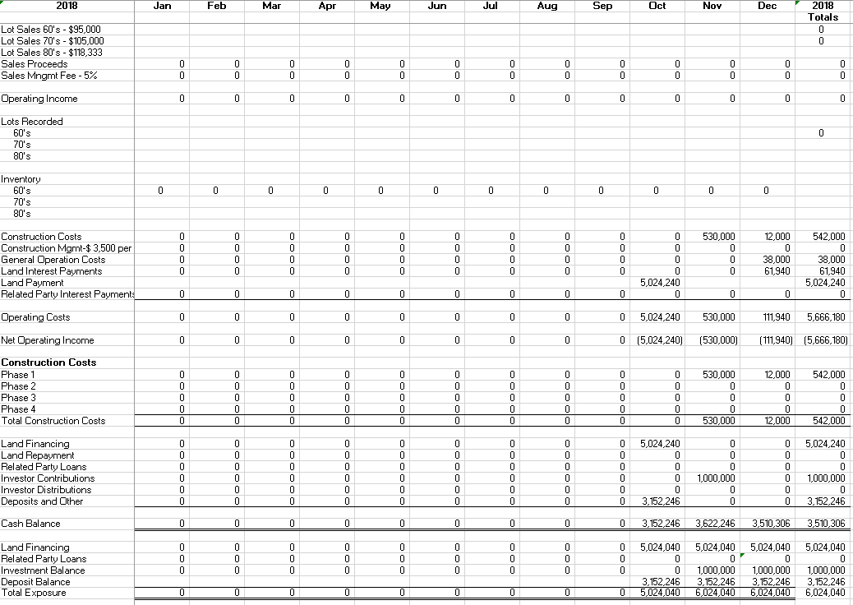
Proforma Example – 2018

Slide 23
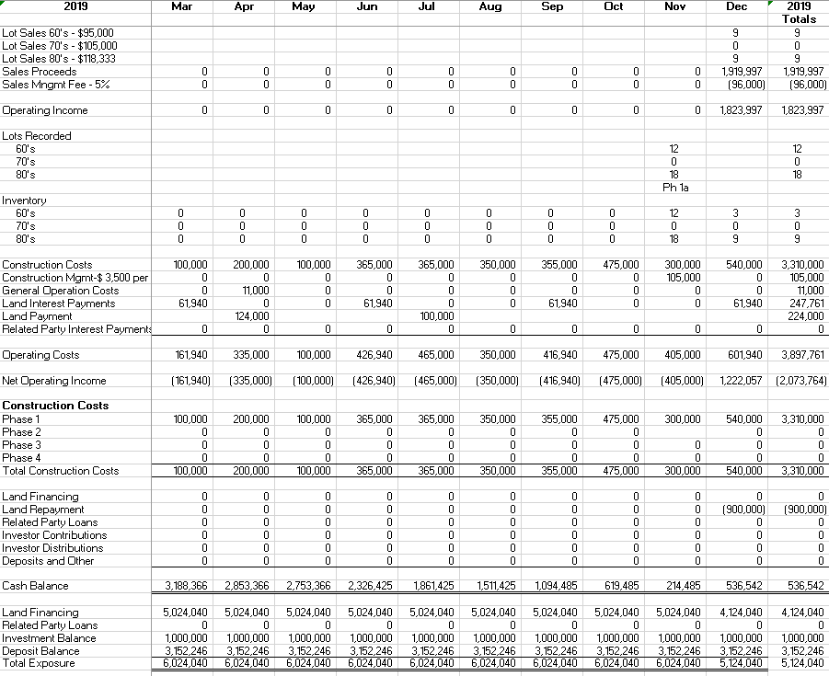
Proforma Example – 2019

Slide 24
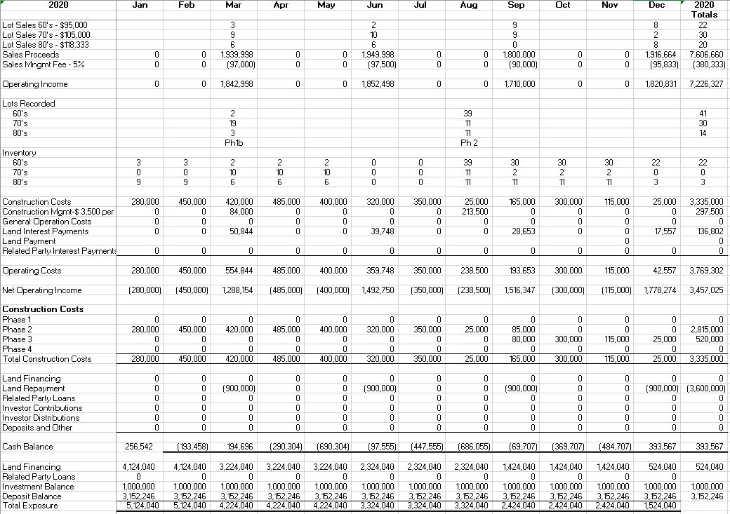
Proforma Example – 2020

Slide 25
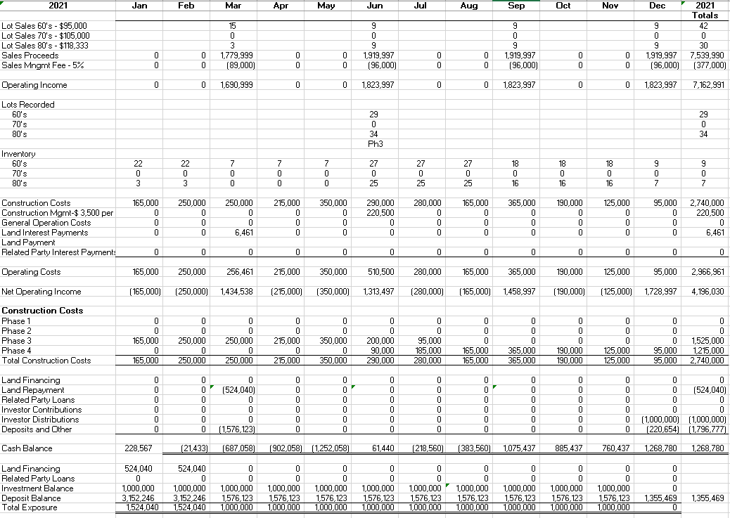
Proforma Example – 2021

Slide 26
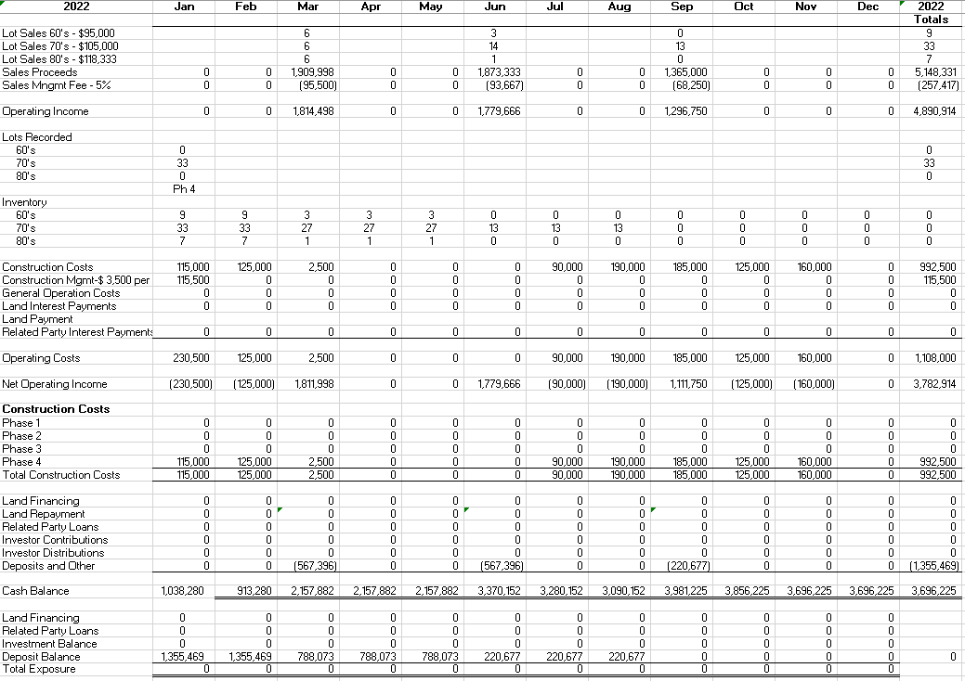
Proforma Example – 2022

Slide 27
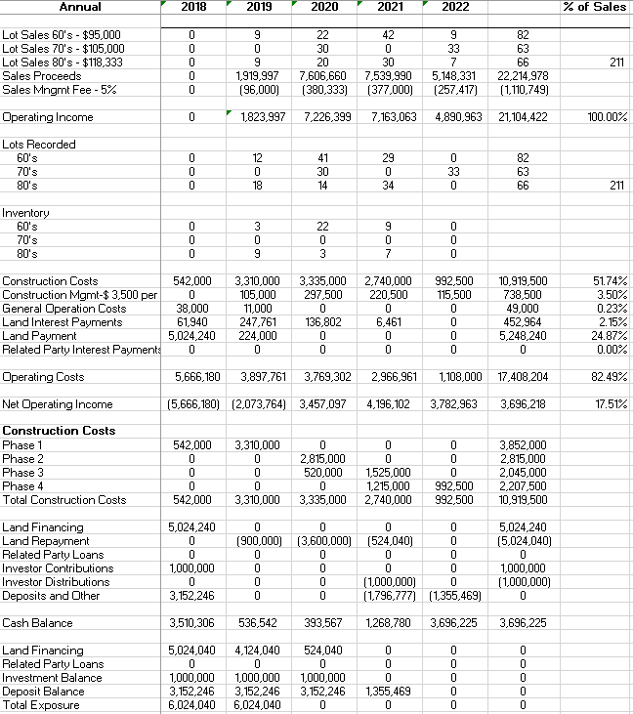
Proforma Example – Annual

Slide 28
Questions/Comments
April 26, 2019

